Slide 1
READY: GLOBAL READINESS FOR
MAJOR DISEASE
OUTBREAK RESPONSE
INFECTION, PREVENTION AND CONTROL (IPC) FOR COVID-19

Slide 2
WHAT IS INFECTION PREVENTION AND CONTROL?
Practical solutions designed to prevent harm, caused by infections, to patients and health care workers
Grounded in principles of infectious disease, epidemiology, social science and health system strengthening

Slide 3
HEALTH FACILITY IPC GOALS
To reduce transmission of health care associated infections
To enhance the safety of staff, patients and visitors
Enhanced ability to prepare and respond to an outbreak
Measures in place to lower or reduce risk of the health care facility itself amplifying the outbreak
IPC is an ongoing activity, and requires a focal point at each facility

Slide 4
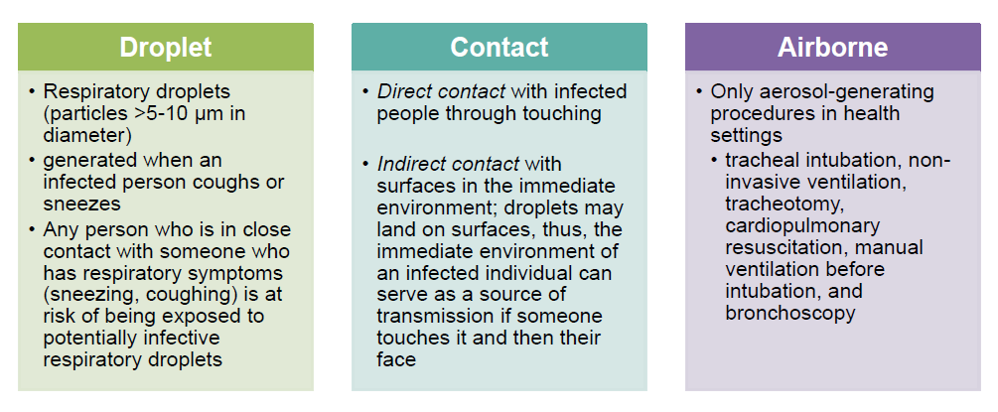
BASED ON THE MODE OF TRANSMISSION
Modes of Transmission for COVID-19
**Emerging disease outbreaks have different risks - it is therefore important that IPC considers appropriate technical guidance based on the disease outbreak**
WASH is a core component of COVID-19 response

Slide 5
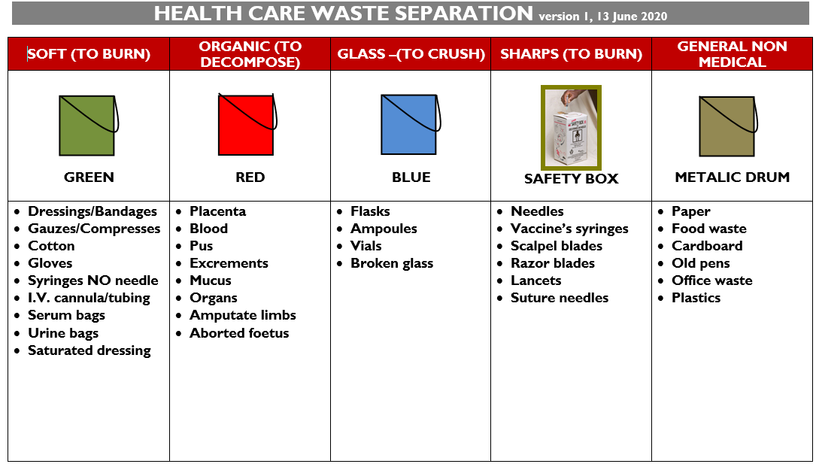
WHO recommended IPC strategies for preventing or limiting the spread of COVID-19 in health facilities
1. Applying standard precautions for all patients:**
Hand hygiene
Respiratory hygiene (etiquette)
PPE according to the risk
Safe injection practices, sharps management and injury prevention
Safe handling, cleaning and disinfection of patient care equipment
Environmental cleaning
Safe handling and cleaning of soiled linen
Waste management (e.g. excreta disposal)

Slide 6
WHO recommended IPC strategies for preventing or limiting the spread of COVID-19 in health facilities
2. Ensuring triage, early recognition, and source control:
Prevent overcrowding
Conduct rapid triage.
Place ARI patients in dedicated waiting areas with adequate ventilation.
In addition to standard precautions, implement droplet precautions and contact precautions (if close contact with the patient or contaminated equipment or surfaces/materials).
Ask patients with respiratory symptoms to perform hand hygiene, wear a mask and perform respiratory hygiene.
Ensure at least 1m distance between patients

Slide 7
WHO recommended IPC strategies for preventing or limiting the spread of COVID-19 in health facilities
3. Implementing empiric additional precautions for suspected cases of COVID-19 infection:
for patients who are symptomatic and suspected or who have a confirmed infection with a highly transmissible pathogen
when medical interventions increase the risk of transmission of a specific infectious agent
when the clinical situation prevents the systematic application of standard precautions
Standard Precautions + Special accommodations/isolation (i.e. single room, space between beds, separate toilet etc.) + Signage + PPE + Dedicated equipment and additional cleaning + Limit transport + Communication

Slide 8
INFECTION PREVENTION CONTROL AT HOME
4. Caregivers and family members should (if possible):
Ensure resources for access to food and other necessities are available.
Advise or ensure the use of available protection to cover their nose and mouth (at a minimum, gloves and facemask) and then be advised on the type of care they are supposed to be providing
Educate the patient on how to limit exposure to the rest of their family, and remind the patient to wear a mask when in the presence of other family members. In particular, with household members who may be at increased risk of/from infection: (e.g., people >65 years old, pregnant women, people, immunocompromised or chronic diseases)
If not providing care, ensure physical separation (keep them in a separate room or at least 1 meter) away from others in the household
Provide training on when to bring to health facility – danger signs, e.g., fast breathing
Notes:
Patients with mild respiratory illness are likely to need care in the home.
WHO recommends the patient has ongoing communication with a health care provider or public health person during the full duration of the home care period –until resolution of symptoms if possible
Promote during key moments and make assessible hand hygiene facilities
Frequently clean high touch surfaces if patient is at home (e.g bedside tables, bedframes, etc)
Ensure access to functioning toilets/latrines + safe containment, conveyance, treatment and disposal
Clean with detergent and disinfect (0.5% sodium hypochlorite) bathrooms at least once a day)
Use PPE while cleaning and practice hand hygiene before and after removing PPE

Slide 9
INFECTION PREVENTION CONTROL & WASH
Let’s demystify IPC and WASH for COVID-19
There is no need to reinvent the wheel, but need for emphasis!
There is no new or special WASH standards to promote, all basic WASH standards apply, and they all contribute to the reduction of COVID-19 transmission
Hand hygiene is a critical health measure. In the absence of soap and water or alcohol-based hand rub, water/ash or water alone is better than nothing.
Social distance coupled with hygiene promotion messaging
Since it enables IPC practices, WASH should be a no-regrets policy (as mentioned, and recommended by WHO)
Plethora of guidance but lack of Operational Procedures !
Clarify responsibility between sectors and based on the organization mandate…
Notes:
Patients with mild respiratory illness are likely to need care in the home.
WHO recommends the patient has ongoing communication with a health care provider or public health person during the full duration of the home care period –until resolution of symptoms if possible
Promote during key moments and make assessible hand hygiene facilities
Frequently clean high touch surfaces if patient is at home (e.g bedside tables, bedframes, etc)
Ensure access to functioning toilets/latrines + safe containment, conveyance, treatment and disposal
Clean with detergent and disinfect (0.5% sodium hypochlorite) bathrooms at least once a day)
Use PPE while cleaning and practice hand hygiene before and after removing PPE

Slide 10
SURVIVAL OF SURROGATE, HUMAN CORONAVIRUSES
No evidence so far that the COVID-19 virus is found in drinking-water or sewage, neither on surface or ground water.
On surfaces, die-off still unclear (from few hours to nine days), but effective inactivation can be achieved in 1 min using 70% ethanol or sodium hypochlorite.
On feces, a study from China* shown that 50% of patients tested positive for COVID-19 RNA in stool, some even after five weeks of their respiratory symptoms finishing. Fecal-oral transmission is possible but not yet confirmed, and remains a concern.
Heat, high and low pH, sunlight and common disinfectants (e.g. chlorine) all facilitate die-off
As there is still a lot to understand.
the more precautions we take, the better…
* https://www.gastrojournal.org/article/S0016-5085(20)30282-1/pdf
Notes:
From February 1 to 14, 2020, among all of the 73 hospitalized patients infected with SARS-CoV-2, 39 (53.42%), including 25 male and 14 female patients, tested positive for SARS-CoV-2 RNA in stool, as shown in Supplementary Table 1. The age of patients with positive results for SARS-CoV-2 RNA in stool ranged from 10 months to 78 years old. The duration time of positive stool results ranged from 1 to 12 days. Furthermore Q11 , 17 (23.29%) patients continued to have positive results in stool after showing negative results in respiratory samples.

Slide 11
COVID-19 IPC / WASH IN
HOUSEHOLDS, PUBLIC SPACES, AND COMMUNITIES
General Hygiene Activities for communities and public spaces, to reduce exposure and transmission
Community hygiene education focused on airborne transmission and hygienic practices, especially handwashing
Community groups and household mobilization
Distribution of hand-washing and cleaning disinfecting NFIs. Ensure enough soap for everyone for a period of 2 months (+50% buffer)
Community leaders and traditional healers play a key role, especially in populations with low literacy levels
Disinfection of affected households, markets and gathering places.
Installation of household and community hand-washing stations
https://spherestandards.org/coronavirus/
Notes:
Promotion/facilitation of hygienic practices, especially hand washing before anything is placed in the mouth for handwashing, cleaning and clothes-washing;
inclusion of marketplaces and other communal gathering places
Additionally, households should be provided with:
Information regarding hygiene measures including steps to take after exposure, e.g. health education messages in local language.
Hand-Washing stations
Sanitation
Clean sanitary facilities
Solid waste management
Consistent daily waste cleaning

Slide 12
COVID-19 IPC / WASH IN
HOUSEHOLDS, PUBLIC SPACES, AND COMMUNITIES
To reduce EXPOSURE and TRANSMISSION in communities and HHs
In vulnerable public spaces
Gathering Spaces
IDPs and Refugess
Slums
WASH Preventative
ASAP
Water supply for handwashing station and soap,
Cleaning, Disinfection.
In non-health care facilities with suspected cases
Collective settings with cases of Covid-19
WASH Reactive
As soon quarantine is setup
Water supply for handwashing station and soap, hygiene and
Cleaning, Disinfection, Dedicated Sanitation facilities
In household with confined cases
Households with case or highly affected clusters
WASH Preventative or Reactive
When MoH requires or after detailed profiling
Water supply, hygiene and
Cleaning material via NFIs or CVA.
https://www.unicef.org/documents/wash-and-infection-prevention-and-control-households-and-public-spaces
https://spherestandards.org/coronavirus/
Notes:
Promotion/facilitation of hygienic practices, especially hand washing before anything is placed in the mouthfor handwashing, cleaning and clothes-washing;
inclusion of marketplaces and other communal gathering places
Additionally, households should be provided with:
Information regarding hygiene measures including steps to take after exposure, e.g. health education messages in local language.
Hand-Washing stations
Sanitation
Clean sanitary facilities
Solid waste management
Consistent daily waste cleaning

Slide 13
COVID-19 IPC / WASH IN
HOUSEHOLDS, PUBLIC SPACES, AND COMMUNITIES
The potential role of Community Health Workers –
“Les relais Communautaires”
If properly TRAINED and EQUIPPED with appropriate PPE they could:
Prevent : communicate to communities signs, symptoms, transmissions, preventative measures. Explain IPC procedures household, schools, health care facilities…
Detect : Identify symptomatic personas. Collect samples and transport to HCFs. Entering alerts and contribute to surveillance.
Respond : Monitor health status, contribute to referral, support self-isolated patients…
https://blogs.bmj.com/bmj/2020/03/27/prevent-detect-respond-how-community-health-workers-can-help-fight-covid-19/?utm_campaign=shareaholic&utm_medium=twitter&utm_source=socialnetwork
Notes:
Promotion/facilitation of hygienic practices, especially hand washing before anything is placed in the mouth for handwashing, cleaning and clothes-washing;
inclusion of marketplaces and other communal gathering places
Additionally, households should be provided with:
Information regarding hygiene measures including steps to take after exposure, e.g. health education messages in local language.
Hand-Washing stations
Sanitation
Clean sanitary facilities
Solid waste management
Consistent daily waste cleaning

Slide 14
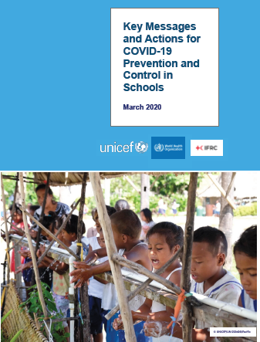
COVID-19 IPC / WASH IN SCHOOLS
Key practices for IPC and WASH in schools:
Ensure availability of safe water in adequate quantities at all times and separate sanitation facilities for girls and boys.
Ensure the availability of hand washing stations with soap and water or hand sanitizer dispensers or water with chlorine solution (0.05%) in schools.
Environmental cleanliness and availability of PPE.
2. Use existing programmes
Review JMP data and assess the situation
Incorporate COVID-19 preparedness and response activities into WASH programmes based on the guidance document on COVID–19 response for WASH in schools.
Strengthen implementation of the «Ecoles Assainis» now that they are closed to make them safe and ready for re-opening.
Ensure age-appropriate WASH facilities for pre-schools and other ECD centers.
https://www.unicef.org/reports/key-messages-and-actions-coronavirus-disease-covid-19-prevention-and-control-schools

Slide 15
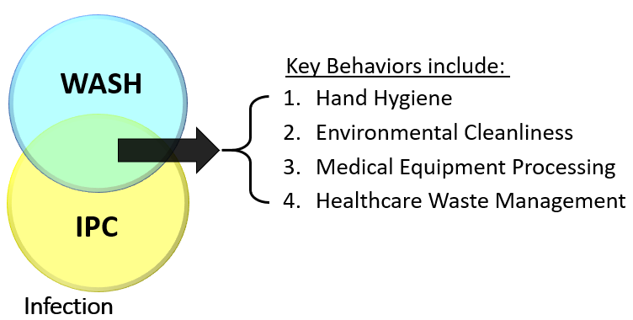
COVID-19 IPC / WASH in HEALTH CARE FACILITIES
1. Key practices for IPC and WASH in HCFs:
2. Use existing programmes
Review national IPC protocols
Review Joint Monitoring Programming data and assess the situation
Incorporate COVID-19 preparedness and response activities into existing WASH programmes
Promote the use of the WASHFIT tool
Promote use of the Clean Clinic Approach
Notes:
Promotion/facilitation of hygienic practices, especially hand washing before anything is placed in the mouthfor handwashing, cleaning and clothes-washing;
inclusion of marketplaces and other communal gathering places
Additionally, households should be provided with:
Information regarding hygiene measures including steps to take after exposure, e.g. health education messages in local language.
Hand-Washing stations
Sanitation
Clean sanitary facilities
Solid waste management
Consistent daily waste cleaning

Slide 16
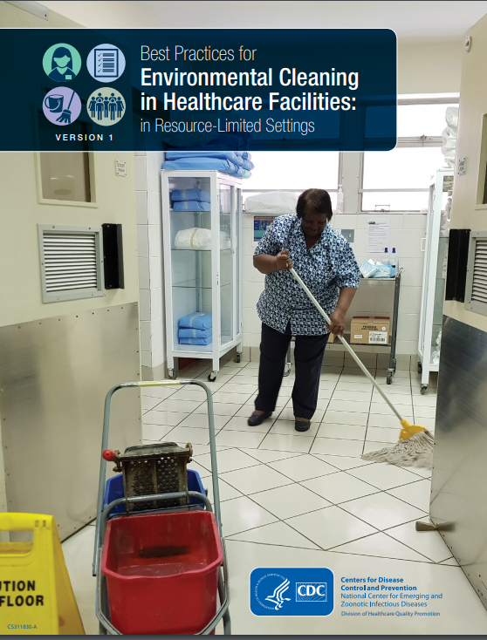
COVID-19 CLEANING IN HEALTH CARE FACILITIES
Follow existing recommendations (e.g., trained staff, SOPs, cleaning frequency based on risks)
Existing disinfectants effective (70% ethyl alcohol and 0.5% sodium hypochlorite)
Soiled linens should be machine washed (60-90°c) with detergent OR soaked in warm water and detergent followed by 0.5% chlorine
https://www.cdc.gov/hai/pdfs/resource-limited/environmental-cleaning-508.pdf
Notes:
Spark further action-grow a movement
engage in key health events
Hold countries and partners accountable
Country tracker, world health assembly updates
JMP 2020 report
Provide technical and country support
WASH FIT updates and implementation
Embedding WASH in health efforts
Raise profile secure more investments
Investment meeting; investment case
Continue to advance learning agenda
Continue learning labs (e.g. on research)
Impact from WASH FIT and other tools

Slide 17
COVID-19 IPC FOR DEAD BODY MANAGEMENT
For the time being, until more data is available…
Dead bodies are not infectious (unless there have been incorrect autopsy procedures),
except in cases of hemorrhagic fevers and cholera
No evidence, so far of infections from exposure to COVID-19 related dead bodies,
however health care workers should wear appropriate PPE according to standard
precautions while handling dead bodies
It is a common myth that persons who have died of a communicable disease should be
cremated, but this is not true. Cremation is a matter of cultural choice and resources.
People who have died from COVID-19 can be buried or cremated.
https://apps.who.int/iris/bitstream/handle/10665/331538/WHO-COVID-19-lPC_DBMgmt-2020.1-eng.pdf
Notes:
Promotion/facilitation of hygienic practices, especially hand washing before anything is placed in the mouthfor handwashing, cleaning and clothes-washing;
inclusion of marketplaces and other communal gathering places
Additionally, households should be provided with:
Information regarding hygiene measures including steps to take after exposure, e.g. health education messages in local language.
Hand-Washing stations
Sanitation
Clean sanitary facilities
Solid waste management
Consistent daily waste cleaning

Slide 18
COVID-19 ADVICE ON THE USE OF MASKS (WHO)
For the time being, until more data is available…
Wearing a medical mask is one of the NPI prevention measures
Medical masks should be prioritized for medical health care workers
At home medical masks should be used by suspected cases and their caregivers. In areas of public interactions and areas with high contamination, they should be used - particularly vulnerable people.
Compliance with hand hygiene, physical distancing and other infection prevention and control (IPC) measures are critical to prevent human-to human transmission of COVID-19.
Note the important difference of impact between medical masks vs non-medical cloth masks
It has to be carefully evaluated based on availability, contexts and exposure
It has to be properly disposed!
https://www.who.int/publications-detail/advice-on-the-use-of-masks-in-the-community-during-home-care-and-in-healthcare-settings-in-the-context-of-the-novel-coronavirus-(2019-ncov)-outbreak
Notes:
Promotion/facilitation of hygienic practices, especially hand washing before anything is placed in the mouthfor handwashing, cleaning and clothes-washing;
inclusion of marketplaces and other communal gathering places
Additionally, households should be provided with:
Information regarding hygiene measures including steps to take after exposure, e.g. health education messages in local language.
Hand-Washing stations
Sanitation
Clean sanitary facilities
Solid waste management
Consistent daily waste cleaning

Slide 19
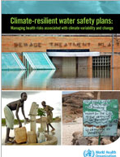
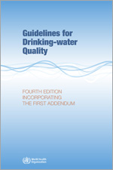

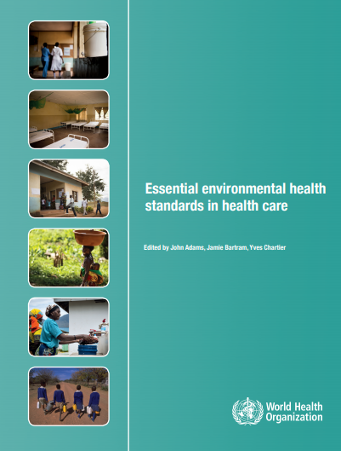
SAFELY MANAGED WATER SUPPLIES
Water safety planning and climate
Guidelines
(e.g. boiling, high performing ultra or nano filters, solar, UV, or appropriately dosed chlorine)
Water treatment performance
Health care facilities
Key considerations
Use water safety approach (protection from source to consumer)
Residual chlorine of ≥0.5 mg/l after at least 30 minute of contact time
Point of use treatment where safe, piped supplies not available

Slide 20
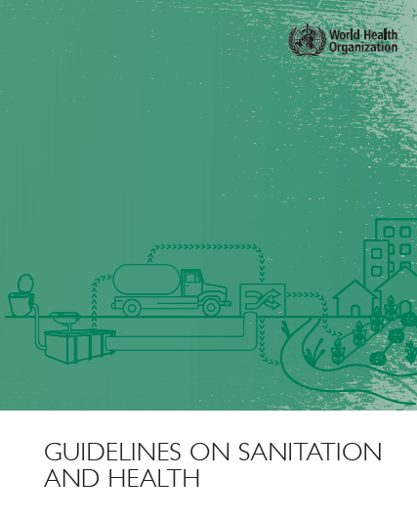
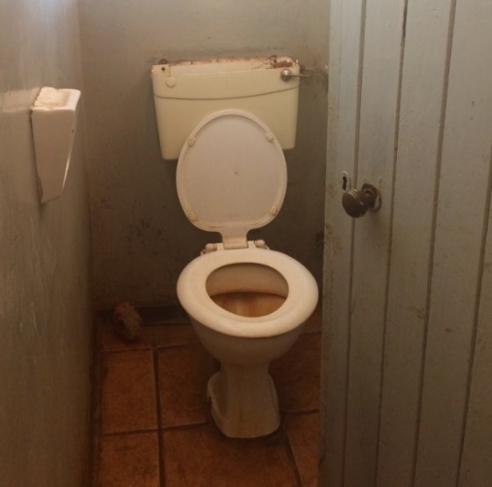
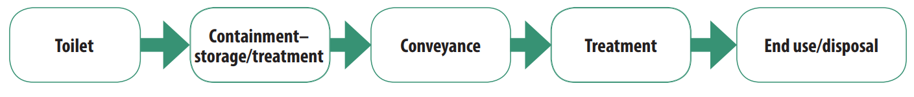
SAFELY MANAGED SANITATION-KEY POINTS
Safe management along every point of the sanitation chain is important; systems should be able to meet an increase in demand
Important to check safety plumbing (e.g., sealed bathroom drains and backflow valves on bathroom sprayers and faucets)
Staff and patients should have separate toilets; where possible COVID-19 patients should have their own toilet
Regular cleaning and disinfection of bathrooms; anyone with risk of exposure to excreta should wear PPE
Practical, simple wastewater treatment technologies exist (e.g., waste stabilization pond)
WHO (2018) Guidelines on Sanitation and Health
https://www.who.int/water_sanitation_health/publications/guidelines-on-sanitation-and-health/en/
Notes:
Safe sanitation systems must meet these requirements in a manner consistent with human rights, while also addressing co-disposal of greywater, associated hygiene practices and essential services required for the functioning of technologies.

Slide 21
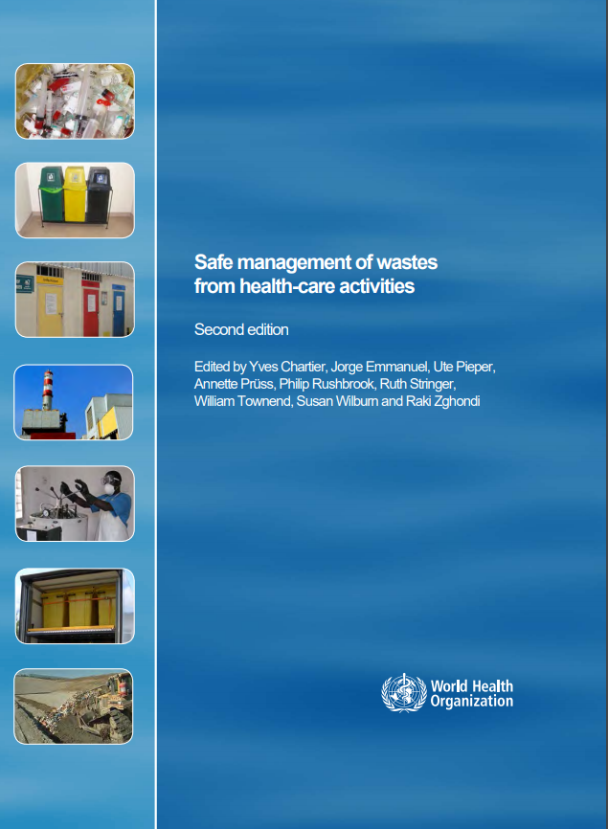
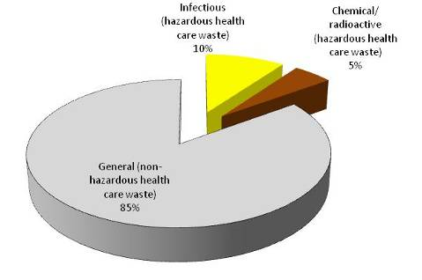
SAFELY MANAGED MEDICAL WASTE
Follow regular safe management of waste practices (e.g., segregation, treatment, safe disposal)
Use PPE while handling waste (boots, apron, long-sleeved gown, thick gloves, mask and goggles or face shield)
Black container (lined)
Yellow container (lined)
Sharps box
Notes:
Spark further action-grow a movement
engage in key health events
Hold countries and partners accountable
Country tracker, world health assembly updates
JMP 2020 report
Provide technical and country support
WASH FIT updates and implementation
Embedding WASH in health efforts
Raise profile secure more investments
Investment meeting; investment case
Continue to advance learning agenda
Continue learning labs (e.g. on research)
Impact from WASH FIT and other tools

Slide 22






HAND HYGIENE
Ensuring hand hygiene occurs at the right time & in the right way is achieved through a multimodal approach:
The infrastructure & resources available to perform hand hygiene
People trained in the why, when and how
Checks in place to monitor whether it is being performed at the right time & in the right way & timely feedback so that corrective action can be addressed
Reminding people to perform hand hygiene at the right time and in the right way
A culture within a care facility that values hand hygiene, especially the support of senior managers
WHO multimodal improvement strategy https://www.who.int/infection-prevention/publications/ipc-cc-mis.pdf?ua=1
Notes:
Hand hygiene is a behavior that is influenced by many factors. The likelihood of hand hygiene occurring at the right time and in the right way is influenced by:
The infrastructure & resources available to perform hand hygiene
People trained in the why, when and how of hand hygiene
Having checks in place to monitor whether it is being performed at the right time and in the right way and timely feedback so that corrective action can be addressed
Reminding people to perform hand hygiene at the right time and in the right way
Senior managers showing they value hand hygiene
This is what the WHO multimodal strategy is all about. Hand hygiene improvers should address all of these five elements commonly referred to as: 1) system change; 2) training and education; 3) monitoring and feedback; 4) reminders and communications; and 5) a culture of safety. In other words, the strategy involves “building” the right system, “teaching” the right things, “checking” the right things, “selling” the right messages, and ultimately ”living” IPC throughout the entire health system. Lessons from the field of implementation science suggest that targeting only one of these five elements (that is, using a “unimodal” strategy) is more likely to result in improvements that are short-lived and not sustainable.

Slide 23
FEW FINAL CONSIDERATIONS
Adequate personal and interpersonal hygiene practices (handwashing, cough and sneeze etiquette) and social distance should be supported by all necessary hardware interventions, while public places environmental cleaning and disinfection should be intensified.
WASH programs are fundamental to enable effective IPC procedures.
Focus on how to operationalize in COVID-19 contexts classic WASH guidelines and standards, for example:
foot activated handwashing stations;
specific COVID-19 relevant WASH NFIs Kit (HHs; Schools; for CHWs, for IPCs HCFs…);
Adapting to social distance centralized water supply systems and communal WASH services, etc…
Think of the secondary impacts of the COVID-19 on WASH services and adapt - or maintain - your existing ongoing programs accordingly (access to WASH for quarantined people, disruption of maintenance and operation of water distribution, sewage systems, waste management, discontinuity of supply fuel chemicals, stock-out wash commodities, WASH market disruptions…and related public health impacts).
Pour la RDC WASH Cluster voir:
DRC – Note d’Orientation Stratégique pour la réponse WASH au Covid19, 25 March 2020
Notes:
The provision of safe water, sanitation and hygienic conditions is essential to protecting human health during all infectious disease outbreaks, including the COVID-19 outbreak. Ensuring good and consistently applied WASH and waste management practices in health care facilities, homes and communities is essential to help to prevent human-to-human transmission of the COVID-19 virus.

Slide 24
KEY WEBSITES FOR WASH AND COVID-19
http://washcluster.net/Covid-19-resources
https://wash.unhcr.org/covid-19-resources/
UNICEF Covid-19 Portal
UNICEF Covid-19 Global Appeal
WHO Covid-19 Portal and Daily Situation Reports
WHO Covid-19 Technical Guidance
WHO IPC Online Course
CDC Covid-19 Portal
CDC Covid19- Portal - Get your home ready
Sanitation and Water for All - Covid 19 Resource Portal
The Lancet - Covid-19 Portal
Globalhandwashing.org - Covid-19 Portal
https://www.washinhcf.org
https://washem.info/blog/8405/covid-19-resources
Notes:
The provision of safe water, sanitation and hygienic conditions is essential to protecting human health during all infectious disease outbreaks, including the COVID-19 outbreak. Ensuring good and consistently applied WASH and waste management practices in health care facilities, homes and communities is essential to help to prevent human-to-human transmission of the COVID-19 virus.

Slide 25
KEY RESOURCES: IPC AND HEALTH CARE
Minimum requirements for IPC programmes
IPC and health care WHO recommendations
PPE and COVID 19
Latest WHO recommendations on use of masks

Slide 26
KEY RESOURCES
Download the WASH and COVID-19 technical brief at: https://www.who.int/publications-detail/water-sanitation-hygiene-and-waste-management-for-covid-19
CDC, 2019. Best practices for environmental cleaning in health care facilities: in resource limited settings. US Centers for Disease Control. USA. https://www.cdc.gov/hai/pdfs/resource-limited/environmental-cleaning-508.pdf
WHO, 2020. Infection prevention and control during health when novel coronavirus (nCoV) infection is suspected. https://www.who.int/publications-detail/infection-prevention-and-control-during-health-care-when-novel-coronavirus-(ncov)-infection-is-suspected-20200125
WHO/WEDC, 2013. Technical notes on water, sanitation and hygiene in emergencies. World Health Organization, Geneva. http://www.who.int/water_sanitation_health/publications/technotes/en/
WHO, 2008. Essential environmental health standards in health care. World Health
Organization, Geneva. http://www.who.int/water_sanitation_health/hygiene/settings/ehs_hc/en/
WHO, 2011. Guidelines for drinking-water quality, 4th edition. World Health Organization, Geneva. http://www.who.int/water_sanitation_health/publications/2011/dwq_chapters/en/index.html
WHO, 2019. Results of Round II of WHO International Scheme to Evaluate Household Water Treatment Technologies. https://www.cdc.gov/hai/pdfs/resource-limited/environmental-cleaning-508.pdf
WHO, 2018. Guidelines on sanitation and health. World Health Organization, Geneva.
https://www.who.int/water_sanitation_health/publications/guidelines-on-sanitation-and-health/en/
WHO, 2014. Safe management of wastes from health-care activities. World Health Organization, Geneva. http://www.who.int/water_sanitation_health/medicalwaste/wastemanag/en/
WHO, 2019. Overview of technologies for the treatment of infectious and sharp waste from health care facilities. https://www.who.int/water_sanitation_health/publications/technologies-for-the-treatment-of-infectious-and-sharp-waste/en/

