Slide 1
READY: GLOBAL READINESS FOR MAJOR DISEASE OUTBREAK RESPONSE
Save the Children / Lei Tapang
INTRODUCTION TO EPIDEMICS & PANDEMICS

Slide 2
OUTBREAKS AROUND THE WORLD
Notes:
This slide here depicts the scale of Infectious diseases globally and emerging or re-emerging threats really has no boundaries.
• From this diagram (red-dots representing emerging disease, and Blue representing re-emerging) it is clear that the next big one can happen anywhere and move anywhere.
• Between 2011 and 2018, WHO tracked nearly 1,500 epidemic events in 172 countries though there may be others that weren’t declared.
• Epidemic-prone diseases such as influenza, severe acute respiratory syndrome (SARS), Middle East respiratory syndrome (MERS), Ebola, Zika, plague, yellow fever and others, are harbingers of a new era of high-impact, potentially fast-spreading outbreaks that are more frequently detected and increasingly difficult to manage.

Slide 3
BURDEN OF EPIDEMICS

Slide 4
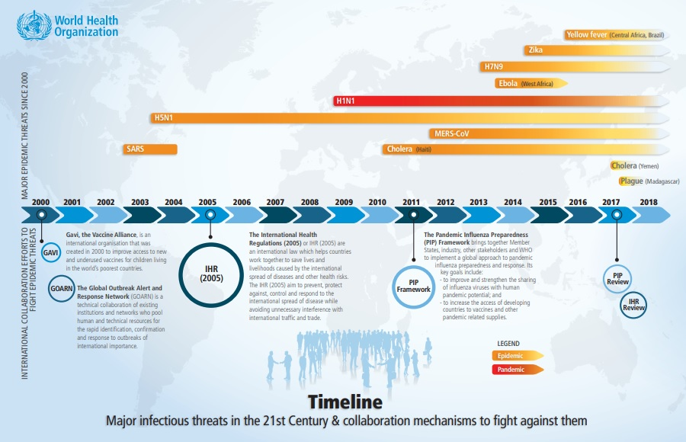
MAJOR INFECTIOUS THREATS IN THE 21ST CENTURY
Notes:
Here is a timeline denoting some major epidemics timelines and introduction of key frameworks/guidance on preparedness as a result. You can see that GAVI and Global Outbreak Response Network was created nearly 20 years ago
IHR was put in place in 2005 that has enshrined into policy much of the obligations on outbreak declaration and response.

Slide 5
BURDEN OF EPIDEMICS
Endemic
Constant presence of a disease or infectious agent in a population within a geographic area
Epidemic
Sudden Increase in the number of cases of a disease above what is normally expected in that population
Outbreak
An epidemic, but often used for a more limited geographic area
Pandemic
An epidemic that has spread over several countries or continents, usually affecting large number of people; typically characteristic of a new disease.
Notes:
We often make reference to all 3 of these and it’s important to make clear definitions between what we mean when we say outbreak/epidemic/pandemic.
Outbreak: In excess of what’s expected in a defined community/geographic area – can be in a restricted area or extended over several countries. Lasts between few days – weeks to years.
Epidemic: Occurs in a community or region with cases of illness that are in excess of normal expectancy.
Pandemic: WORLDWIDE spread of a new disease

Slide 6
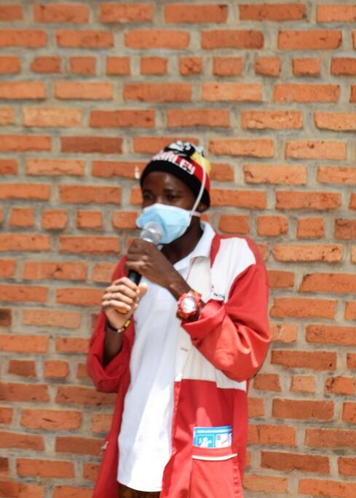
ON JANUARY 31, 2020, WHO DECLARED COVID-19 A PHEIC
WHY?
Constituted a public health risk to other states through the international spread of disease
Impacted several countries beyond China
The declaration allowed state and local authorities to use more flexible measures to shift staff and resources to coronavirus response activities
The outbreak required a coordinated international response
Thacien Biziyaremye / Save the Children
Notes:
A serious public health events that endanger international public health
DETERMINATION: unusual and unexpected event (2 out of 4)
Event resulting in serious Public health Impact
Event with significant risk of international spread
Event with significant risk of international travel or trade restriction
It is an extraordinary event that:
Constitute a public health risk to other States through the international spread of disease
Require a coordinated international response
There are implications for public health beyond the affected State’s national border
May require immediate international action

Slide 7
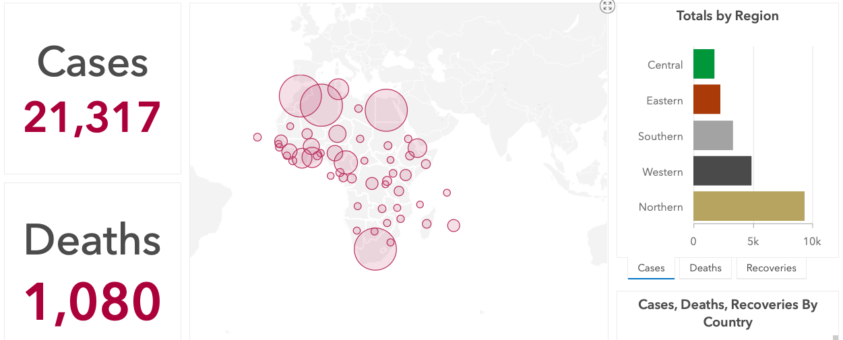
PHEIC Declared Since 2005 by WHO
H1N1 Influenza (2009)
Wild Polio virus (2014)
Ebola West Africa (2014)
Zika Virus (2016) Americas
Ebola DRC Kivu (2019)
COVID-19 (2020)
Hugh Kinsella Cunningham / Save the Children

Slide 8
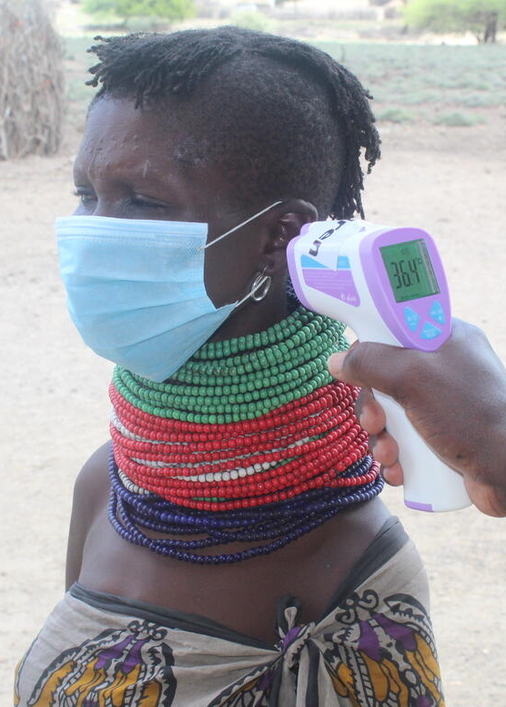
WHAT CHARACTERIZES A PANDEMIC?
Hezbone Etyang / Save the Children
Efficient human-to-human transmission
An appreciable case fatality rate
The absence of an effective or widely
available medical countermeasure
An immunologically naive population
Respiratory mode of transmission
The ability to transmit during incubation periods
ARIE BASUKI / PHOTOSHARE
Notes:
Infectious disease outbreaks have always occupied a critical space in public health, requiring dedicated levels of effort towards controlling disease spread and minimizing population health impact.
However, epidemic-fueled public health emergencies have gained greater international focus in recent years.
Inadequate responses to large-scale crises like the 2014 West Africa Ebola Virus Disease (EVD) outbreak and increasing effects of globalization have exponentially increased the potential impact of both known and unknown pathogens in limited-resource settings.

Slide 9
PANDEMIC DECLARATION
1918 – HINI virus
1957 – H2N2 virus
1968 – H3N2 virus
2009 H1N1(pdm09)
March 11th 2020: COVID-19 is characterized as a pandemic

Slide 10
THE CURRENT WHO PHASES OF PANDEMIC ALERT
The pandemic influenza phases reflect WHO’s risk assessment of the global situation
The assessments are made initially when such viruses are identified and are updated based on evolving virologic, epidemiological and clinical data. The phases provide a high-level, global view of the evolving picture.
As pandemic viruses emerge, countries and regions face different risks at different times. For that reason, countries are strongly advised to develop their own national risk assessments based on local circumstances
Risk management decisions by countries are expected to be informed by global risk assessments but based on local risk assessments.
Notes:
Each country is in a different phase along the same continuum – Some are still in 1-3 therefore are concentrating their effort toward containment
Whereas those in phases 5-6 would focus on mitigation.
Overall majority of affected countries are between phase 4-5 and looking at both Containment and mitigation

Slide 11
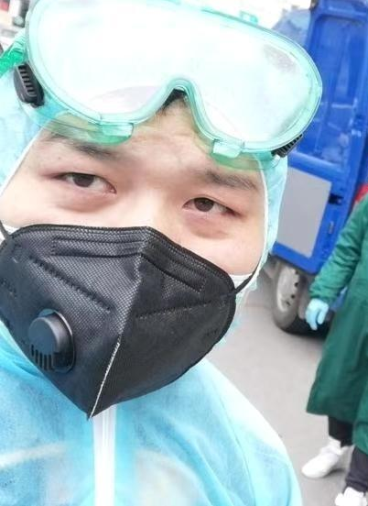
COVID-19 IS A PANDEMIC - WHAT DOES THAT MEAN?
The World Health Organization (WHO) is responsible for declaring a pandemic
“Pandemic” is the term used to describe a new virus that emerges and spreads to multiple countries throughout the world
It implies that the virus is spreading efficiently in multiple countries
It does not tell us how severe the virus may be
Save the Children

Slide 12
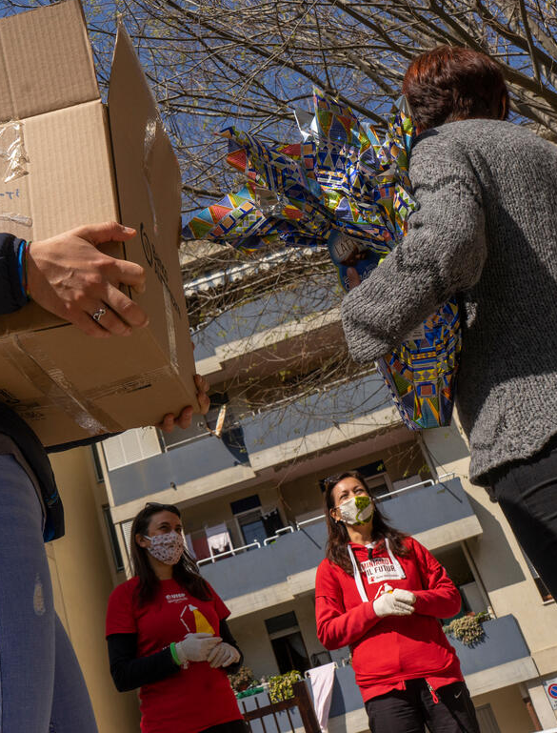
IMPLICATIONS FOR NGOS AND INGOS
Participate in established coordination mechanisms and relevant technical working groups to coordinate COVID-19 regional activities
Strengthen the capacity of institutional counterparts
Prioritize countries and activities based on available resources and needs assessments
Conduct prioritization and risk assessment plans for program adaptation
Marco Sanna / Save the Children

Slide 13
FUNDING MECHANISMS FOR COVID-19
Pandemic Emergency Financing (PEF): Designed to “save millions of lives and entire economies” by speedily funneling money to nations facing pandemics. It has not been activated yet for COVID-19 because of the complex criteria including outbreak size, growth rate, deadlines and death tolls.
Over the Easter weekend, DFID announced it would be contributing £200 million to fight COVID-19 in low-income countries, with £130 million going toward United Nations agencies, £50 million to the International Red Cross and Red Crescent Movement, and just £20 million for other NGOs. NGOs have voiced that DFID should multiply the amount by four or five times. £20 million would not be enough to reach the most vulnerable communities given the global scale of the response.
A new multi-partner trust fund (MPTF) has been set up by the UN Secretariat to support low- and middle- income countries in overcoming the health and development crisis caused by the COVID-19 pandemic . The first round of funding has just been launched for some USD 40 M.

Slide 14
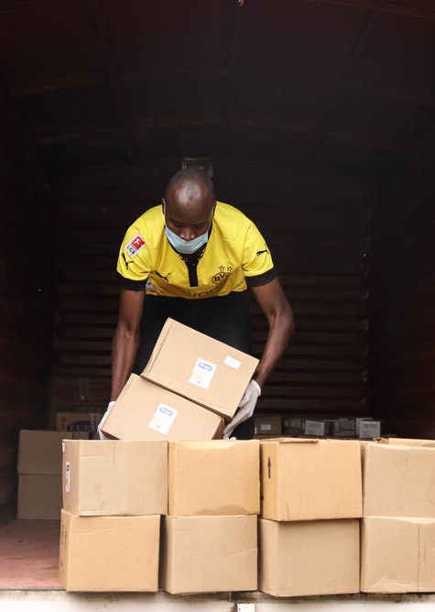
FUNDING MECHANISMS FOR COVID-19
WHO appealed for $640 M for “frontline efforts” to contain coronavirus
UN Humanitarian Chief released US$15 million from the Central Emergency Response Fund (CERF) funding the global efforts to contain the COVID-19 virus
The World Bank approved a $14 B package to assist private sector and countries to prevent, detect and respond to COVID-19
A total of $ 1,3 B will be made available by USAID. $ 528M to OFDA for emergency response, to address COVID-19 in the context of on-going humanitarian crisis.
US State Department has allocated $ 350M for COVID-19 in refuges and IDP setting
CDC has been allocated USD 300M for technical cooperation
If we really want to ensure global health security, we should link funding mechanisms to the declaration of a public health emergency of international concern or pandemic
Mark Njoroge / Save the Children

Slide 15
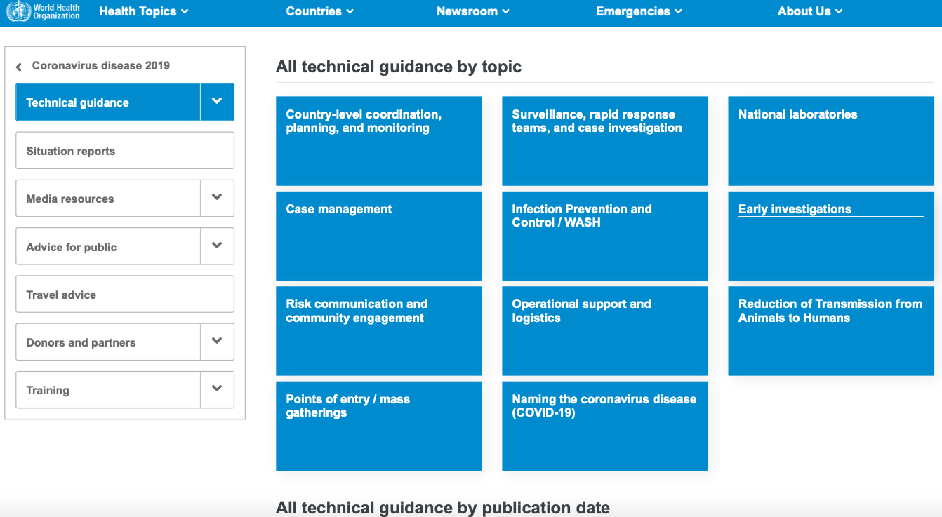
COVID-19 TECHNICAL GUIDELINES AND TOOLS
https://www.who.int/emergencies/diseases/novel-coronavirus-2019/technical-guidance
https://africacdc.org/covid-19/covid-19-resources/

Slide 16
WHO COURSES AND TRAINING
https://openwho.org/courses/introduction-to-ncov
Emerging respiratory viruses, including COVID-19: Introduction: This brief introduction provides an overview of emerging respiratory viruses, including COVID-19.
Module A: Introduction to Emerging respiratory viruses, including COVID-19: Overall learning objective: To be able to explain why a emerging respiratory viruses, including COVID-19, are a global threat to human health
Module B: Detecting Emerging respiratory viruses, including COVID-19: Surveillance and Laboratory investigation: Overall learning objective: To describe how to detect and assess an emerging respiratory virus outbreak
Module C: Risk Communication and Community Engagement: Overall learning objective: To describe what strategies should be used to communicate risk and engage communities to detect, prevent and respond to COVID-19
Module D: Preventing and Responding to an emerging respiratory virus, including COVID-19: Overall learning objective: To describe strategies for preventing and controlling emerging respiratory pathogens, including coronavirus outbreaks.

Slide 17
QUESTIONS
What has been the immediate impact of the PHEIC and pandemic declarations in your region?
What are the immediate impacts on your current operations, if different from above?
How have you been developing your program adaption plan?

