Slide 1
SCENARIO EXAMPLE PROGRAM ADAPTATION
Uganda
NGO “X” Country Office

Slide 2
Scenario 1: Kampala, Uganda
In the process of reprogramming, your organization has mapped its essential services and prioritized life-saving and life-sustaining interventions.
At the health facility level, your organization has put in place a screening, isolation, and treatment area for COVID-19 patients, and suspended certain routine and non-urgent services.
However, there is a risk of disruption to essential health services due to diversion of the already limited numbers of health personnel to respond to COVID-19, as well as decreased service utilization arising from lockdowns and other mobility restrictions.
Populations and health workers may also be facing weariness from not seeing the large spike in cases that was predicted, which may lead to a decrease in preventative behaviors. Continued fear from the population may also be preventing them from accessing services. Finally, the lock-down has also disrupted staffing schedules and supply chains for essential medicines.
Your staff is concerned that routine services such as vaccination, nutritional screening and MNRH services will be de-prioritized and result in a significant reduction in access to these essential health care services.

Slide 3
Scenario 1: Questions
What procedures is your organization putting in place to guarantee that essential services will continue?
What is your organization doing to ensure employees remain prepared, capacitated and motivated?
How would you develop differentiated service delivery models for COVID-19, without compromising essential services such as immunization, nutrition, etc.?

Slide 4
Scenario 2: Rakai District, Uganda
The government has instituted a number of measures to mitigate the spread of COVID-19 in Uganda. In response to new cases among drivers, including truck drivers entering Uganda and a surge of cases specifically in the Masaka region, a buffer zone has been created comprised of districts along the borders including Rakai District. These measures have a major impact on your agency's education, health, nutrition and protection programs in Rakai district.
The team in Kampala has already been experiencing significant supply chain delays, HR constraints, and other implications affecting regular operations and service continuity.
Your agency is an essential player in the provision of essential services for vulnerable populations in this district. Due to the spread of the disease, you must adapt your ongoing programs according to the related guidelines and define an adaptation plan to ensure the continuity and relevance of those programs and services in this new context.

Slide 5
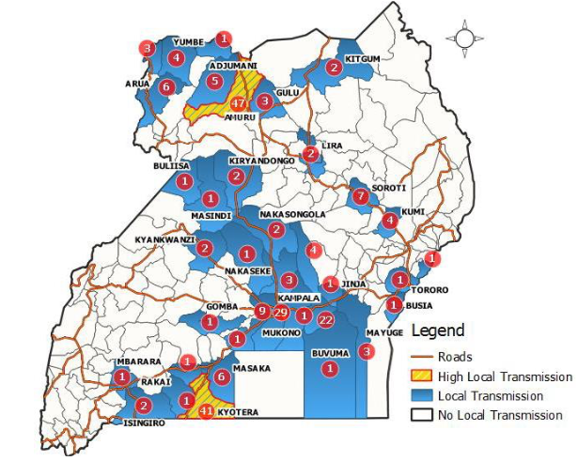
Scenario 2: Risk Map

Slide 6
Scenario 2: Questions
In the framework of your COVID-19 program prioritization and adaptation, what are the activities your organization should focus on?
In this exercise, consider the following typology:
life-saving
life-sustaining
life-dignifying
life-enhancing
Please provide example interventions for each of the above.

