Slide 1
READY: GLOBAL READINESS FOR MAJOR DISEASE OUTBREAK RESPONSE
Mohammed Osman & Abubaker Garelnabei / Save the Children
PROGRAM ADAPTATION CONSIDERATIONS FOR COVID-19
April 2020: Dr Omnia conducts health screening in a religious school in Khartoum state, Sudan

Slide 2
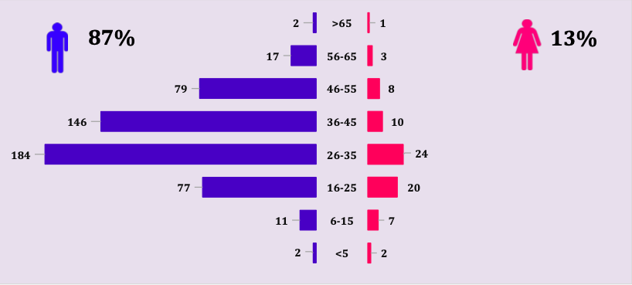
PLANNING ASSUMPTIONS
With no mitigation efforts, 80% of world’s population will become infected
Substantial impact on the healthcare system, with critical care capacity being overwhelmed by 25-30 times
Mortality: lower in < 10 y, modest in 10-19 y, going up with age to very high in >75 y
Week 23 -2020
Sex and age distribution of confirmed COVID-19 cases in Uganda

Slide 3
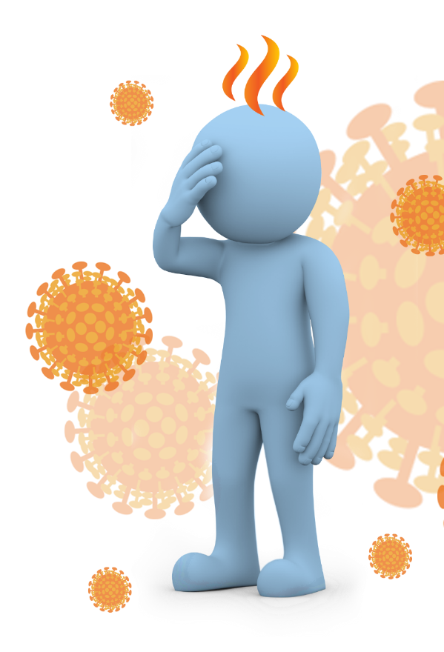
PRIORITY INTERVENTIONS
Flatten the epidemiological curve, pushing down the height of the curve of illness and death at its peak through social distancing measures
Continue key services while implementing social distancing measures
Focus interventions on reducing the risk of infection for those in the highest risk group (the elderly and those with pre-existing and chronic health conditions)
Protecting staff

Slide 4
PRIORITIZATION ACTIVITIES
Priority 2
Program continuity
Ensure continuity of critical programs and services following specific guidelines and protection measures
Minimize the negative impact of lockdown measures on populations
Priority 3
COVID-19 specific response activities
Support containment and mitigation efforts to reduce the impact of the outbreak within communities
Implement additional response activities based on pillars of outbreak response
Priority 1
Staff safety
Train staff and provide adequate protective supplies to work safely
Implement policies on staff safeguards to mitigate risk of infection and support staff

Slide 5
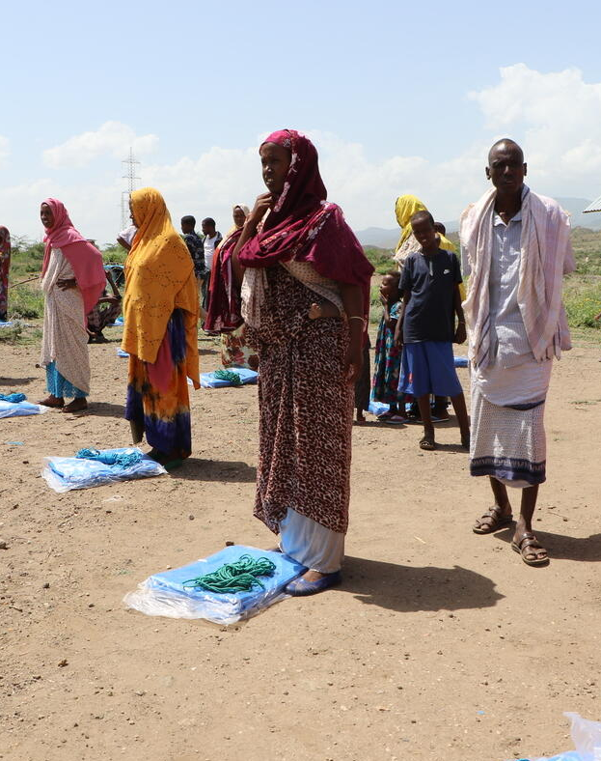
PROGRAM LEVEL RESPONSE
Seifu Asseged / Save the Children
All programs have similar risks which may promote the transmission of COVID-19 during an outbreak. We must adapt our existing programming to reduce these risks
Program adaptation will contribute to improving safety for staff and beneficiaries, support business continuity of existing programs to the extent possible, and limit further transmission
Implement additional response activities based on pillars of WHO Strategic Response Plan: Surveillance, IPC, CCM, RCCE, etc.

Slide 6
PROGRAM ADAPTATION STEPS
Prioritization
Programs should list all activities and rate their “Criticality" from 1-4
Risk assessment
Risk assessment for all programming types (by modality and applicable to all program sectors)
Adaptation measures
Measures required to ensure safe business continuity with accompanying thresholds for program suspension, a clear list of the resources required for program adaptation, and a clear plan to prepare programs based on these adaptation measures

Slide 7
PROGRAM PRIORITIZATION LEVELS
1. Life-saving interventions (e.g., clinical care for emergency conditions, emergency WASH, emergency food distributions & cash).
2. Life-sustaining interventions and those with potential impact on COVID-19 (e.g., PHC, vaccination, MCH and any community engagement activities that promote prevention).
3. Life-dignifying
4. Life-enhancing

Slide 8
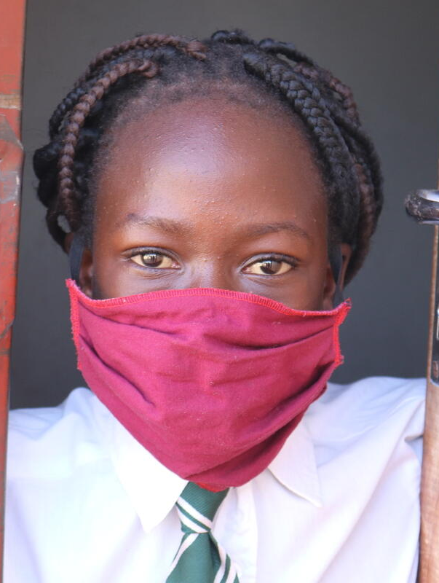
Sophie Hamandishe / Save the Children
IMPLEMENTATION OF PROGRAM PRIORITIZATION
Life saving and life sustaining
Continue with identified program adaptation measures when there is confirmed local transmission of COVID-19 in areas of operation. Consider temporary suspension if risk mitigation measures cannot be implemented
Life-dignifying and Life-enhancing
Consider temporary suspension

Slide 9
Save the Children
RISK ASSESSMENT
Household visits
Mass meetings/gatherings
Health facilities
Nutrition centers not attached to health facilities
Schools
Spaces (CFS, WFS, Community rehab, MHPSS spaces)
Community construction / rehabilitation (e.g. WASH)

Slide 10
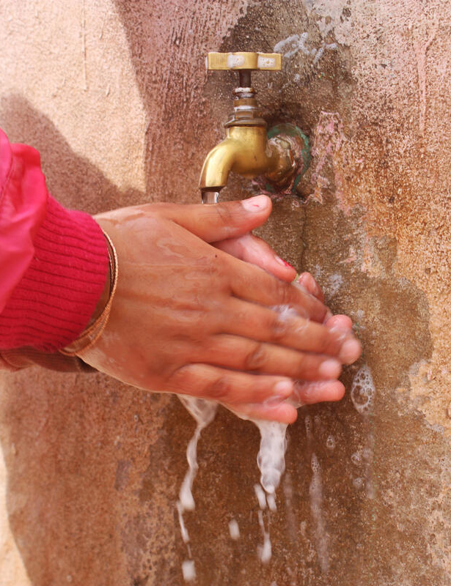
CONSIDERATIONS FOR PROGRAM ADAPTATION
Save the Children / GMU
Be realistic
Need to ensure basic needs
Program adaptation takes time and resources
Multi-sectoral and not only health sector
All sectors could be leveraged to reduce transmission and provide community isolation or care for ill patients
Context-specific; local challenges require local solutions, that may evolve over time

Slide 11
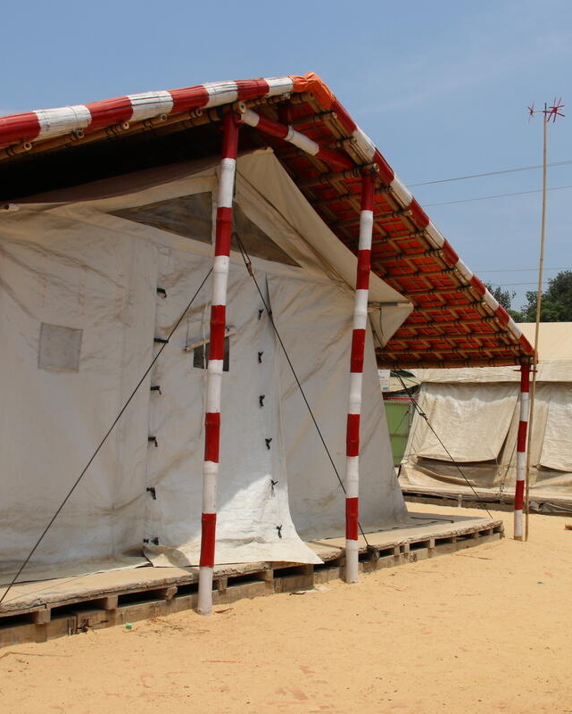
HEALTH FACILITY ADAPTATION
Sonali Chakma / Save the Children
Triage / screening & isolation area
Standard & transmission-based IPC precautions
Provision of PPE
Strict staff sickness policy
Home-based treatment protocols
Cancellation of routine/non-urgent services
Prepare for disruptions in patient access
Limit visitors and movements
Patient transfer protocols
Surge capacity
PPE conservation strategies
Staff repurposing

Slide 12
OUT-PATIENT MANAGEMENT OF MAM AND SAM
Whenever possible, engage Community Health Workers (CHWs) in the distribution of all treatment for uncomplicated severe acute malnutrition, and employ decentralized mobile health teams using a limited or no-touch simplified treatment approach.
PROGRAMMATIC MODIFICATIONS SHOULD INCLUDE
Simplified admission criteria (e.g., MUAC and edema only)
Simplified Ready-to-Use Therapeutic Food (RUTF) dosage (1 sachet/day for uncomplicated moderate wasting, and 2 sachets/ day for uncomplicated severe acute malnutrition
Reduce frequency of follow-up visits to once per month by increasing the take-home ration of RUTF
Caregivers and CHWs practice social distancing
PPE for staff treating children
Information on the follow-up plan, potential disruption of services, when to go to health facility and prevention of COVID-19
Prepositioning supplies and RUTF near CHWs/mobile health teams

Slide 13
LARGE-SCALE GATHERINGS
Program Activity | Risks | Options for Mitigation Measures | Resources Needed | Actions per Program Phase / Program Criticality
All Sectors
Large-scale Meetings / Gatherings Definition: Meeting or gathering over 25 people Examples: Community gatherings for awareness-raising, information dissemination, and community engagement, child participation, large trainings or staff meetings, etc. | Individuals with COVID-19 attend the meeting and spread the infection to other people and staff (or conditions with similar symptoms, initiating COVID-19 suspicion and self-quarantine) SC staff who is sick attends the meeting and transmits the infection to others (or conditions with similar symptoms, initiating COVID-19 suspicion and self-quarantine) | All large gatherings should be avoided. Strongly consider alternative approaches for awareness-raising, information dissemination, and community engagement, child participation, e.g., telecommunications, smaller groupings with safe distancing, house-to-house (see below) Identify alternative delivery formats for the meeting: telecommunications, webinar, etc. Limit the number of people attending to ensure social distancing can be practiced. Adjust the venue for meetings to be in a bigger space to enable social distancing (2m) and good ventilation. Ensure no-one with cough, fever, or shortness of breath attends. Strict staff sickness policy implemented – staff to not attend work if displaying symptoms. Must be discussed and agreed with HR and communicated to all staff to remove the incentive to attend work sick. | Staff trained on COVID-19 prevention. Awareness-raising and communication materials available Telecommunications | PREPAREDNESS Identification of relevant meetings and gatherings, (for staff and communities) per program criticality level Conduct awareness-raising with staff, children, and communities about potential changes to activities. Readying of telecommunications resources, if applicable INITIAL RESPONSE All large-scale gatherings should be avoided Postpone non-critical meetings (PC3 and PC4) Implement modification measures for critical meetings (PC1 and PC2) and suspend all in-person mass meetings if modifications can’t be met. LARGE SCALE RESPONSE Suspend all types of in-person meetings

