Slide 1
READY: GLOBAL READINESS FOR MAJOR DISEASE OUTBREAK RESPONSE
Thacien Biziyaremye / Save the Children
Risk Communication and Community Engagement in Disease Outbreaks – COVID-19

Slide 2
Session Outline
Part 1
Social Behavior Change, Risk Communication and Community Engagement – 101
Part 2
Key Considerations for COVID-19

Slide 3
Part 1. Social Behavior Change and Risk Communication – 101

Slide 4
What is Social Behavior Change? The intentional process that seeks to understand and facilitate change in behaviors, social norms and the contexts that drive them.
Notes:
Defining social behavior change so everyone is on the same page.

Slide 5
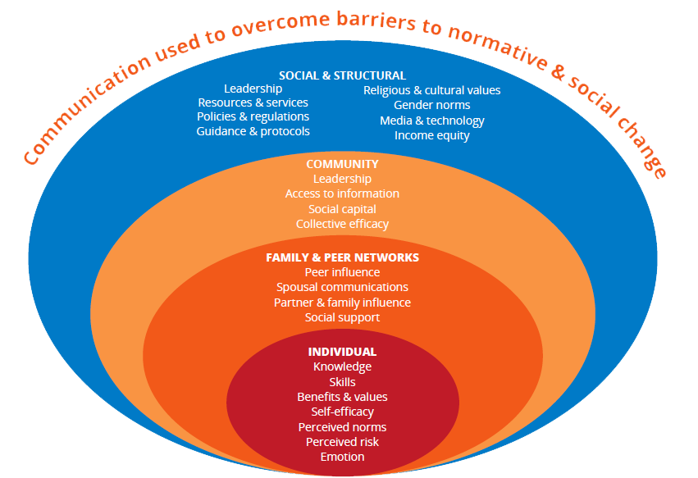
Notes:
What is happening around them matters as much as what they think themselves, which can also be biased.

Slide 6
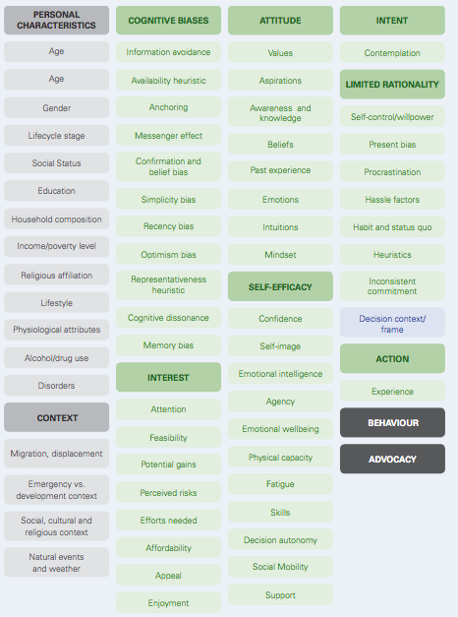
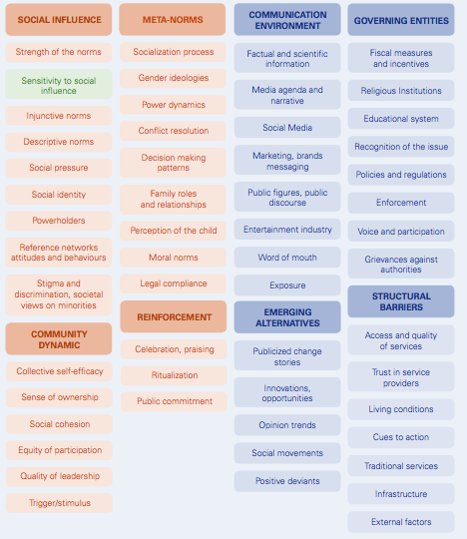
Behavioral Drivers: Complexity of Human Behavior
Source: UNICEF C4D
People generally don’t just consider pros and cons to make a rational decision on the best path of action: providing them with the right information will rarely automatically translate into the ‘’logical choice’’.
Notes:
When we unpack the behavioral drivers at each of the three main levels – individual/psychological, social and structural, we see just how complex human behaviors are. People generally don’t just consider pros and cons to make a rational decision on the best path of action: providing them with the right information will rarely automatically translate into the ‘’logical choice’’.

Slide 7
What Are the Common Social Behavior Change Approaches?
Intervention Categories | Sub-categories
1. Community-based approaches | Community engagement & interventions Community mobilization Community outreach Social mobilization Social movements & empowerment Positive deviance
2. Interpersonal Communication | Client-provider/physician-patient interaction Community/frontline health workers/midwives/ tradition birth attendants Counseling Home visits / household outreach Peer educators
3. Group-based approaches | Social capital / social support Social networks Social norms / normative change
4. Behavioral economics | Financial incentives / vouchers Non-financial incentives & motivators
5. Media and social marketing | Advocacy Mass media Social marketing / marketing heath services Social media, digital approaches Strategic/persuasive communication
Notes:
And then implementing through a combination of processes and interventions, depending on what is needed, from community engagement to interpersonal communication between service providers and clients, mass media, incentives and motivators and so on.

Slide 8
What is Risk Communication?
WHO
The exchange of real-time information, advice and opinions between experts and people facing threats to their health, economic or social well-being. Purpose is to enable people at risk to take informed decisions to protect themselves and their loved ones.
Source: WHO Source, Page visited April 4, 2020
Notes:
Decisions for mitigating the effects of that threat, so that they can take protective and preventive actions to protect themselves and their loved ones. And so, we need information and engagement; we need decision-making by those at risk; and we need them to take action. So, to know about risk is not enough, but to take action to reduce the risk or risk reduction is key.

Slide 9
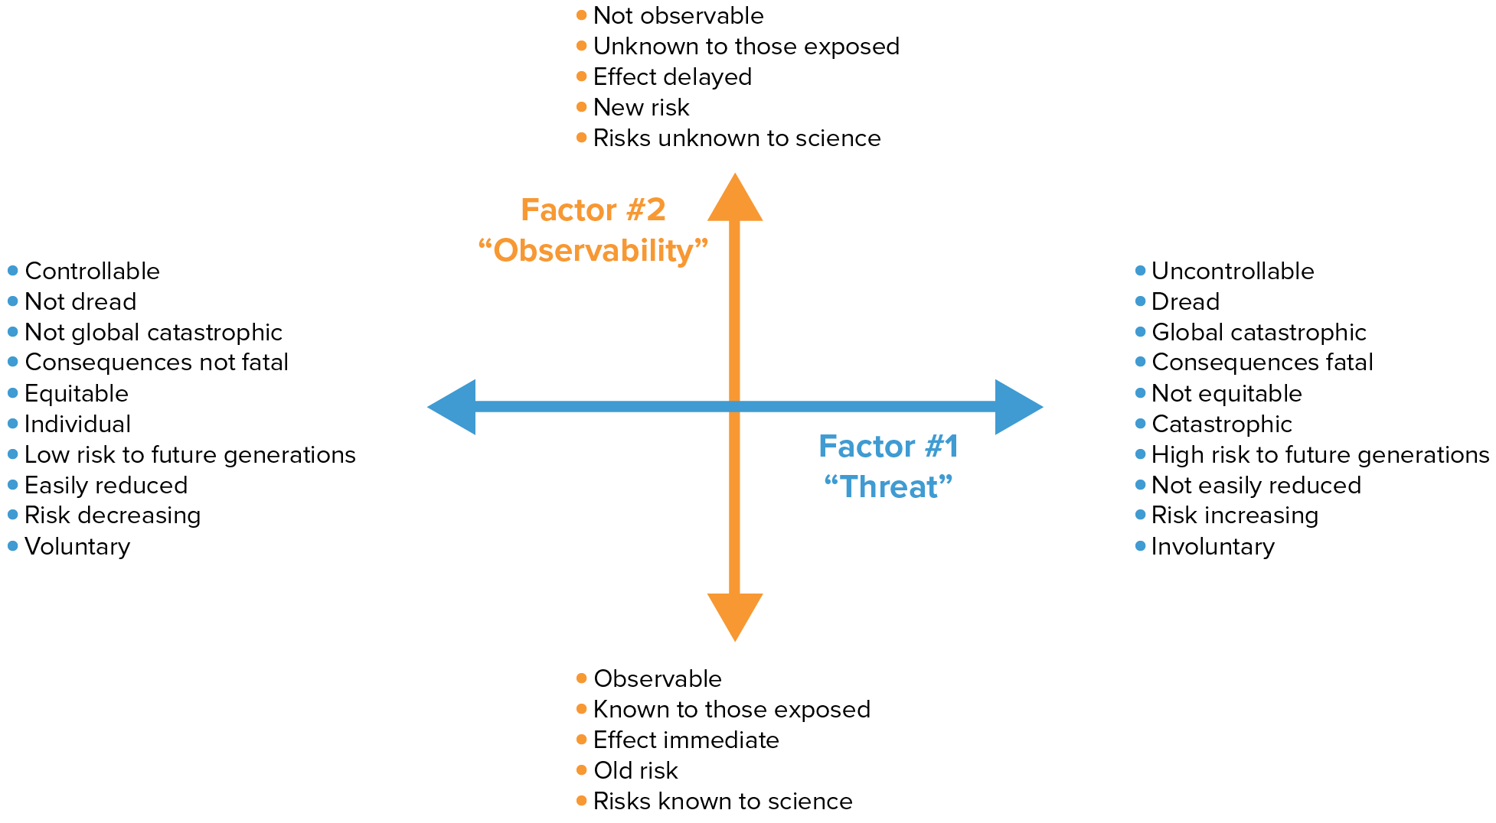
Paul Slovic: Perception of Risk (Science, 236: 280–285, 1987)
Notes:
There were famous studies done in the 70s and 80s on perception of threat.

Slide 10
We are less concerned about health risks that are – voluntary, familiar, controllable, controlled by self, fair, endemic, not fatal.

Slide 11
We are more concerned about health risks that are – involuntary, unfamiliar, uncontrollable, epidemic, grouped by time and location, fatal.

Slide 12
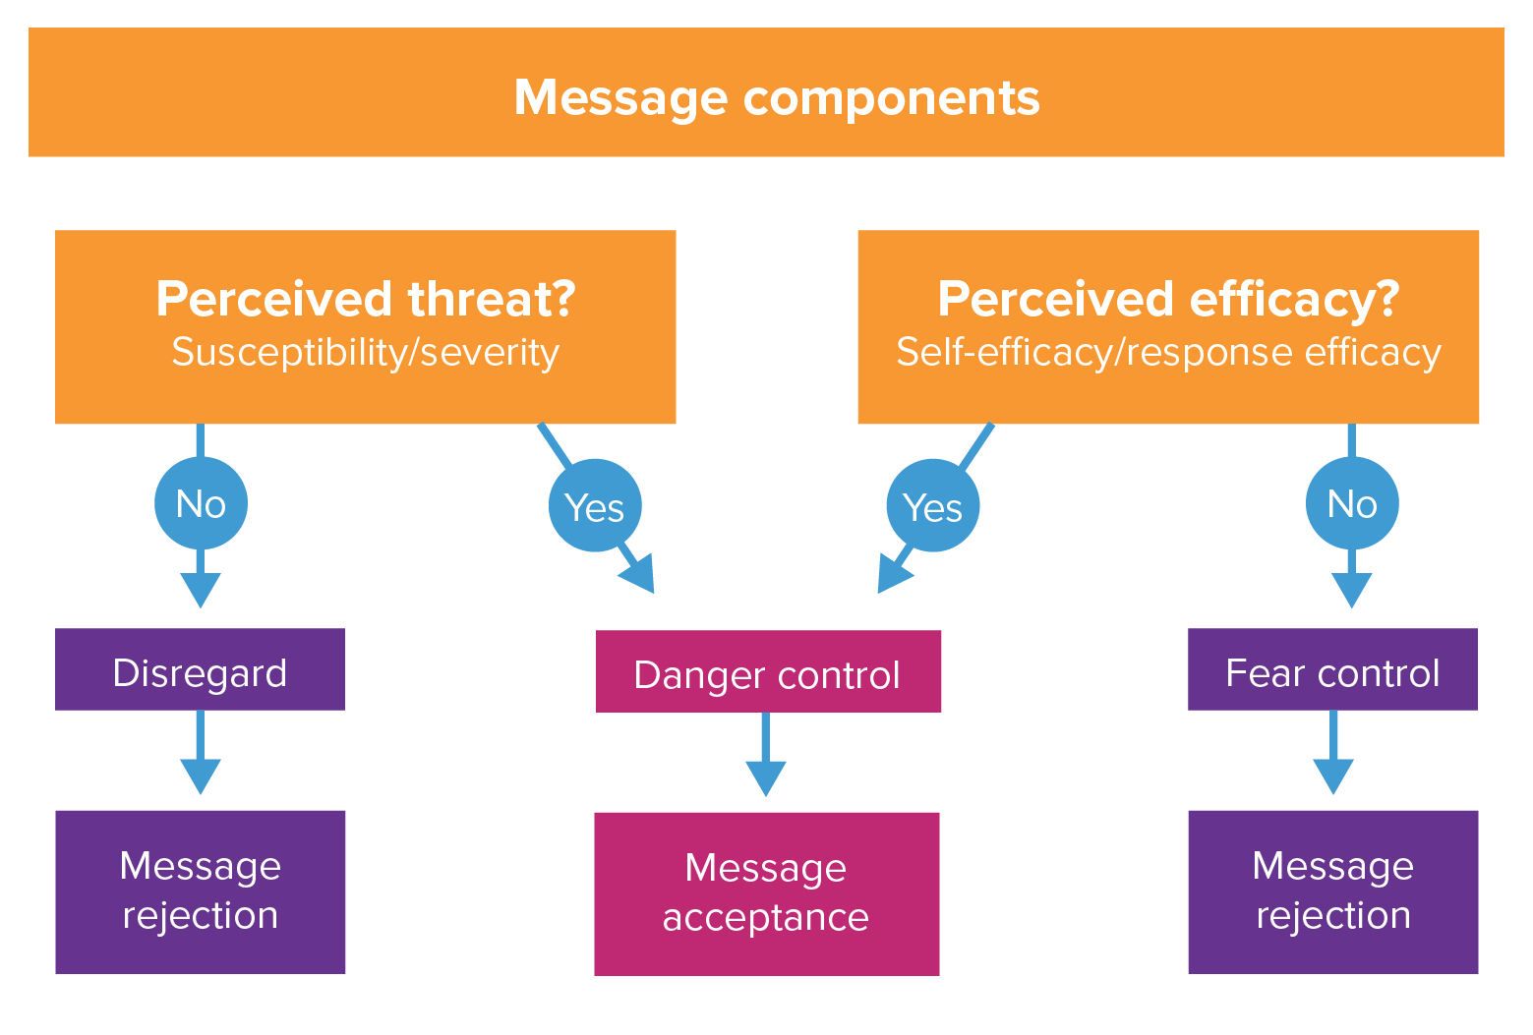
Extended Parallel Process Model
Can this happen to me? Is it bad?
Is there an effective solution? Can I do that?
Notes:
Extended Parallel Process Model states that for individuals to take protective action they must feel threatened by the consequences of a behavior and feel able to act to avoid that threat and believe the action is effective.
Can it happen to me? Is it bad? Is there an effective solution, and am I able to do the solution?
All four must be present for a positive response.
People want to know how to protect themselves and their families and friends during a pandemic and the ability to act provides a sense of relief that “they could do something.”

Slide 13
Competing Priorities and Other Challenges
People who are struggling even more to meet their basic needs due to the pandemic, may ignore prevention measures or bypass mobility restrictions.
Tommy Trenchard / Save the Children
Notes:
People who are struggling even more to meet their basic needs due to the pandemic, may ignore prevention measures or seek to bypass imposed mobility restrictions.

Slide 14
How Can We Address with Risk Communication and Community Engagement?
Accelerate information on disease transmission,
Emphasize severity and susceptibility of threat
Especially for younger people, emphasize the potential threat for them of spreading the disease to people at higher risk of severe disease – e.g., family member/people in the community
Use role models, testimonials about dangers and effectiveness of solutions.
Emphasize the ability of people to do something positive for their family and neighbors, their community, and the potential consequences of doing nothing. Regain sense of control.

Slide 15
Risk Communication and Community Engagement (RCCE)…
Provides evidence-based, timely, relevant and actionable life-saving information through the most appropriate communication approaches to encourage people to adopt safe health practices and reduce fear, stigma and misinformation.
Listens to community feedback to understand the beliefs, fears, rumours, questions and suggestions communities have about COVID-19 and use this to guide the response.
Informed by data, builds innovative approaches to encourage social behaviour change and take actions to prevent and reduce the spread of the disease
Identifies and supports community-led solutions for bringing the outbreak under control, ensuring people’s active participation in the response.
IFRC, 2020
Notes:
The main pillars of RCCE:
Live-saving information: Employing a variety of community engagement approaches and trusted communication channels to reach and engage communities with accurate, easily understood and trusted health information about COVID-19 risk and transmission, causes, symptoms, prevention and treatment through trusted communication channels. This also includes sharing factual information to counter rumours and misinformation and reduce fear and stigma around the disease.
Feedback: Establishing systematic community feedback mechanisms to understand the beliefs, fears, rumours, questions and suggestions circulating in communities about COVID-19 so that we can stay in touch with communities and address what their real concerns are. Community feedback needs to be analysed and acted upon. For example, by changing the information we share to address rumours or fears, by changing our activities to better meet community’s needs and be more effective. It is important to give opportunities and open channels of communication for people and communities to ask questions and debate issues of concern.
Encourage behavioral change: RCCE approaches need to go beyond information sharing and awareness raising and motivate people to ACT by adopting safe health practices or complying with infection prevention measures like staying at home. This means using two-way forms of communication to engage communities in discussions about COVID-19 and how it can be prevented.
Community-led solutions: It’s important to build community ownership of the COVID-19 response by identifying and supporting community-led solutions for preventing the spread of infection and bringing the outbreak under control, ensuring people’s active participation in the response. Asking people what they know, want and need, and involving them in designing and delivering COVID-19-related services and prevention approaches improves the effectiveness of our community interventions and sustains the changes we promote.

Slide 16
Turning Point: 2014-16 Ebola Outbreak in West Africa
=
Fear, Hiding –
Increase in Transmission, Deaths
Notes:
Early on, RCCE was undervalued and underresourced and not brought in early enough.
In the face of early and persistent denial that Ebola was real, health messages issued to the public repeatedly emphasized that the disease was extremely serious and deadly, and had no vaccine, treatment, or cure.
While intended to promote protective behaviours, these messages had the opposite effect. If there were no treatments, therapies, or cures, families hid their loved ones at home, let death happen as comfortably as possible at home, amid familiar and well-loved faces. (in Sierra Leone, 80% of deaths were linked to unsafe burial practices).

Slide 17
What Can We Do to Help Drive Behaviors?
Diffusion of Innovation
Social Cognitive Learning Theory
Observational learning: seeing the behavior in practice and the benefits derived can help others adopt it
Self-efficacy
Interaction between individual and environment, importance of creating an enabling environment.
Communication channels can help an idea become more popular,
Works best when prominent members of society can influence.
How simple? Does it work for me? Can I see it? Can I try it?
People are initially slow to adopt new behaviors, but as the behavior becomes better known and accepted, more people practice it
Notes:
In designing for behavior change, knowing some social behavior change theories will go a long way in informing your approaches.
For example, the social cognitive learning theory, in short, argues that seeing the behavior in practice can help others adopt it. This can be done in person or through the media by real or fictional characters demonstrating a desired behavior and benefits. It focuses on creating an enabling social environment.
Diffusion of Innovation approaches work best when applied to issues that can be influenced by prominent members of society. As the behavior becomes better known and accepted, more people start to practice it and eventually the behavior becomes commonplace. Communication channels can influence how quickly an idea is shared, and you can help an idea become more popular. People will want to know: How simple? Does it work for me? Can I see it? Can I try it?

Slide 18
Communities MUST BE at the heart of any public health intervention, especially in emergencies Involves those affected in understanding the risks they face and involves them in response actions that are acceptable.
Notes:
Community engagement must be at the center of public health interventions, especially in emergencies. Engage communities in a dialogue about COVID-19 readiness. Create opportunities for two-way dialogue with affected community enables a better response, empower the community to give feedback and participate, and ensure a response is based on the needs, capacities and opinions of the people affected.
This helps ensure health systems are responsive to changing health priorities

Slide 19
Quality Standards and Indicators for Community Engagement - Core Minimum Standards
Participation
Empowerment and Ownership
Inclusion
Two-Way Communication
Adaptability and Localization
Building on Local Capacity
UNICEF C4D
Notes:
Participation: Communities assess their own needs and participate in the analysis, planning, design, implementation, monitoring and evaluation of governance, development and humanitarian initiatives
Empowerment: Communities have opportunities to own and feel empowered by community engagement processes. Empowerment is both a process and an outcome of community engagement and participatory practice.
Inclusion: Community members and groups that are under-represented, disadvantaged, vulnerable, and marginalized are identified, supported, and ensured of a role and a voice in all aspects of community engagement. This includes discriminated, deprived, and disadvantaged groups such as poor households, persons with disabilities, adolescents and youth, the elderly, children, ethnic and linguistic minorities, indigenous communities, religious minorities, LGBTI community members, women, and. Safety considerations should be taken into account in implementation of this standard.
Two-Way Communication: Communities give and receive clear, appropriate and accurate information through two-way communication pathways on a regular and predictable basis in order to ensure access to information and participation.
Adaptability and Localization: Community engagement approaches are developed based on local contexts. They are able to be flexible and responsive to local populations’ needs, conditions, and concerns. Adaptable and localized community engagement approaches ensure that community engagement processes are able to adapt to new circumstances, deal with sudden or anticipated changes, and respond to uncertainty.
Building on local capacity: Community engagement should build on the existing skills and resources of communities and the local groups and organizations that serve them.

Slide 20
Part II: But what does this mean in Challenging Environments during a Covid-19 Pandemic when Social Distancing is a Critical Measure?

Slide 21
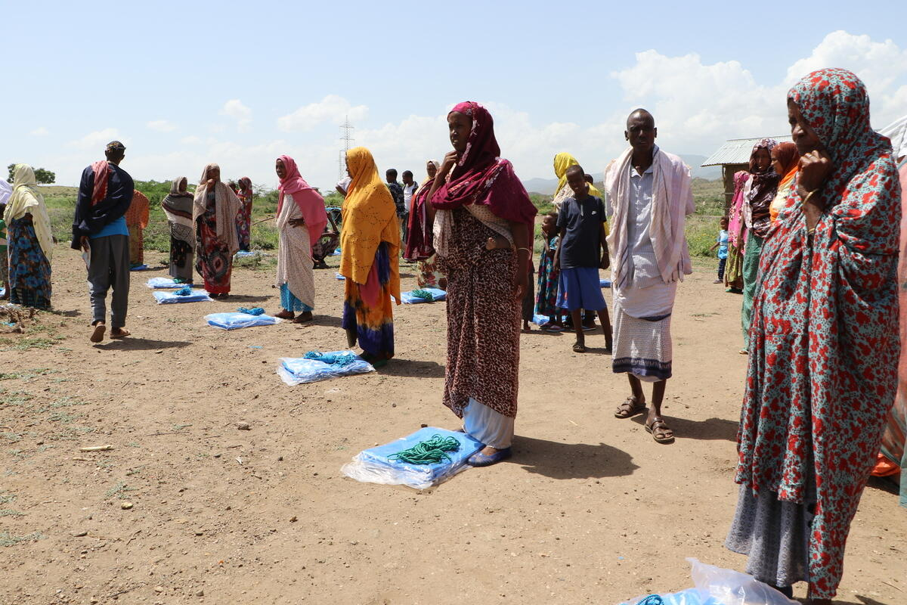
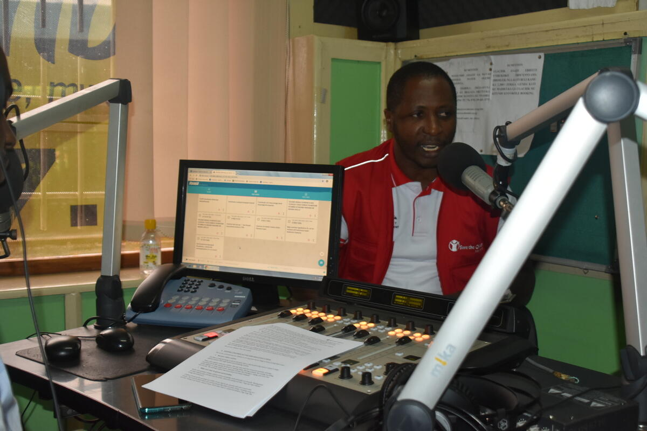
Community Engagement
Seifu Asseged / Save the Children
Joachim Bibuli / Save the Children
A process of working collaboratively with groups of people affiliated by geographic proximity or special interests with respect to issues affecting their well-being.
Notes:
We need to think about community engagement differently now with social distancing measures in place. There are interactive mobile platforms, radio programming and technologies that we can use to engage, in addition to ramping up traditional mass media, where that is appropriate.

Slide 22
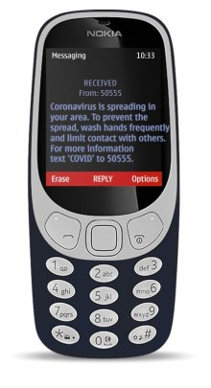
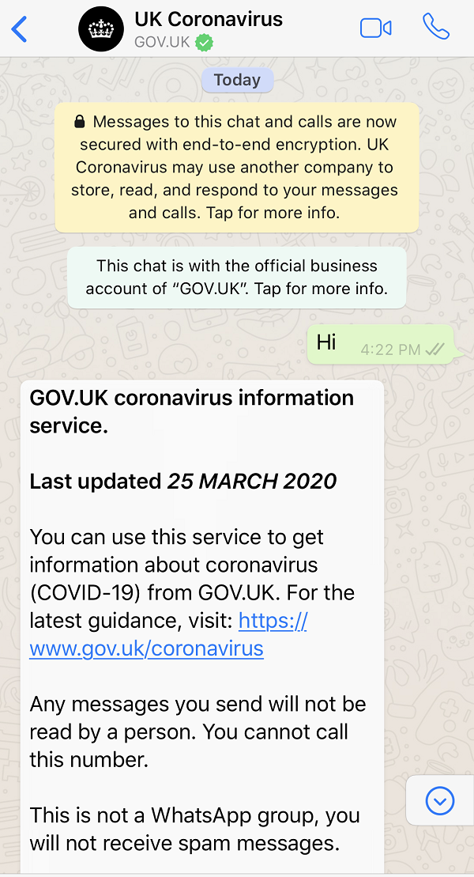
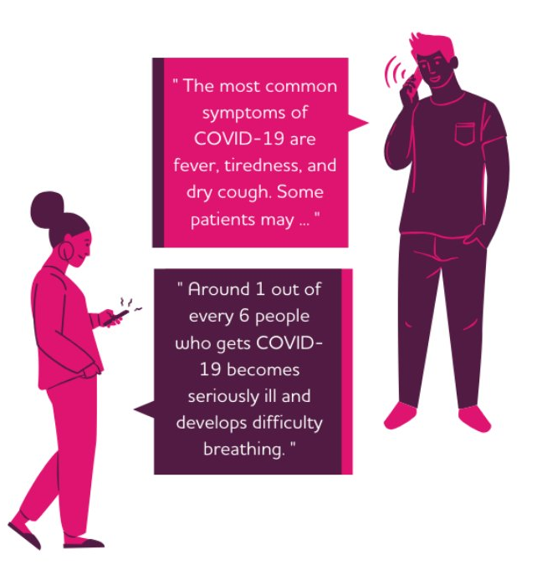
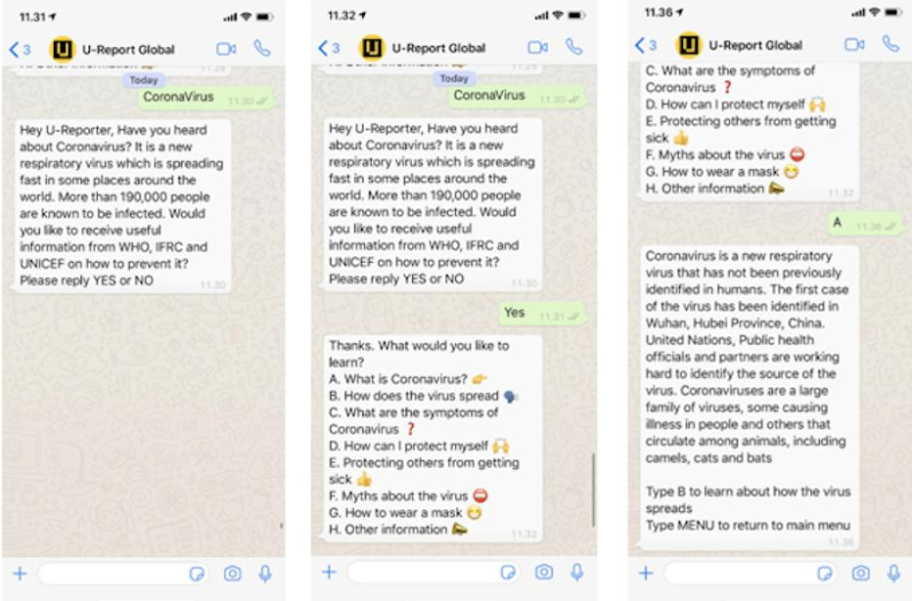
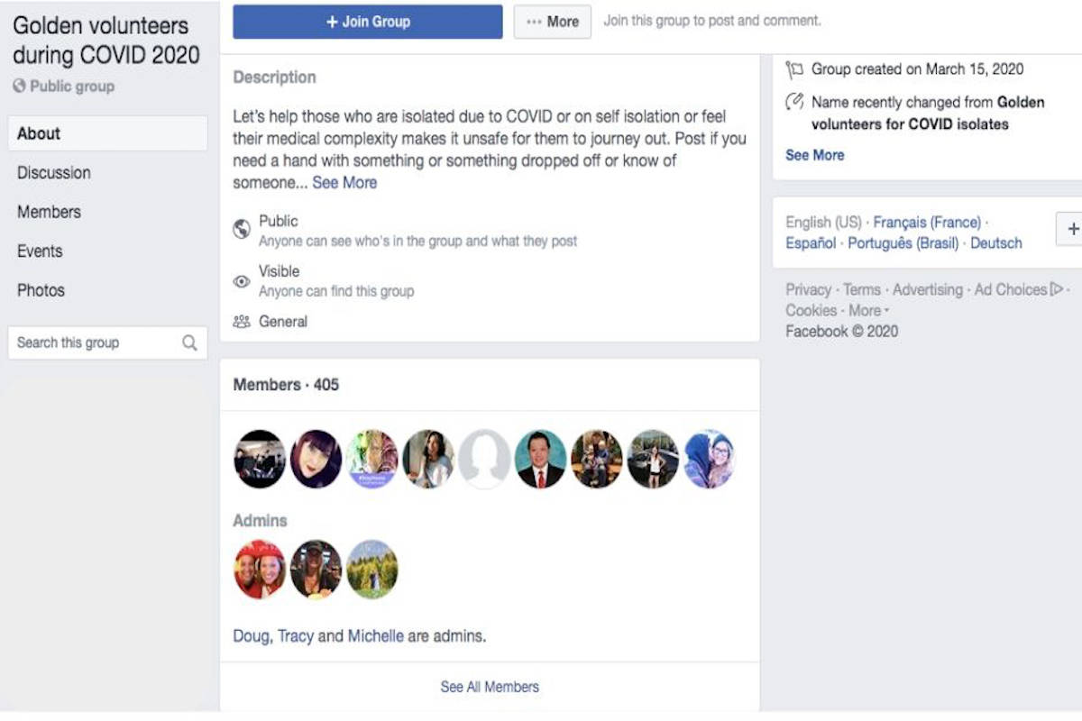
Exemples of Mobile Technologies and When to Use Them
Pour partager information avec les membres des communautés et pour capturer leurs questions et commentaires:
To train health workers
To share information with the community and capture their feedback, concerns.
Notes:
Viamo’s 321 platform, which is a phone line that people can call to connect to a pre-recorded menu of Covid information like signs, symptoms, and prevention
Important to use two way communication as well, to share information, to capture information, to answer questions and clarify doubts and to capture rumors and misinformation from communities:
SMS with Covid information and tips and to capture rumors and misinformation
Facebook group to post information and create two-way communication with a community group either on messenger or online page, and to capture rumors and misinformation
WhatsApp group to share information via text, audio recordings, video, photos, link to websites, and to create two-way communication to capture rumors and misinformation
IOM Indonesia is conducting meetings with refugees via WhatsApp and online platforms to disseminate prevention information and receive comments. The mission has also developed RCCE materials for returned Indonesian migrant workers in collaboration with the Ministry of Women Empowerment & Child Protection and the Ministry of Social Affairs.
5. U-Report: a messaging tool that gathers opinions and information from young people, where they repsond to polls, report issues and support activities. The data and insights are shared back with communities and connected to policy makers who make decisions that affect young people.
For areas that are hard to reach, with little or no technology:
6. Phone calls to have a conversation
7. Call Centers and Hotlines for people to get more information from a live person
8. Radio to share information, and where community members can call in or send text to comment and ask questions
In order to provide those responding to COVID19 in Somalia with a snapshot of how the people of Somalia are thinking about the epidemic in these early days, Africa’s Voices reached out using its established multimedia interactive platform called Imaqal (‘listen to me’) that promotes gender equality and social inclusion. AVF sent out this broad question to Imaqal listeners. This message was sent out to 51,000 recipients and responses were collected over the course of a weekend, 3-5 April 2020. 7,747 responded (approximately 15%) with over 18,000 SMS received.
Interactive radio programming using radio broadcases and SMS messaging. Katikati - 1-to-1 SMS conversations with cohorts at scale, either from the interactive radio shows or existing databases. Especially relevant to sustaining engagement remotely and then layering both SBBC communications as well as monitoring/accountability.
To train CHW and leaders on Covid
Audio Job Aids and mobile phone training: using Viamo, for example can have pre-recorded short, weekly training modules for CHW and Leaders
The National Department of Health in South Africa launched HealthWorkerConnect, a WhatsApp-based service that provides official and up-to-date COVID-19 guidance and information for Health Workers of all cadres. Content includes information on the epidemiology and clinical characteristics of COVID-19, management of suspected cases, management of confirmed cases, infection, prevention & control, recording and reporting, ways to contact specialists, support for health workers under stress and other useful resources.
Facebook live: use livestreamed video in those areas with access and good infrastructure, to train people, where participants can also comment, ask questions. Can also be used with communities
Risk communication/SMS/IVR push messaging: Callers in DRC can share demographic information about themselves on Viamo’s 42502 platform that allows the service to push targeted SMS and/or IVR alerts (approved by MOH) to notify community members on new security measures or numbers of cases. Many people living in Kinshasa cannot access the Internet, so these COVID-19 alerts are a vital form of communication.
Facebook Live is a feature of the Facebook social network that uses the camera on a computer or mobile device to broadcast real-time video to Facebook. Live broadcasters can decide who on Facebook can see their video and use this content to engage their audience during the moments and events that are important to them

Slide 23
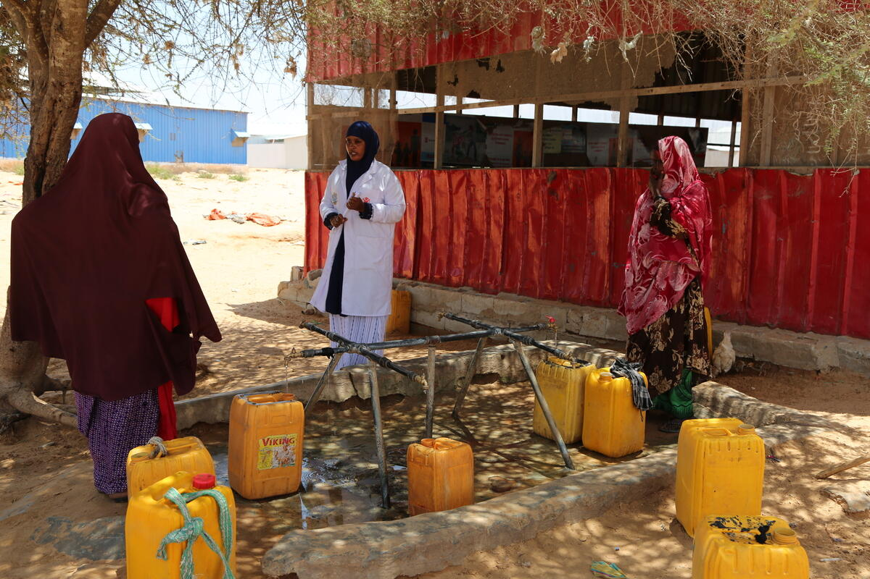
Community Participation in COVID-19 Response
Mohamed Osman / Save the Children
Notes:
Consider networks within the health sector, such as CHWs, and outside. Examples may include:
Youth leaders, social media influencers
Spiritual, community and traditional/cultural leaders
Community groups, women’s groups, etc.
Educational networks such as teachers, parent-teacher associations
Peer educators
Village or commune development committees

Slide 24
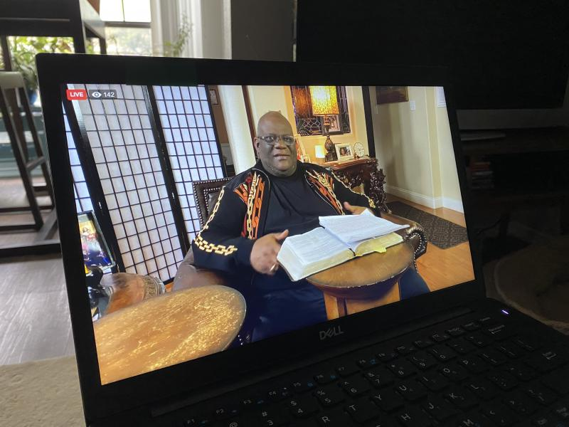
WHO Guides for Religious Leaders
There are tips for conducting distance religious activities, safe celebrations, safe funeral practices, building mental health and resilience, and the role of religious leaders in Covid education

Slide 25
Work with Community Leaders and Community Members to Map High-Risk Areas for COVID-19
Are we working with community leaders, community members and medical teams to understand the highest transmission risk at home, the community level, the health post?
Are we mapping how key people can play a role in the various points within that pathway, and what the entry points for two-way communication are?
Notes:
To what degree are we identifying certain key people, for example, community leaders, and connect to medical teams to understand the transmission pathway from the home to the community level and healthcare/health post. It is not a linear pathway but understand key people to play a role in the various points within that pathway, and entry points to communication.
Can we identify and build on existing networks of trusted community and religious leaders who can share credible information necessary to prevent the spread of COVID-19? Can these trusted community leaders make the difference in helping their communities believe that COVID-19 is a real threat but that there are ways people can protect themselves? Should we be adding people with conflict mitigation or negotiation skills into the mix along with COVID-19 experts? Can we push back against this wave?

Slide 26
Why is Participatory Community Engagement Still Critical in this Pandemic?

Slide 27
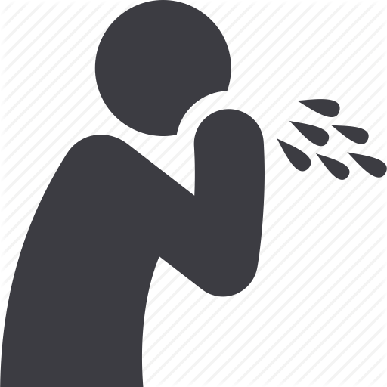
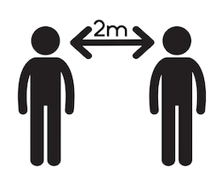
Risk Communication Messages for COVID-19
Clean Surfaces
Mask Use
Hand Hygiene
Home care
Signs & symptoms
Prepare home and family
Stay informed
Respiratory Hygiene
Avoid touching face
Social Distancing
Avoid public exposure if you are sick
Respiratory Hygiene
Notes:
These are risk communication messages for Covid-19 based on WHO guidance, including from its non-pharmaceutical interventions guidance. There are currently discussions of development of a global good document with messages, and possibly expanding messages to not just WHO/CDC but for example partners like CORE group

Slide 28
But Consider…
Communities with overcrowded housing and large families.
Inadequate or limited access to health facilities.
Inadequate access to soap, water and supplies like face masks for people ill with Covid-19, hand-sanitizers.
Resistance to staying home from work if it means loss of needed pay.
Cultural and social norms related to communal eating; religious/spiritual practices of communal prayer services.
Notes:
But what are the potential barriers to recommended behaviors? It is important that recommended actions in pandemic plans are accepted by the public and can be realistically executed at the community level. Populations best understand how they will be affected by a public health emergency and can identify barriers to current public health recommendations, placing them in a position to create innovative mitigation strategies. People will tailor risk reduction strategies to their personal circumstances.

Slide 29
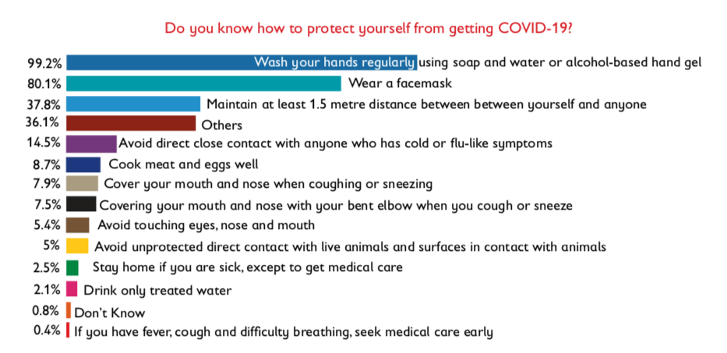
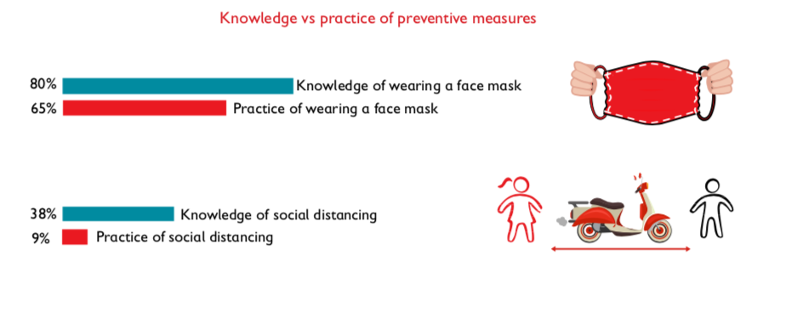
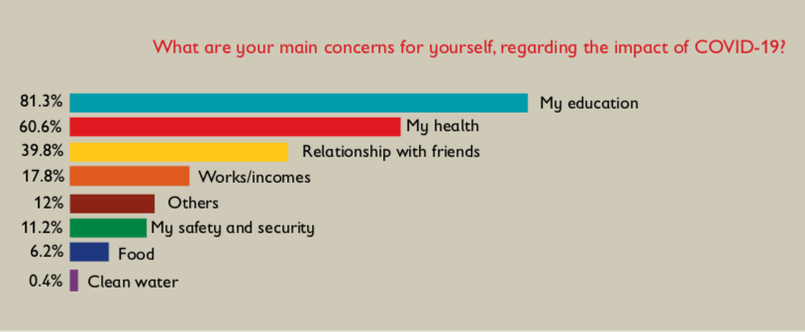
Rules for Risk Communication Messaging about COVID-19
Know what people don't understand or have questions or concerns about
Communicate a threat
Provide a call to action – give people practical advice on what they should do
Explain why what is being said is important
Consider the level of existing knowledge, rumors/misinformation
Consider cultural beliefs and practices
Be realistic and feasible
Update regularly
Notes:
FACILITATOR NOTES
Existing knowledge: Know the level of knowledge people already have about coronavirus so you do not just repeat information they already have. Find out what the gaps in knowledge are and what questions they have about the virus and respond to these.
Communicate the threat: be clear about the danger or risk if people don’t follow the advice, e.g., “if you don’t stay at home you increase your risk of catching coronavirus – and the risk you will infect other people.” This is one the main differences from messaging in development or non-emergencies – in a crisis situation you need to clearly communicate the risk people face. However be careful to strike a balance between COVID-19 being 'deadly' and 'most people will have mild symptoms'. You want people to take it seriously but not feel scared or hopeless.
Provide a call to action: Clear and practical action you want people to take. Providing a call to action tells community members what they can do to achieve the benefit. This could be ‘wash your hands to protect against coronavirus’
Explain why: What do people gain by following your advice? Always explain why you are advocating for a certain behavior, if people understand why it is important to do something they are more likely to do it – for example if people understand that washing their hands before eating stops germs getting from their hands onto their food and into their mouths they will more likely remember than if they just know they should wash their hands before eating, but they don’t know why this is important.
Cultural beliefs and practices: Knowing and understanding the cultural beliefs and practices of the community is very important. Some of these beliefs may act as barriers to what you are trying to achieve. For example in many cultures it is considered rude not to shake hands or kiss on the cheeks when meeting someone. You need to be aware of this in the information you share, explain why these normal practices are dangerous right now, and provide an alternative.
Feasibility: Messages need to provide information that people find useful and/or can act upon. There is no point crafting a message that tells people to do something when the situation on the ground makes it impossible for them to follow that advice. The classic is telling people to wash their hands with soap when there is no soap available. Or telling people living in a refugee camp or slum to maintain a 1-2 metre distance from other people. When we tell people to do something that is not possible for them, they will stop listening to us and feel we do not understand their situation.
Update regularly: It is critical that messages are regularly updated and adapted based on the changing situation and feedback from the community. If people just continue to hear the same information over and over again, they will switch off and stop listening to us.

Slide 30
Shift Tactics for Effective Risk Communication
Tell people what to do
Ask people what they know and think first – then address them with information
Use one-way messages & channels to communicate
Have a two-way conversation with communities
Write messages at the start of the outbreak and don’t update them
Regularly adapt and update information based on community feedback
ENGAGE, ENGAGE, ENGAGE
IFRC, 2020
Notes:
Facilitator Notes:
For effective risk communication we may have to change the way we do things. E.g. instead of telling people what to do, we can ask the community what they know and think first, and then share key health information with them.
Risk communication and community engagement is not about blasting out handwashing messages and raising awareness – we know from Ebola this will not work. Action at the community level will end this epidemic so we as the Red Cross need to listen to their ideas, identify community-led solutions and support these to be implemented.
The situation is always changing. Health messages written at the start of the epidemic may need to be updated regularly as the situation changes. For example, initial messages was that coronavirus is similar to the flu – the aim of this message was to reduce fear and panic, but we are realising now that this leads some people to dismiss it as not serious or important and so they won’t follow measures like staying at home or hand washing.

Slide 31
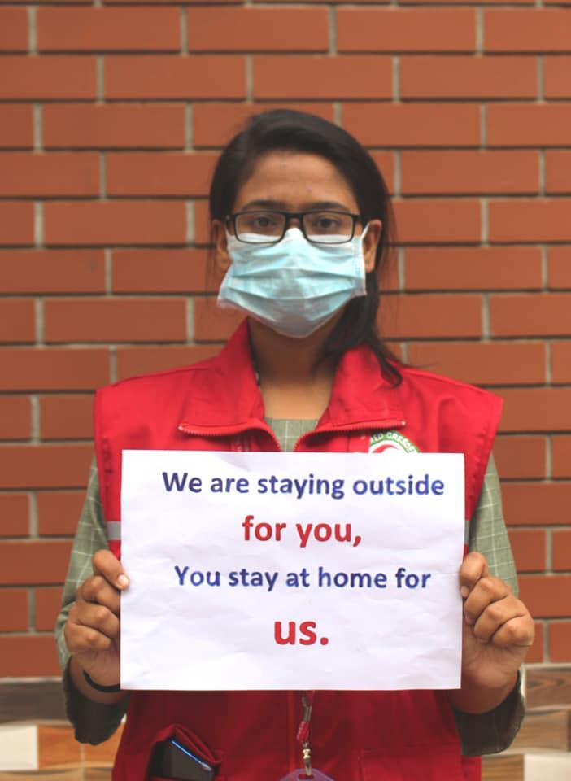
To Choose the Right Channels Consider…
Is it two-way?
How much information can it convey?
How many people can it reach at once?
Is it accessible to different people? Who might be excluded?
Do people trust this channel?
Is it safe in the current context?
Is it in the right language(s)?
Twitter from Bangladesh Red Crescent Society
Notes:
Facilitator notes
How much information can it convey? What information do you need to share? If it is simple messages then SMS will work, but if you want to explain complex issues and engage people in conversation this is not the right channel to use
Reach: Do you need to reach a lot of people quickly – for example to correct a dangerous rumour? If so you need to think about a channel that has mass reach like radio, SMS or social media
Two-way: If you want to ask questions and collect feedback then the channel you choose should allow two-way conversations. For example a hotline, face to face or messenger apps. Radio also an option – but is limited in the amount of feedback you collect in one radio show and not everyone who wants to give feedback will be able to.
Accessible: Can everyone you want to reach use this channel? For example, do people have radios? Batteries or electricity to power them? Can people read? Women, children, disabled or minority language groups might not have access to or use mainstream channels. For example, it might only be appropriate for men to attend community meetings, so you will need to find other ways to engage with women and children.
Trusted: Do people trust the channel? What is the reputation of the channel? Be careful of using state TV if people are suspicious of the government. Or for example, using a religious radio station might alienate members of the community not of that religion.
Context: What context are you working in? Do you still have access to communities? Is it safe for volunteer to access communities? Has there been any instances of violence against health staff?
Language: Does the channel use the right language? People much prefer to share and receive information in their native language so you will have much better impact and engagement if you use local languages.

Slide 32
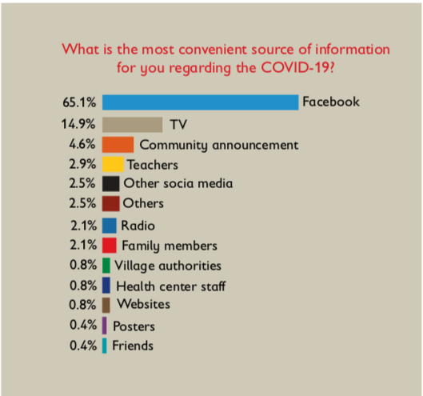
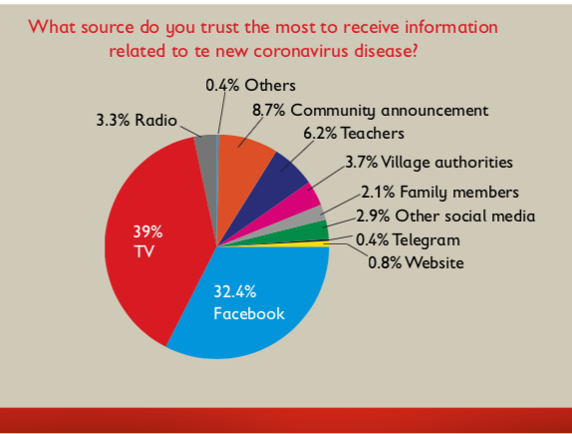
Sample Survey Results: Community Feedback, Channels (Yemen, 2016)
Source: Oxfam, OCHA, Community Engagement Policy Brief, 2016
Notes:
Importance of understanding what the most used, most trusted and most required communication channels are. (The bottom half here is not really relevant to this point so feel free to remove).

Slide 33
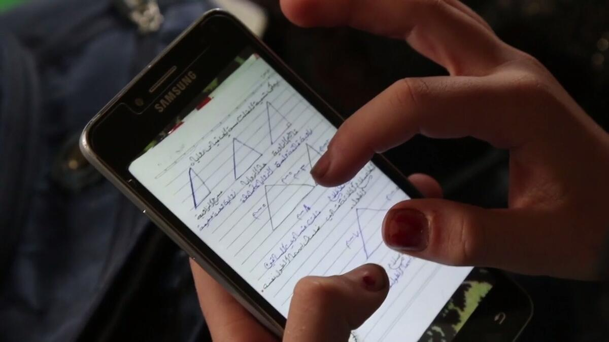
How are People Already Communicating and Adapting?
Are they still communicating with their phones: SMS and voice? Some have Smart phones. Look at what people are doing and how they are communicating, and understand adaptions they are already making,.
Save the Children's partner Syria Relief
Notes:
For example, in Syria/Jordan border, people are still communicating with their phones: SMS and voice. Look at what people are doing and how they are communicating, and understand adaptions to this new reality, how they are perceiving the risk and barriers.

Slide 34
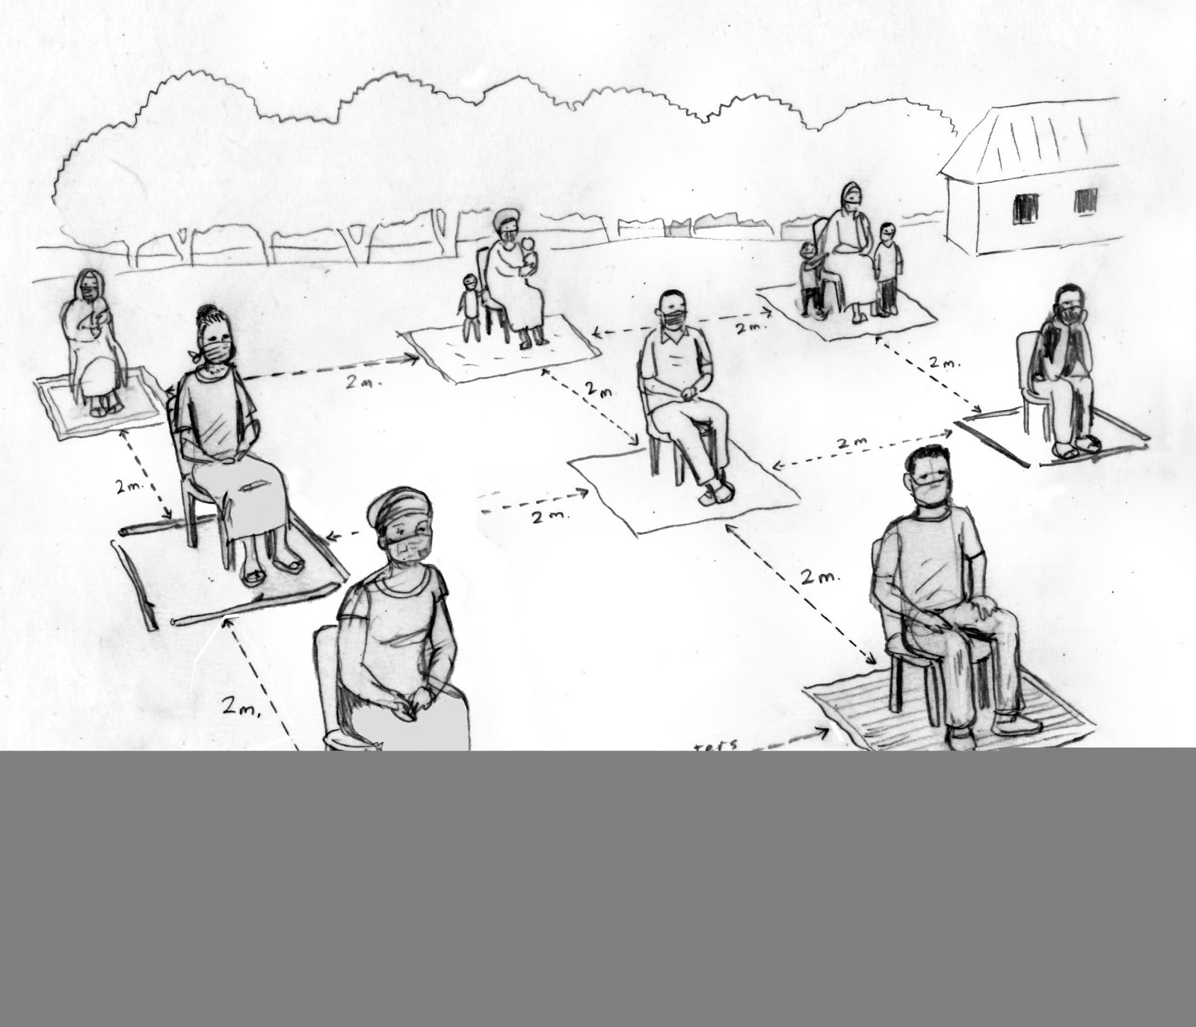
Safe In-Person Community Meetings
1. Ensure participants are not ill or have been exposed to COVID-19. For example:
Ask community leaders to inform community to not attend if ill or were in close contact with someone who was ill in the last two weeks.
Create a simple referral procedure identifying whom to contact and how if a someone feels unwell during the meeting (e.g., a hotline or health post).
2. Maintain physical distancing of between 1-2 meters. For example:
Work with community leaders to select a meeting site that is outdoors and spacious.
Ensure directional flow (1-way flow) to meeting space if meeting is indoors or in a semi-enclosed area with proper ventilation.
3. Avoid typical physical greetings, such as handshakes, kisses on the cheeks or hugs.
Notes:
Optional Considerations Related to Measure 1
Before:
Advise staff they should not participate if they feel ill or were near anyone with COVID-19 in the past two weeks.
Ask community leaders to inform community members to not attend if they feel ill or were in close contact with someone who was ill in the last two weeks. Create a simple referral procedure identifying whom to contact and how if a someone feels unwell during the meeting (e.g., a hotline or health post). Create a simple procedure to report people who are showing systems of COVID-19 (fever, coughing and shortness of breath), which may require investigation. Create a plan to adapt or stop community dialogues in the event of a resurgence of cases or additional public health measures. Plan to have dedicated isolation spaces for people to wait until support arrives if someone is ill during a community meeting. During:
Prohibit participant(s) who display symptoms of COVID-19, such as a cough, fever, or shortness of breath, from attending. Advise them on how to avoid infecting other people within the household. Screen participants by asking them if they feel ill with symptoms of COVID-19, such as a cough, fever, or shortness of breath, or if they’ve come into contact with someone who has symptoms or is ill with COVID-19 within the past two weeks, and take action to prohibit attendance if so.
After:
Refer all suspected COVID-19 cases for investigation/testing if it is possible in that setting.
Optional Considerations Related to Measure 2 Before
Work with formal or informal community leaders to select a meeting site that is outdoors and spacious.
If the meeting needs to be held indoors (e.g., in urban areas), ensure space is or can be ventilated and consider supplying and promoting facemasks.
Ensure directional flow (1-way flow) to meeting space if meeting is indoors or in a semi-enclosed area with proper ventilation. Provide barriers and use chairs, chalk, tape, sticks, mats or any other means to demarcate clear separation of participants to sit or stand at least between 1-2 meters apart.
Restrict number of participants, based on national guidelines and recommendations (e.g., between 5-10 participants and no more than 2 facilitators). Plan to conduct meetings in shifts so the same group of people are exposed only to each other. Limit time duration of meetings to half the time it would normally take for a community meetings. Limit the number of community meetings to not more than 2 per day. Ensure children stay with caregivers and are separated from other adults or children (e.g., using mats and supervising children so they do not roam). Avoid setting up meetings that require travel outside of community or region. If staff and volunteers must travel with public transportation, make personal protective equipment (e.g., gloves, masks, etc.) available to them. Determine essential functions of meetings in advance, and limit meetings to these essential functions only. Plan to conduct part or all of the dialogues using remote options (e.g., interactive radio, WhatsApp discussion groups), where possible. During:
Ensure people are at least between 1-2 meters away from others at all times. Facilitators should also maintain a distance of between 1-2 meters from participants and from each other. Limit the number of people who handle transfer of objects (e.g., food, products) to participants. Discourage private social gatherings (e.g., shared family meals, childcare services) connected to the community meetings. After:
Practice physical distancing on the way home and encourage others to do so.
Optional Considerations Related to Measure 3
During::
Avoid typical physical greetings, such as handshakes, kisses on the cheeks or hugs. Do not touch others, even if socially expected. Engage community members to develop culturally and socially appropriate alternatives and practice new ways to greet people without touching (for example by a slight bow).
Note: Consider handmade sanitizers, tippy taps or other low-tech hand-washing equipment with buckets that collect run-off water. Optional Considerations Related to Measure 4
Before:
Identify priority cleaning supplies to disinfect materials that will be shared, identify who will be responsible for cleaning and ensure they have gloves. Have a supply plan for the following: hand sanitizer, tissues, soap, paper towels, bins for disposable hygiene products, and hand washing stations. Make sure you have enough supplies to cover all meeting participants including staff, volunteers, or any service providers (e.g., food preparation). Ensure hand-washing facilities are near the meeting space, including physical distancing demarcations so people do not group near the stations. Avoid serving food or beverages; If any food or beverage is being served for the meeting, ensure people preparing and serving them wash their hands with soap first and wear masks during food or beverage prep and service, and that single serve portions are handed out individually to reduce transmission.. Ensure gloves are available for serving food or beverages, removing rubbish and other cleaning tasks. Encourage staff and participants to avoid wearing jewelry, watches, or other things that would need to be cleaned afterwards.
During: Clean hands after touching surfaces and encourage others to do the same. If meals or snacks are served, ensure people wash their hands with soap before distributing and eating, and that rubbish is disposed of safely - e.g., using gloves
After:
Clean/disinfect all supplies and materials, pens, megaphone, clipboard, and other items with bleach mixed with water. Immediately wash your hands with soap or use sanitizer. Designate a space for removing and cleaning clothing at home
Alternatives include locally made facecloths, fabrics or scarves people can use as masks [WHO guidance on facemasks}.
Considerations to Promote Respiratory Etiquette
Before
Learn global WHO, national and local guidelines for wearing facemasks in public; even if not mandatory, consider having something available should people elect to use them (e.g., extra fabric that can be used as masks, or locally produced offerings). Train staff, local partners and community leaders on COVID-19 transmission, signs/symptoms, public health and social measures (e.g., hand-washing, respiratory etiquette, physical distancing). [Refer to Tips for Engaging Communities during COVID-19 in Low-Resource Settings (WHO, UNICEF, IFRC) for remote options].
During:
If you are staff, wear facemasks to in part reduce fear that you are spreading the virus. Encourage participants to wear them or alternative fabric offerings (or, ensure they are worn if mandated by the government).
Considerations to Promote Respiratory Etiquette
Before:
Conduct a rapid perception survey to understand the community’s knowledge, perceptions, rumors/misinformation, and concerns about the new public health and social measures.
Adapt messaging guides and materials to reflect new PHSMs and to ensure people continue to practice essential protective behaviors. These will depend on the context, but in general these may include physical distancing (from 1-2 meters), respiratory etiquette (perhaps including facemasks), hand washing with soap, and avoiding touching your face.
Adapt materials to large format (posters and banners) to maintain distance. Work with national and/or sub-national RCCE coordination working groups to ensure harmonization.
Recruit trusted celebrities, community and religious leaders, existing community groups, media and radio stations to support making the nation’s new PHSMs more desirable.
Work with community leaders to provide information on COVID-19 at-risk populations to all participants so they may make an informed decision on attendance due to personal risks.
As services begin to open up, engage the community to reduce fear of going to a health facility with symptoms other than associated with COVID-19, to reduce delays in seeking care and to promote safe care-seeking. Procure signage and other notices related to hygiene procedures, adapted to local language and literacy levels – ensure these are large format. Procure community feedback on these meetings and measures, and adapt to align with safety protocols and cultural, social norms. Make sure that vulnerable populations understand the risks of not being shielded.
During:
Orient participants on COVID-19, its risks and transmission routes, clinical signs and symptoms, vulnerable population groups and the steps to take to limit spread and transmission (depending on the context, this may include respiratory etiquette, hand hygiene, public physical distancing, use of facemask, etc.). [For example, see GOAL’s body mapping and disease spread exercises in Community-Led Action (CLA) for COVID-19: A Field Manual for Community Mobilizers]
Engage the community to define challenging in maintaining or practicing Explain the meaning of physical distancing during the event. Remind participants to follow safety guidelines throughout the meeting. Leave behind leaflets in local language, with graphics considering literacy levels.
Display large format signage and posters on handwashing and hygiene etiquette. Provide supplies to sanitize objects or surfaces when interacting with them.
After:
Share information on best practices on safety protocols for community dialogues to other implementers.

Slide 35
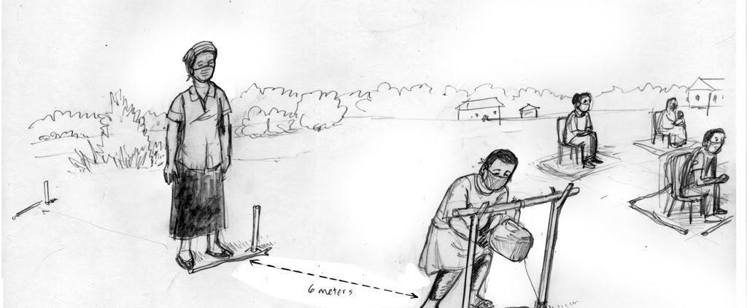
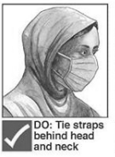
Safe In-Person Community Meetings
4. Ensure optimal hygiene practices, placing hand-washing facilities near the meeting space. For example:
Include physical distancing demarcations near hand-washing stations so people do not group near the stations.
Avoid serving food or beverages; If any these are being served, ensure people preparing and serving them wash their hands with soap
5. Practice and promote respiratory etiquette. Provide facemasks if facemasks are mandatory in-country. For example:
If you are staff, wear facemasks to in part reduce fear that you are spreading the virus.
Encourage participants to wear them or alternative fabric offerings (or, ensure they are worn if mandated by the government).

Slide 36
Promote Prevention and Safety As Movement Restrictions are Being Lifted
Sample Considerations
Conduct a rapid perception survey, include concerns about the new public health and social measures.
Adapt messaging guides and materials to reflect new measures and to ensure people continue to practice essential protective behaviors. Adapt materials to large format (posters and banners) to maintain distance.
Make sure vulnerable populations understand the risks of not being shielded.
Work with community leaders to provide information on COVID-19 at-risk populations to participants so they may make informed decisions based on personal risks.
As countries begin to open, engage community to reduce fear of going to a health facility, to reduce delays in seeking care and to promote safe care-seeking.
Procure signage and other notices related to hygiene procedures, adapted to local language and literacy levels – ensure these are large format.
Procure community feedback on these meetings and measures, and adapt to align with safety protocols and cultural, social norms.

Slide 37
Collecting and Acknowledging Community Feedback

Slide 38
Community Feedback – Concerns and Misinformation
Collect and address community feedback, concerns and misinformation. This is paramount to building and maintaining trust.
Focus on adapting COVID-19 messaging and programming based on community feedback, and behavioral and social evidence, aligned with country context.
Coordinate with humanitarian actors collecting feedback, concerns, and misinformation—and response teams and humanitarian actors that can help solve these concerns (e.g., WASH, malaria programs, food security).
Report back to communities, set realistic expectations.

Slide 39
Additional Considerations for COVID-19
Fear, helplessness, denial, complacency
Vulnerable populations
Lack of trust
Vaccines and antivirals
Isolation/quarantines
Rumors and misinformation
Death & grievance
Stigma
Overwhelmed health systems and lack of supplies
Conflict
Notes:
There are many additional key considerations for RCCE in an Outbreak response.
Refugees, IDPs and migrants, particularly those in irregular situations, may be fearful of reporting health conditions and accessing needed treatment. In many countries, refugees and migrants do not have access to national health, education or social security schemes, leaving them unable to rely on the response offered to nationals. Refugees, displaced people and other marginalized groups may also experience xenophobia or a de-prioritization by government security services. Tensions between host communities and refugees/IDPs may arise.
Children outside of family care, such as street children, children on the move, and children in institutions or in detention centres, are particularly vulnerable, including to discrimination within the community.
may cause children to be at heightened risk of being separated or unsupervised for longer periods, suffer neglect and increase their risk of being abused or exploited, including girls who can fall victim of sexual and gender-based violence.

Slide 41
Thank you!

Slide 42
Risk Communication and Community Engagement Toolkit: https://www.ready-initiative.org/covid-19-risk-communication-and-community-engagement-toolkit-for-humanitarian-actors/

