Slide 1
READY: GLOBAL READINESS FOR MAJOR DISEASE OUTBREAK RESPONSE
Thacien Biziyaremye / Save the Children
Rumors & Misinformation – COVID-19

Slide 2
ADDITIONAL CONSIDERATIONS FOR RCCE
IN AN OUTBREAK RESPONSE
Complacency
Vulnerable populations
Lack of trust
Vaccines and antivirals
Isolation/quarantines
Rumors/misinformation/ Community feedback
Death & grievance
Stigma
Community engagement, lack of protective supplies at community level
Conflict
Notes:
Lack of trust and misinformation, a lot of conflicting information
Vulnerable groups: refugees, children, elderly people, people living with disabilities
Conflict
Isolation/quarantine

Slide 3
WHY IS TRACKING RUMORS/MISINFORMATION AND CONCERNS IMPORTANT?
Rumors thrive when there is less certainty about an issue.
Rumors are a “social barometer” that can give us insight into how people are thinking or feeling about COVID-19.
Notes:
The motivations for creating, sharing and amplifying rumors may vary from something as simple as trying to be helpful to needing to feel some sense of control in stressful times to wanting to position oneself as being “in the know” or even intentionally misleading (for economic or political gain).

Slide 4
ABC International Development has released their latest look at social media rumors in the Pacific. This edition covers conversations collected from 24 popular Facebook groups in April and May and shows conversations have moved to focus on the economic impacts of the crisis.
As infections reduce in some countries, the discussion has turned to fears of a ‘second wave’ of infections.

Slide 5
WHY WE MUST ADDRESS RUMORS/MISINFORMATION
Can affect trust in the response
Can lead to risky behaviors
Can also undermine accurate health information
Can provide honest feedback on our work
Can affect the safety of staff, volunteers and the community

Slide 6
STEP 1: COORDINATE
Bring together partners working on similar issues to share information and avoid possible message conflict.
Tasks could be split on the comparative strengths/geographical presence of different partners.
Information-gathering, analysis and outflow can be more coordinated and impactful.
For example, the Eastern and Southern Africa regional Risk Communication and Community Engagement (RCCE) coordination hub is organizing a region-wide community feedback/rumor tracking mechanism led by Sharon Reader/IFRC.

Slide 7
STEP 2: IDENTIFY, LISTEN AND DOCUMENT
Identify the channels where rumors are shared: e.g., through community conversations, discussions with key informants (health workers), social media posts such as WhatsApp and Facebook. Establish a system to document rumors from different people through multiple channels.
For example:
Volunteers
Radio call-in show
Media monitoring (traditional and social media)
Key informant interviews, focus groups discussions
Rapid assessments, surveys
Community groups and leaders
Community meetings or house to house visits
Health hotlines
Notes:
Listening to your community/ public is essential to understand what they are worried about, what information they believe, concerns they have and rumors they’ve heard around coronavirus. Make sure to pick people who represent the diverse and dynamic groups within the community – this will enable you to develop a network that reaches deep into the community.
Identifying rumours is not as simple as asking people ‘what rumours have you heard’. People may believe a rumour to be true and therefore not even consider it a rumour, or people may not trust you as someone to discuss this with. To effectively listen to rumours, you need to:
• Build on existing and trusted relationships as ways to listen.
• Ensure you can listen to the language the community is most comfortable using.
• Have open and unstructured conversations with the community
• There are lot of channels for collecting rumours.

Slide 9
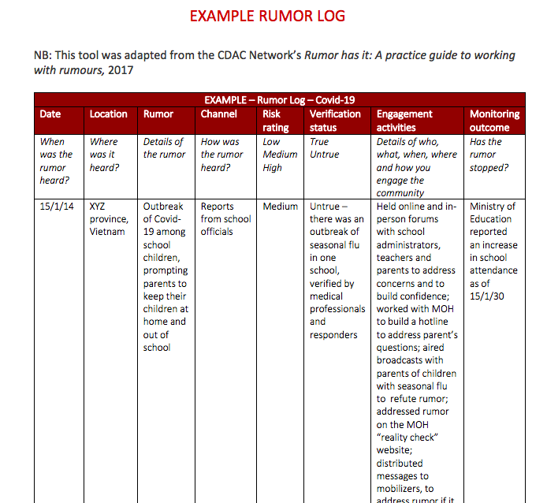

Slide 10
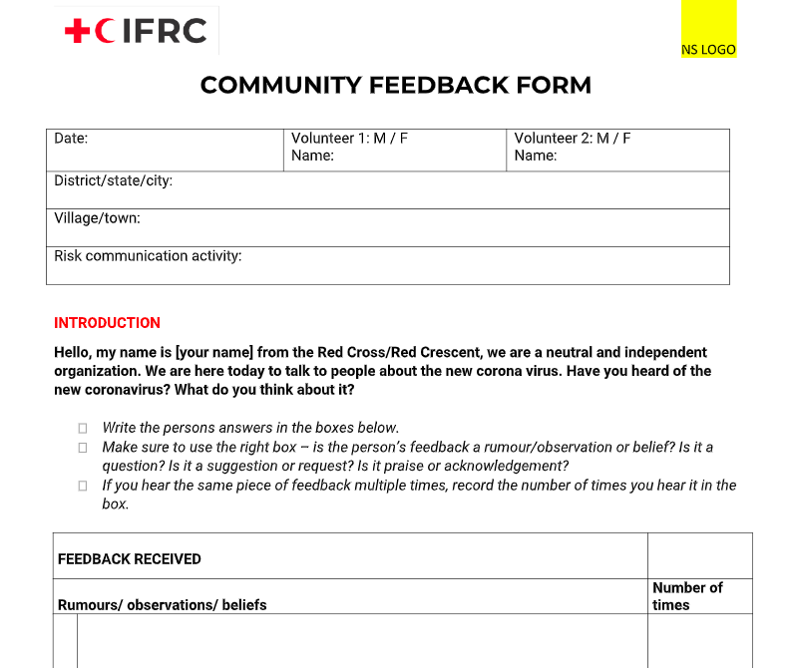

Slide 11
STEP 3: VERIFY AND UNDERSTAND THE UNDERLYING CAUSES
Understand the causes, underlying issues and concerns and consequences of rumors / misinformation to help with the response
What about the rumor is true or false?
Check with the experts and get the facts
Speak to the community to understand more, e.g., understand not just the rumors but their concerns
Be careful not to spread rumors
Notes:
Importantly, consider how they know what they know and don’t be afraid to ask them that. You don’t want someone’s opinion; you want the facts, so it is helpful to consider a person’s qualifications, position, interests and biases.
1. Explain to your contact that you are verifying a rumour, which may or may not be true, and explain the rumour that you have heard.
2. Ask them what is true/untrue20 about the rumour and to state in simple terms the facts and how they know them.
3. Ask for any supporting documentation, or where members of the community could get more information.
4. Repeat to them what you have heard to check that you have understood correctly. You should finish with a clear understanding of the facts – if you aren’t sure ask again.
• Understanding what triggered the rumour can help you plan a response and prevent it from being repeated. For example, did the rumour start because a badly worded message? Something a volunteer said? A Government announcement? Or because of the way we carried out activities – for example around safe and dignified burials?

Slide 12
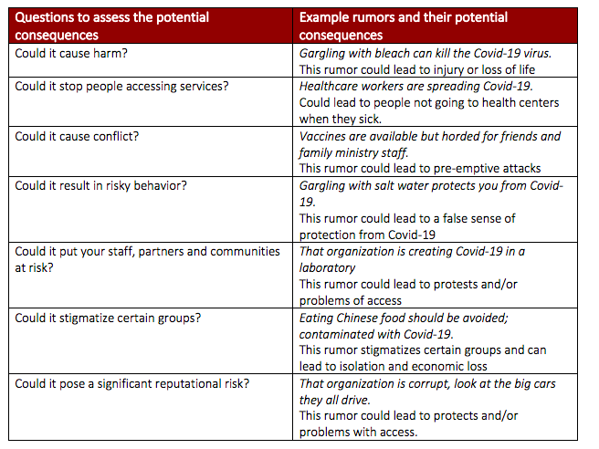

Slide 13
STEP 4: STRATEGIZE, ENGAGE AND RESPOND
Prioritize rumors to be addressed based on potential consequences.
Identify audience and use appropriate language. Respect local customs and culture.
Develop and pre-test materials / messages with members of target populations,.
Provide all staff with FAQs. Give accurate and actionable information. Use familiar language(s) and words.
Disseminate new information through multiple trusted channels, such as radio, social media, and with partners to ensure wider reach and consistency.
Notes:
Responding to rumours
• Don’t just ignore or deny the rumour. Replace it by sharing factual information through trusted communication channels using words and the language that the community best understand
• Check that the messages and the new narrative are being received,
• Make sure all staff and volunteers, especially community mobilizers are regularly informed about the latest rumours and how they should respond if they hear them.
• Respect local beliefs! For instance, a common rumor during the Ebola outbreak was that Ebola is caused by witchcraft; the conventional response was to refer to Ebola as a virus. However, more useful would have been to accept this alternative explanation and create recommendations consistent with community mind-set (e.g., don’t touch this person unprotected, but provide food [and prayers] as a token of empathy).

Slide 14
EXAMPLES OF COLLECTING RUMORS, CONCERNS
Ground Truth Solutions has been surveying a number of communities in countries including Uganda, Syria, and Iraq to measure information access, behaviors, trust, and the economic impact of COVID-19. These perception surveys make interesting reading to understand the community’s feelings towards the crisis and how they change over time and are a great source of information for humanitarian responders and story ideas for journalists.
CARE International’s Turkey office implemented a helpline system to respond to concerns about COVID-19. Given the two-way communication functionality of the helpline, CARE uses this channel both to collect data on sources of information, myths, and misconceptions on COVID-19 and to address refugees’ questions, needs, and concerns.
In Libya, an inter-agency call center named Tawasul 1414, recently launched by the Emergency Telecommunications Sector in Tripoli, is being used by the National Centre for Disease Control (NCDC) as the national COVID-19 hotline, serving a dual purpose of providing people information on COVID-19 and providing trends and analysis to health partners to inform decision making.

Slide 15
EXAMPLES OF ADDRESSING RUMORS
UNHCR coordinated with Jamjang FM radio in South Sudan to disseminate information on COVID-19 prevention, including a talk show that brings on board medical doctors from UNHCR and partners. Programs also run to respond to questions, quash rumors, and address misconceptions about COVID-19.
A series of community radio sessions on COVID-19 are delivered in two districts in Zambia, with Q&A sessions addressing myths and misinformation. These are produced through a partnership between MAMaZ Against Malaria at Scale and the District Health Management Teams.
For example, some communities were concerned they couldn’t follow handwashing protocols because they are unable to afford expensive medicated soap when ordinary soap, which is much cheaper, is perfectly adequate.
Harmful ideas about COVID-19 being a disease that only affects foreigners were also countered in the Q&A sessions.

Slide 16
Click here for READY’s Risk Communication and Community Engagement for COVID-19 Toolkit

