Slide 1
READY: GLOBAL READINESS FOR MAJOR DISEASE OUTBREAK RESPONSE
Sonali Chakma / Save the Children
STAFF HEALTH ESSENTIALS IN A PANDEMIC
Health workers in Cox's Bazar learn how to use personal protective
equipment for the COVID-19 isolation and treatment unit

Slide 2
OBJECTIVES
Why is staff health essential, and what are the key principles?
Whose role is it and what are their responsibilities?
Communication for staff
Identifying staff risk
Caring for isolated and unwell staff
Mental health and psychosocial support
Signposting key resources

Slide 3
WHY IS STAFF HEALTH ESSENTIAL?
Duty of care to staff and their families
Vital to ensuring that we do not become part of the problem
Helps ensure business continuity
Use this space to discuss the current COVID-19 situation in your region
X cases
X deaths
Additional details
Additional details
Additional details

Slide 4
KEY PRINCIPLES
All guidance should be in line with the national Ministry of Health and Public Health Authorities guidance and directives
Collaboration and coordination with others:
Local coordination structures
World Health Organisation
Key partners
Regional and international head offices
Insurance and healthcare service providers
Notes:
As Donatella mentioned there are severe restrictions, be realistic about what we can do – not just in terms of response but also for our staff

Slide 5
WHO’S ROLE IS STAFF HEALTH?
EVERYBODY’S!
Country Director
Senior Management Team
Security
Human Resources
Office staff
Community workers
Healthcare workers

Slide 6
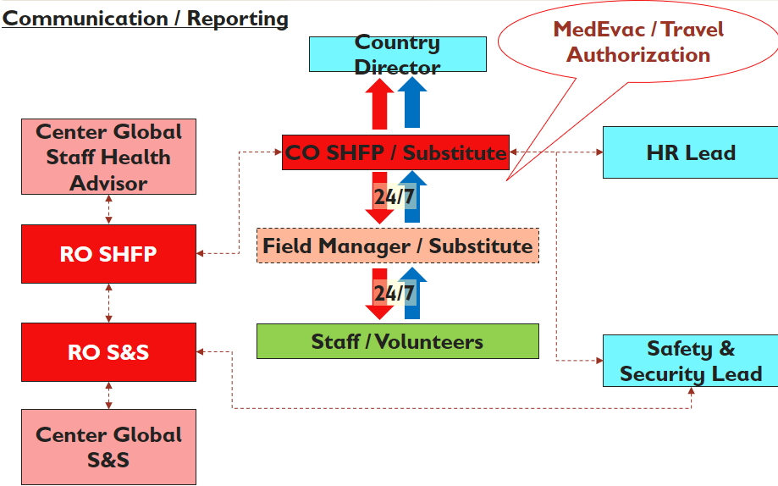
STAFF HEALTH POLICY
Disease and country specific
Aligned to national and international guidelines
Applies to all areas of organizational responsibility, including office, staff accommodation, transport and travel, community work, health facilities
Sets out individual and organisational responsibilities
Establishes communication channels
Sets up Staff Health Focal Points
READY: GLOBAL READINESS FOR MAJOR DISEASE OUTBREAK RESPONSE

Slide 7
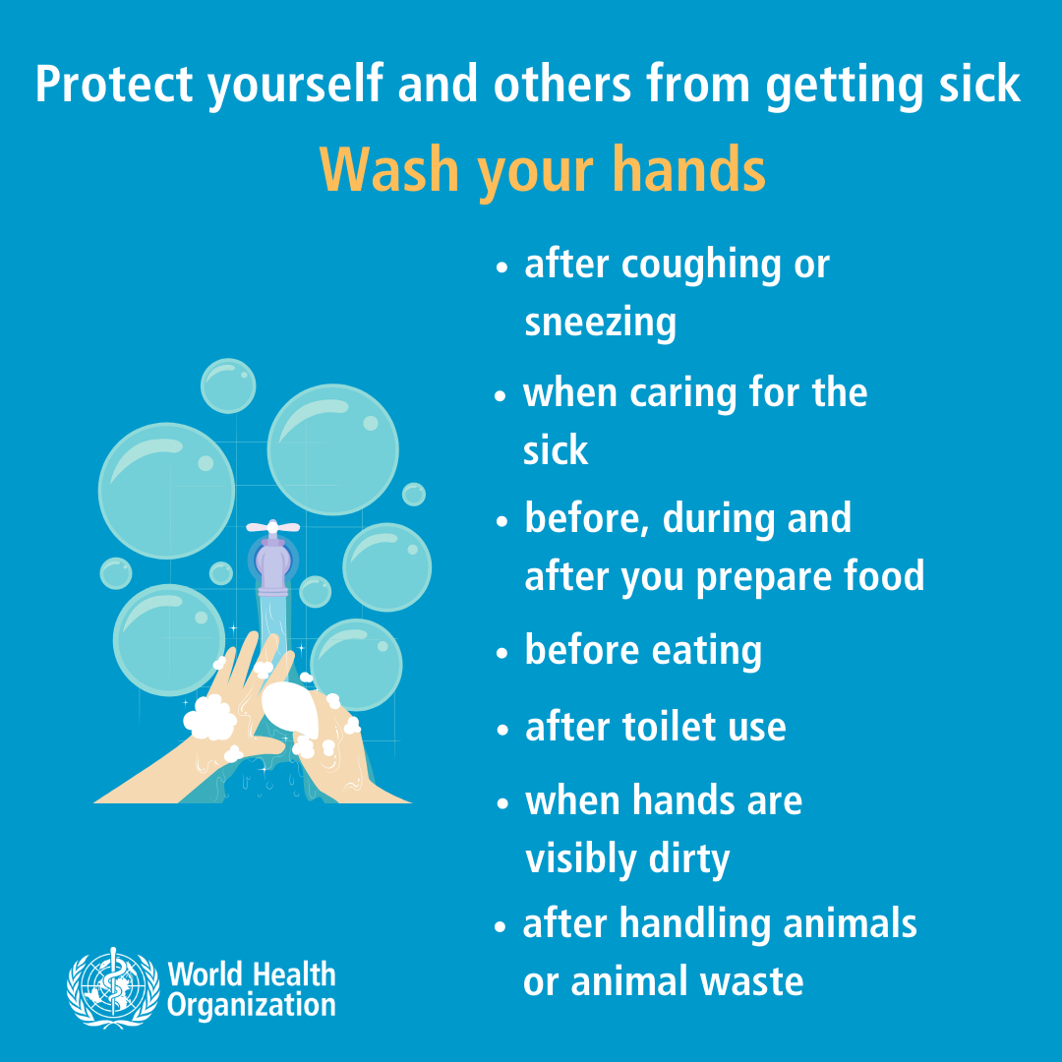
COMMUNICATION FOR STAFF
Key information (in appropriate language):
What the disease is
Signs and symptoms
Protecting themselves and their loved ones
What you are doing as an organization to protect staff
What to do if they get sick
Awareness of staff health policy and their local staff health focal point
Establish clear communication channels
Provide opportunities to ask questions and raise concerns
Be aware of emerging rumors and empower staff to be able to counter misinformation in their communities
Notes:
Be honest and clear about restrictions, be clear to staff about what we can do

Slide 8
IDENTIFYING STAFF RISK
Environment:
Individual:
Geographic risk
Level of community spread
Government response
Work environment
Local practices and customs
Population density
Role and area of work
Home working
Office based
Community based
Clinical area
Individual vulnerabilities
Over 70 years old
Co-morbidities, e.g., diabetes
Pregnancy
Carer for vulnerable person

Slide 9
PERSONAL PROTECTIVE EQUIPMENT
Follow national public health authority directives
If used incorrectly, may inadvertently increase risk
Must be accompanied by appropriate guidance
Medical grade masks should be reserved for frontline response workers
Basic messaging should focus on:
Social distancing
Handwashing
Cough hygiene
Avoidance of touching the face
Infection prevention and control

Slide 10
SUSPECTED OR CONFIRMED COVID-19 CASES
MILD symptoms
Moderate to severe symptoms
Self-isolation should be mandatory
Ensure access to food, water and essential medications
Allocate ‘buddy’ for regular check-in
Adhere to national guidelines on accessing testing
MHPSS support
Consider medivac of international staff if possible and appropriate
Treatment facility and referral process identified in advance
Medivac options discussed with senior management, relevant national bodies and WHO
RESPECT CONFIDENTIALITY

Slide 11
MENTAL HEALTH AND PSYCHOSOCIAL SUPPORT
Increased risk for all staff, particularly those working in high risk settings or in self-isolation
Increased levels of fear and anxiety
Disruption to daily life
Access to supplies
Financial concerns
Caring for others
Media overload
Isolation and lack of support networks
Negative coping strategies
Increased risk of SGBV
Notes:
Fear and anxiety in normal – when excessive, impeding in ability to function and leading to negative coping strategies that it becomes an issue
Frontline workers – particular concerns around their families and the risks they maybe posing; witnessing high numbers of deaths and people in distress, stigmatisation

Slide 12
HOW CAN WE SUPPORT?
Stay connected
Recognise the need for supportive and flexible HR strategies
Access to Psychological First Aid materials and online training
Train managers to identify warning signs
Have defined referral pathways for at risk staff
Encourage peer-to-peer support systems
Creation of social space for staff, utilising social media
Recognise the link with physical wellbeing, encourage exercise and sleep
Notes:
Stay connected – earlier discussion on communication is key here - provide regular updates and give staff opportunities to raise and discuss concerns
HR practices – recognise that children at home, clinical staff feeling pressure to work on frontline response, homeworking arrangements, other pressures may increase need for flexible hours
Referrals and resources – where possible ensure culturally appropriate, recognise that there is no one size fits all solution, people will have different levels of resilience dependent on many factors, give access to wide range of resources
Working from home – difficult to switch off, competing demands etc

Slide 13
SUMMARY
Staff health is the essential first step to ensuring we can continue to operate safely in an outbreak
Everyone in the organization carries a responsibility for ensuring we keep staff and beneficiaries safe
Good communication is key to implementation
There must be clear policies in place for supporting isolated and unwell members of staff and their families
Fear and anxiety are normal reactions to this situation. but we must have clear referral systems for those for whom this becomes overwhelming
Notes:
Communication key to ensuring adherence and helping staff remain connected

Slide 14
KEY RESOURCES
World Health Organisation: https://www.who.int/emergencies/diseases/novel-coronavirus-2019
European Centre for Disease Control: https://www.ecdc.europa.eu/en/novel-coronavirus-china
US Centre for Disease Control: https://www.cdc.gov/coronavirus/2019-ncov/index.html
Public Health England: https://www.gov.uk/coronavirus
IFRC: https://go.ifrc.org/emergencies/3972#additional-info

