Slide 1
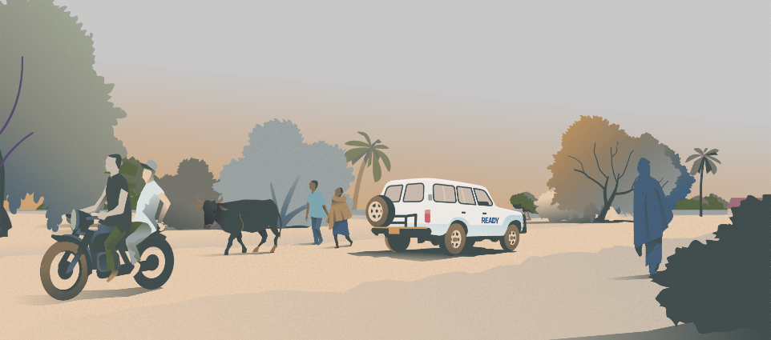

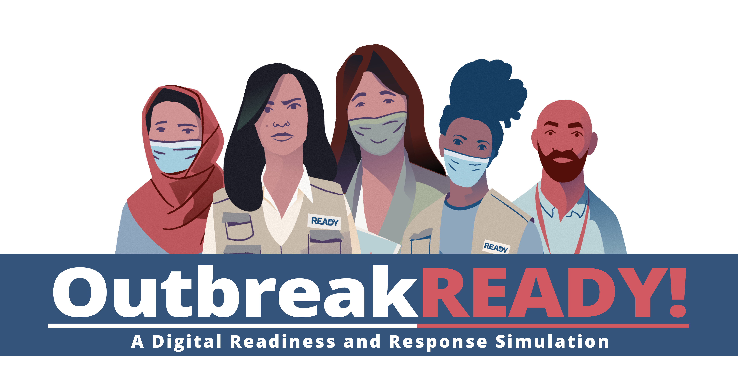


Slide 2


YOU WILL SEE THE SCREEN BELOW, WITH THE LOADING BAR BELOW.
PLEASE MAKE SURE YOUR COMPUTER IS PLUGGED IN AND CHARGING.
LEAVE YOUR COMPUTER OPEN TO THE WEBPAGE.
PLEASE DO NOT CLICK "START SIMULATION" YET.

Slide 3

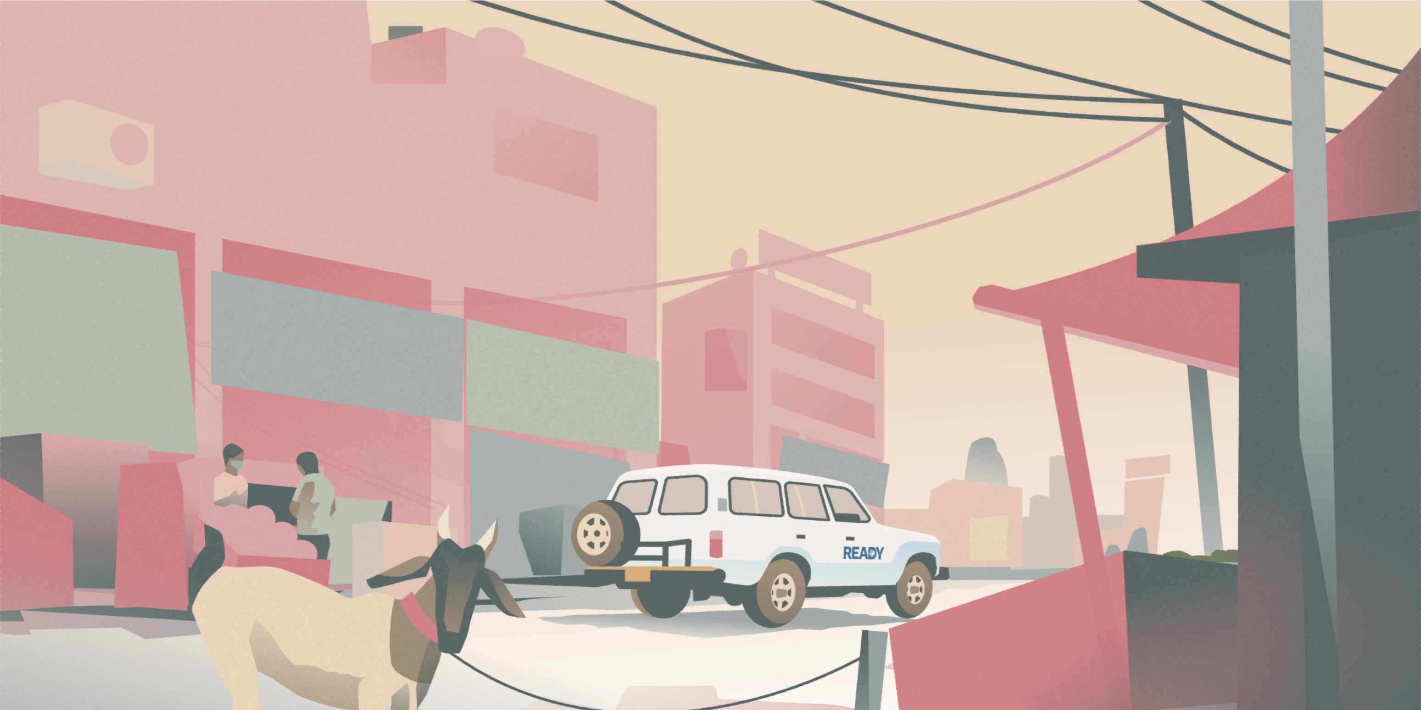

TROUBLESHOOTING GUIDANCE
Ensure you have the right URL: www.outbreakready.com
If you see a white screen that says “Can’t load this page” or “Can’t reach this page”,
please refresh the page.
Ensure you are opening the URL on a supported browser: the sim is supported on
Google Chrome, Microsoft Edge, and Firefox.
Ensure most updated version of browser is being used: the sim is supported on the
latest and one-before the latest versions of Google Chrome, Firefox, and Microsoft Edge.
Try opening the simulation in an ‘incognito’ window.
The initial splash screen may take time to load, depending on internet speed.
If participants are able to see the previous screen, then they have access and must
wait for the progress bar to load before clicking "Start Simulation".
Try opening the simulation in an ‘incognito’ window.
READY: Global Readiness for Major Disease Outbreak Response

Slide 4





SIMULATION AGENDA
1
INTRODUCTION
4
BREAK
2
PLAY OUTBREAK READY! (TURNS 1-3)
5
PLAY OUTBREAK READY! (TURNS 4-7)
3
DEBRIEF
6
GROUP DISCUSSION

Slide 5


QUIZ TIME!
Q1: How would you describe the political climate of Thisland?
Q2: What is the relationship
between Thisland and Neighborland?
Stable. All conflict has ceased since recent elections
and the new government is widely celebrated for
eliminating corruption.
The two countries have a shared border, history, and ethnic and cultural ties.
Unstable. Tensions remain, corruption is rampant, and the new government is limited in its capacity and perceived legitimacy.
These countries are largely isolated from each other due to natural barriers.
Neighborland does not exist.
Active conflict. There is no recognized government and fighting has escalated to the point of civil war.
Q3: Where is Murelle located?
Q5: What is the primary reason that READY established a suboffice in the city of Murelle?
Q4: Approximately how many Thislanders were internally displaced during the recent conflict?
Along the eastern coast.
In the northeast of the country.
A substantial increase in funding and donations.
In the Western Province.
280,000 total; 150,000 northeast and 130,000 southeast.
Security concerns in the capital of Myro.
60,000 to the southern coast.
A large influx of internally displaced persons in Murelle’s urban area as well as several informal settlements surrounding the city.
130,000 to the Western Province.

Slide 6


HOW TO PLAY
There are NO “right” or “wrong” choices, and you CANNOT win or lose the simulation!
Purpose to reflect on what is the best choice given the context
Simulation structured in 7 “turns” – every “turn” simulates a day in the office
Overtime - check your To Do list
Fast paced, unable to read all the information provided
Timing prompts given throughout the simulation
Beginning of turn 1, time to read the background documents in File Explorer – suggest starting here
There is a page inside the simulation which gives instructions on how to navigate the interface

Slide 7

HOW TO PLAY
Please do not click the back button no your browser or click out of the simulation
Restart the game at the beginning of the turn that you were previously in
How to mute the simulation (headphones)
Please make sure your computer is charging
If you have questions at any point, please raise your hand
What questions do you have?

Slide 8
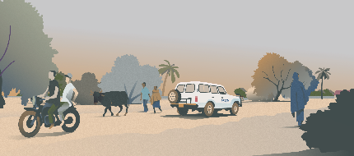
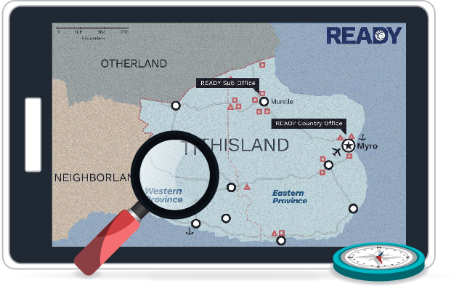
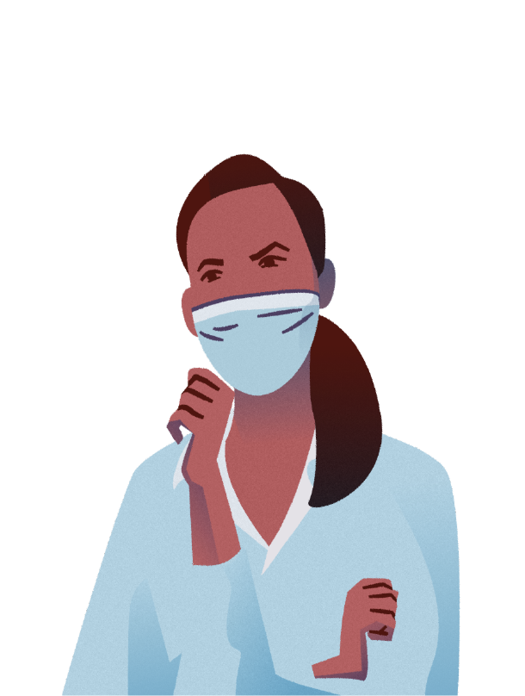
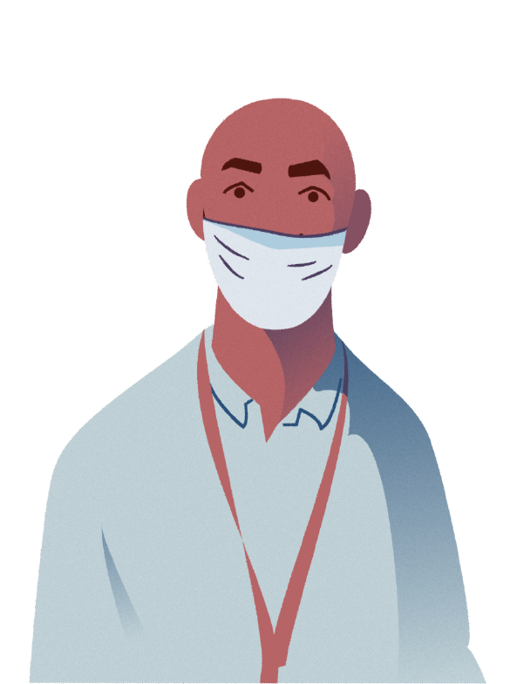
WELCOME TO THISLAND

Slide 10



Slide 11
BEGIN PLAYING

Slide 12
BRIEFING SCREEN
WEEK THREE

Slide 13
BRIEFING SCREEN
WEEK FIVE

Slide 14
PAUSE PLAY
WHEN YOU ARRIVE AT BRIEEFING SCREEN – WEEK NINE

Slide 15

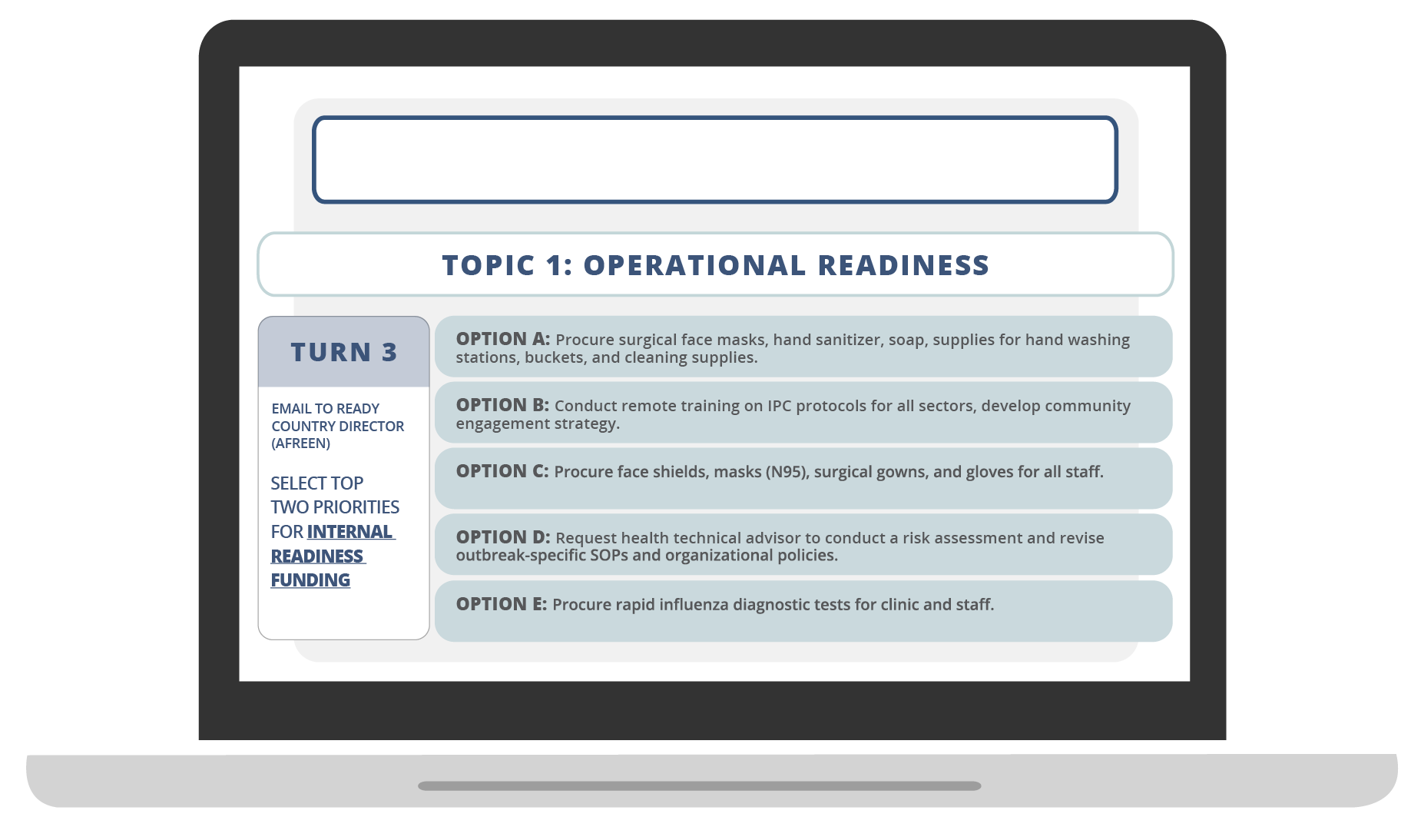
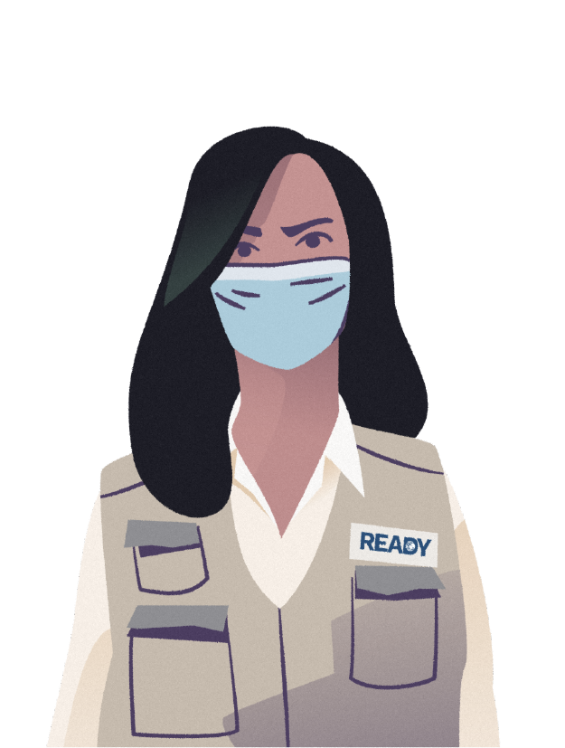
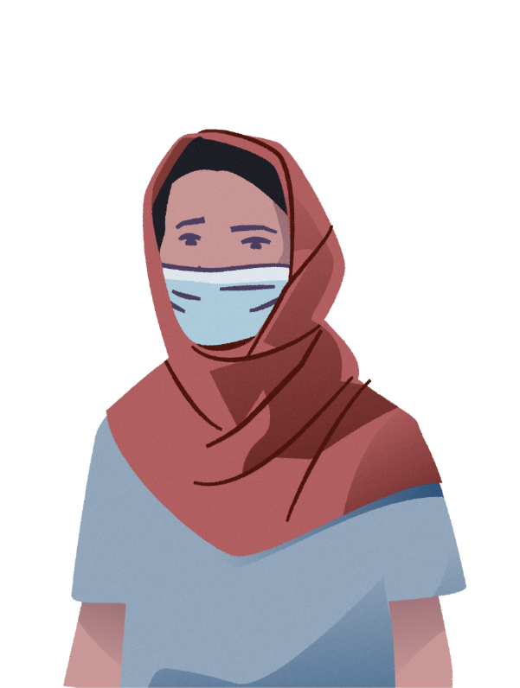
TEAM MEETING
SLIDE TWELVE

Slide 16
RESUME PLAY
BRIEFING SCREEN – WEEK NINE

Slide 17
BRIEFING SCREEN
WEEK THIRTEEN

Slide 18
BRIEFING SCREEN
WEEK TWENTY-ONE

Slide 19
BRIEFING SCREEN
WEEK THIRTY-ONE

Slide 20
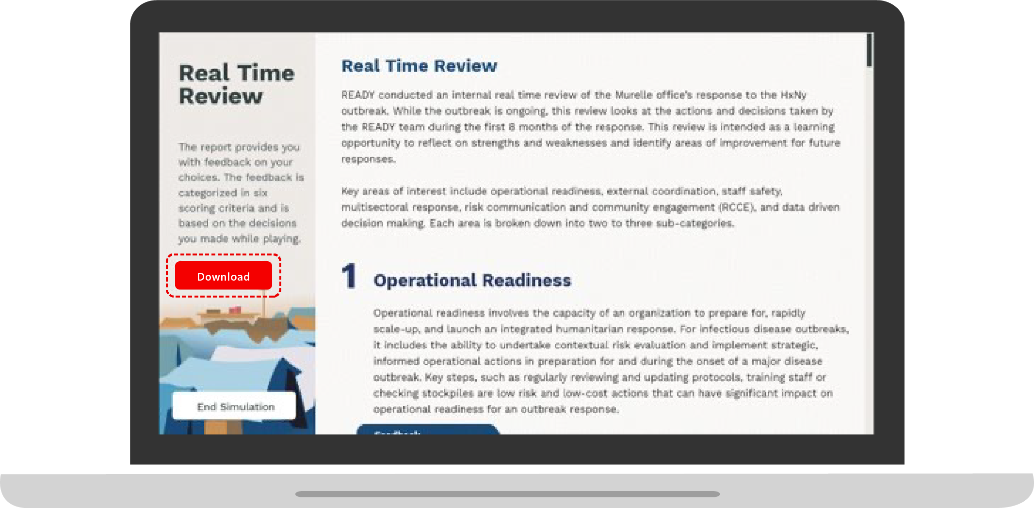
REAL TIME REVIEW
DOWNLOAD THE REAL TIME REVIEW REPORT
This report provides you with feedback on
your choices. The feedback is categorized in six scoring criteria and is based on the decisions you made while playing.

Slide 21

BRIEF SURVEY
TAKE THE SURVEY
Please take 5 minutes to complete a brief Survey about your experience with the Outbreak Ready Simulation.

Slide 22

GROUP DISCUSSION

Slide 23
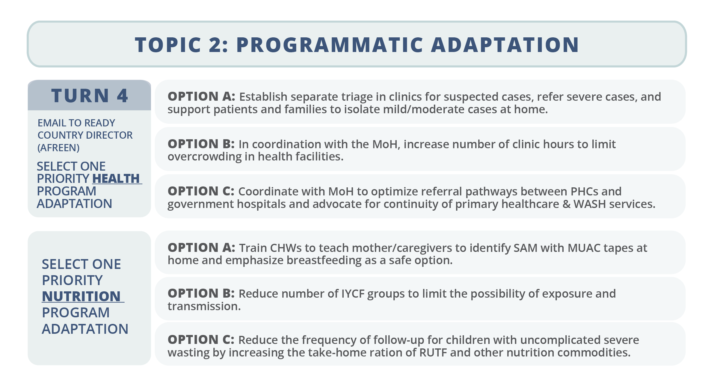
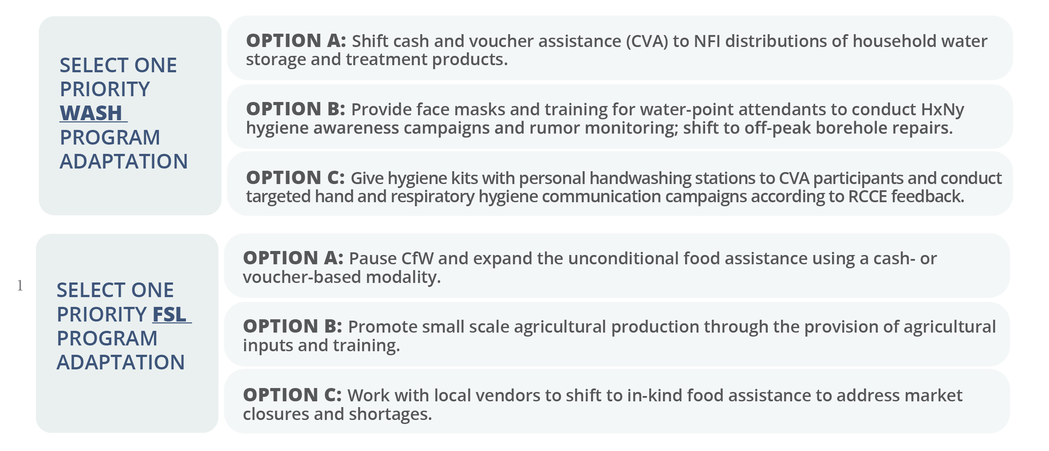
TOPIC TWO
PROGRAM ADAPTATION
(TURN 4)
SLIDE TWELVE

Slide 24
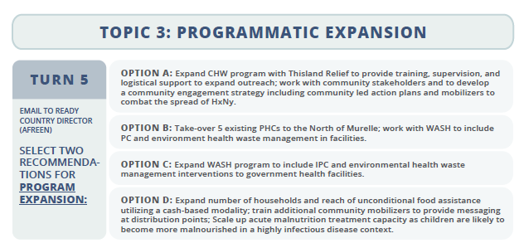
TOPIC THREE
PROGRAM EXPANSION
(TURN 5)
SLIDE TWELVE

Slide 25
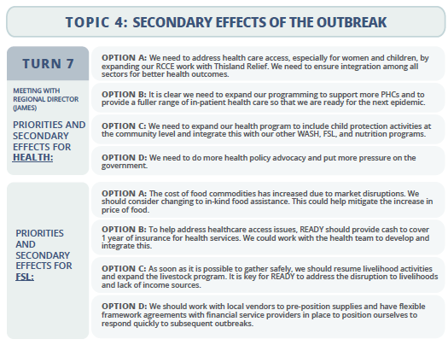
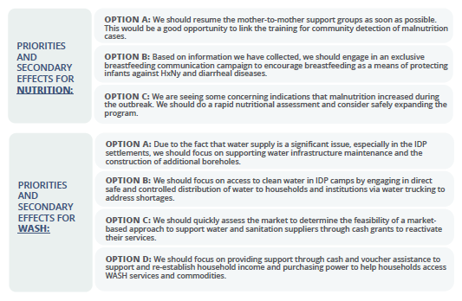
TOPIC FOUR
SECONDARY EFFECTS
(TURN 7)
SLIDE TWELVE

Slide 26
GROUP DISCUSSION

Slide 27
ACTION STEPS
What action steps can you take to improve your/your organization's operational readiness for an infectious disease outbreak?

Slide 28


ADDITIONAL RESOURCES
You can access Outbreak READY!, Outbreak READY 2!, and other training tools via the READY website here: www.ready-initiative.org.

Slide 29
THANK YOU FOR PLAYING!
You can access Outbreak READY! and other training tools via the READY website here: www.ready-initiative.org.
The simulation is also available in French and Spanish.
Want more of the READY universe? Check out Outbreak READY 2!

