Slide 1
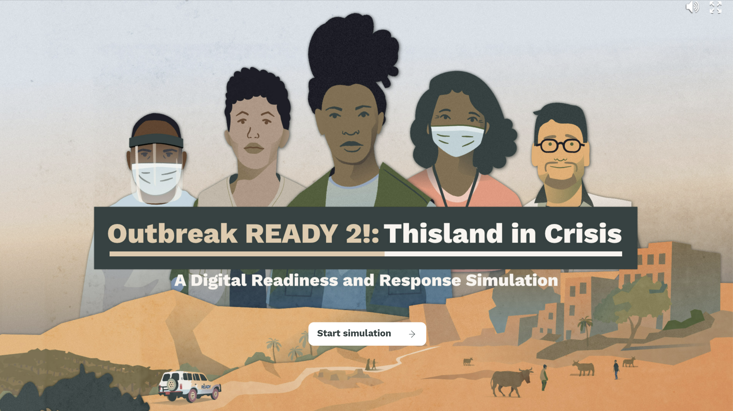



Slide 2
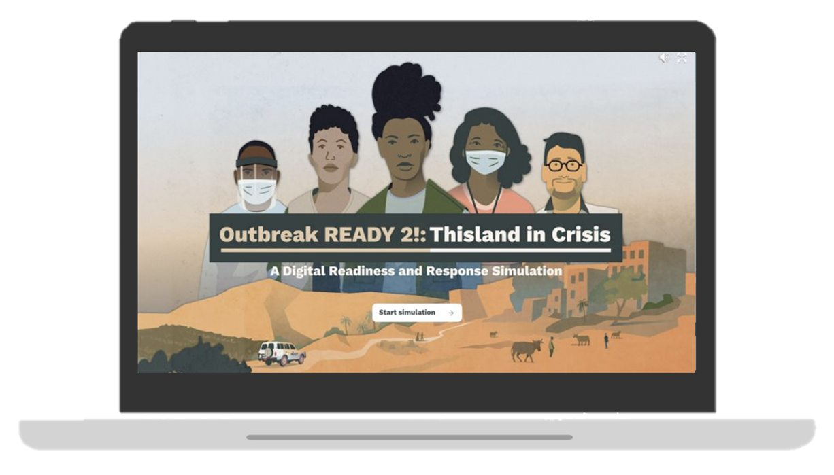

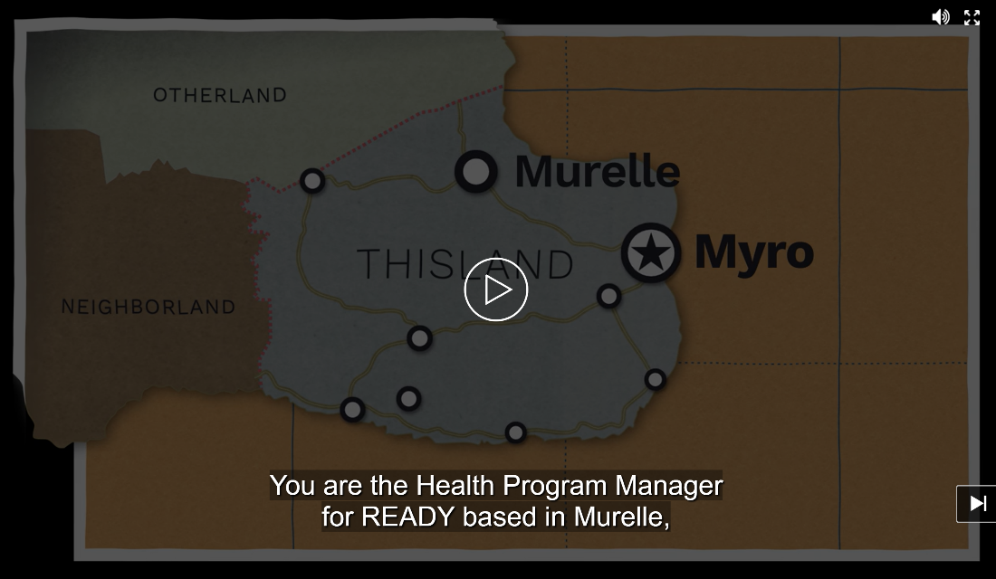
WELCOME!
Please open the link on your computer:
https://www.outbreakready-thislandincrisis.com/
YOU WILL SEE THE LOADING SCREEN ON THE RIGHT.
CLICK "START SIMULATION."
WHEN THE VIDEO STARTS PLAYING, PAUSE THE VIDEO BY CLICKING IN THE CENTER OF THE SCREEN.
WAIT FOR FURTHER INSTRUCTION.

Slide 3


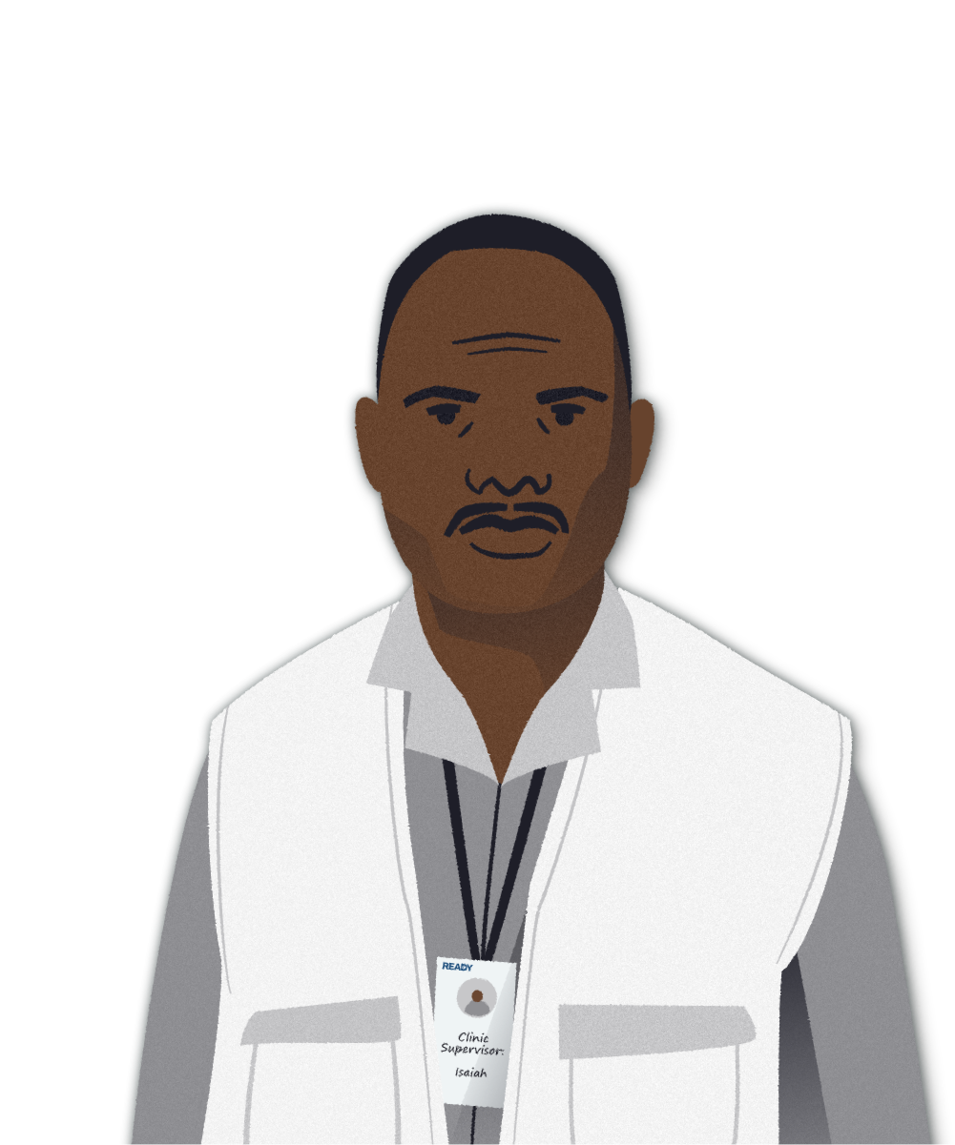
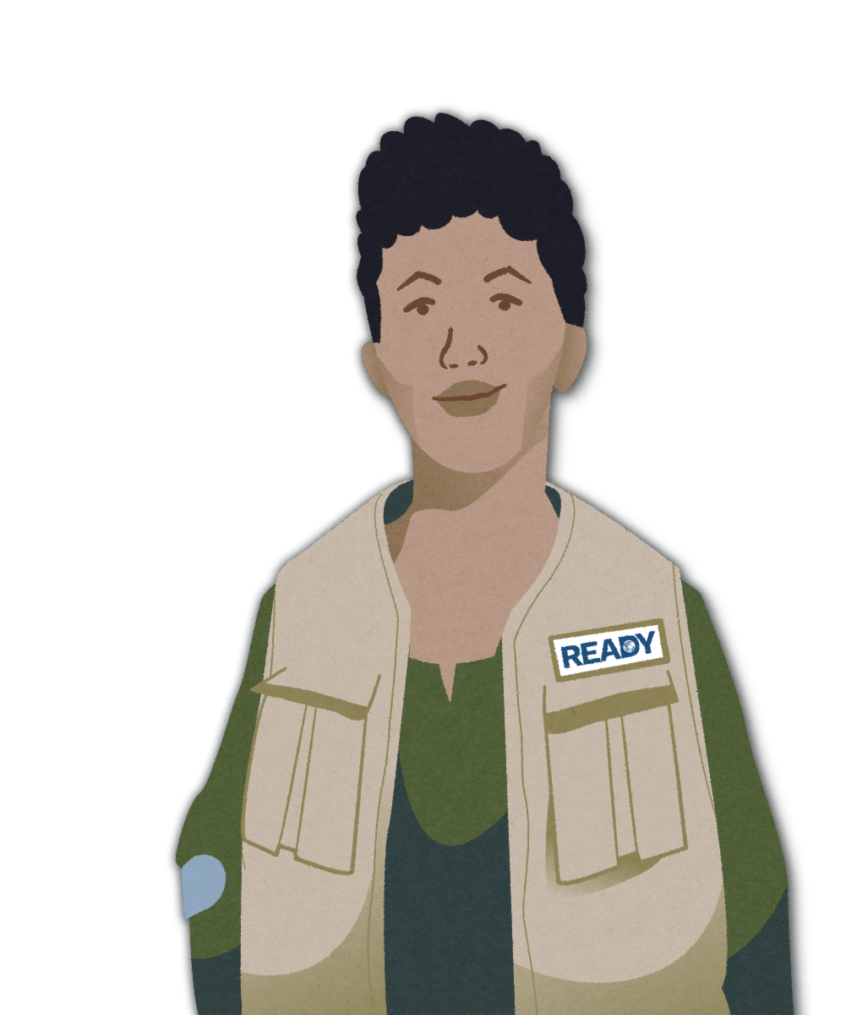


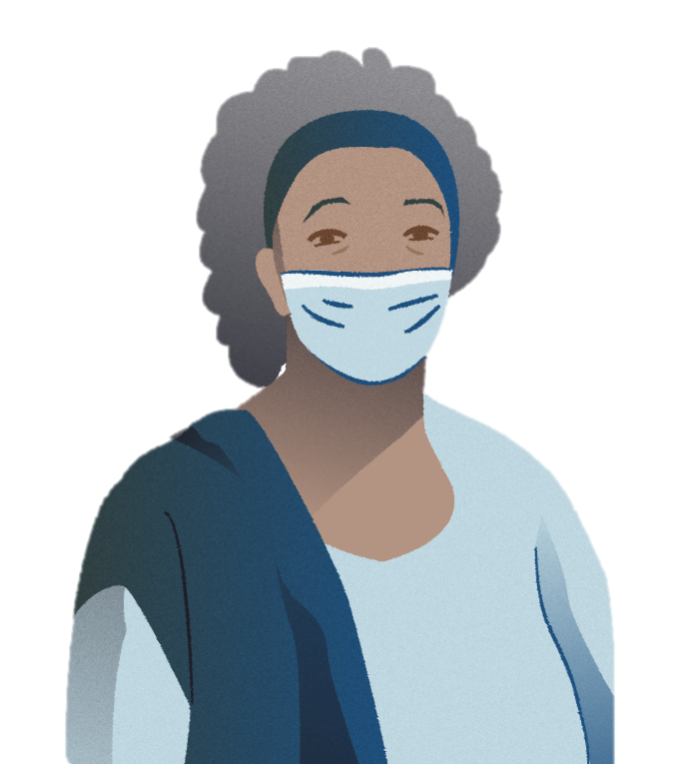
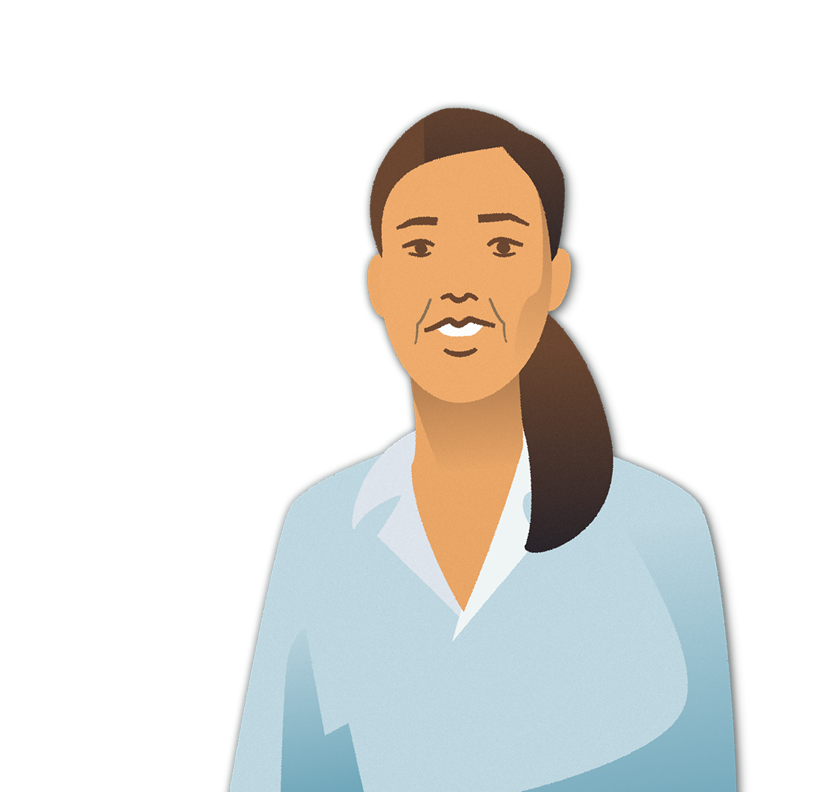








SIMULATION AGENDA
1
INTRODUCTION
5
PLAY EPILOGUE
BREAK (10 MIN)
2
PLAY CHAPTER 1
6
FACILITATED DISCUSSION
BREAK (5 MIN)
3
PLAY CHAPTER 2
8
CLOSING
BREAK (10 MIN)
6
4
PLAY CHAPTER 3
7

Slide 4
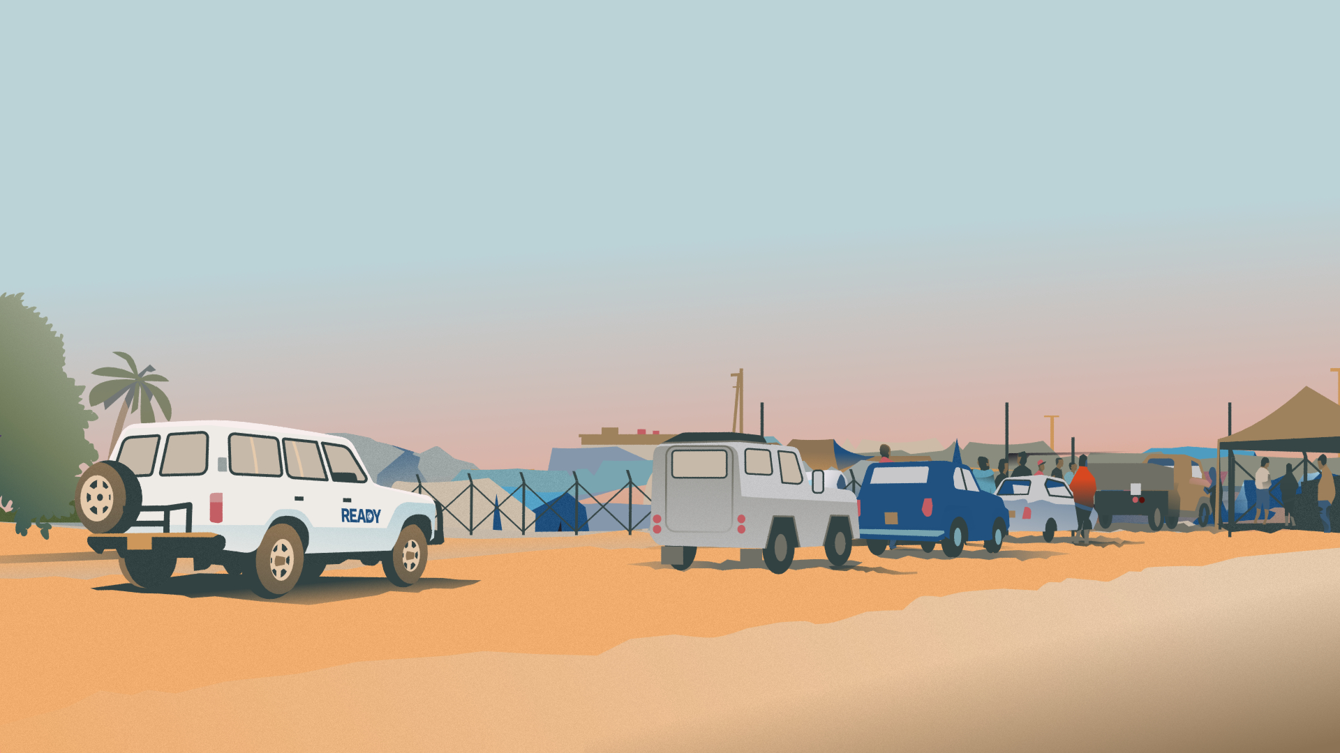
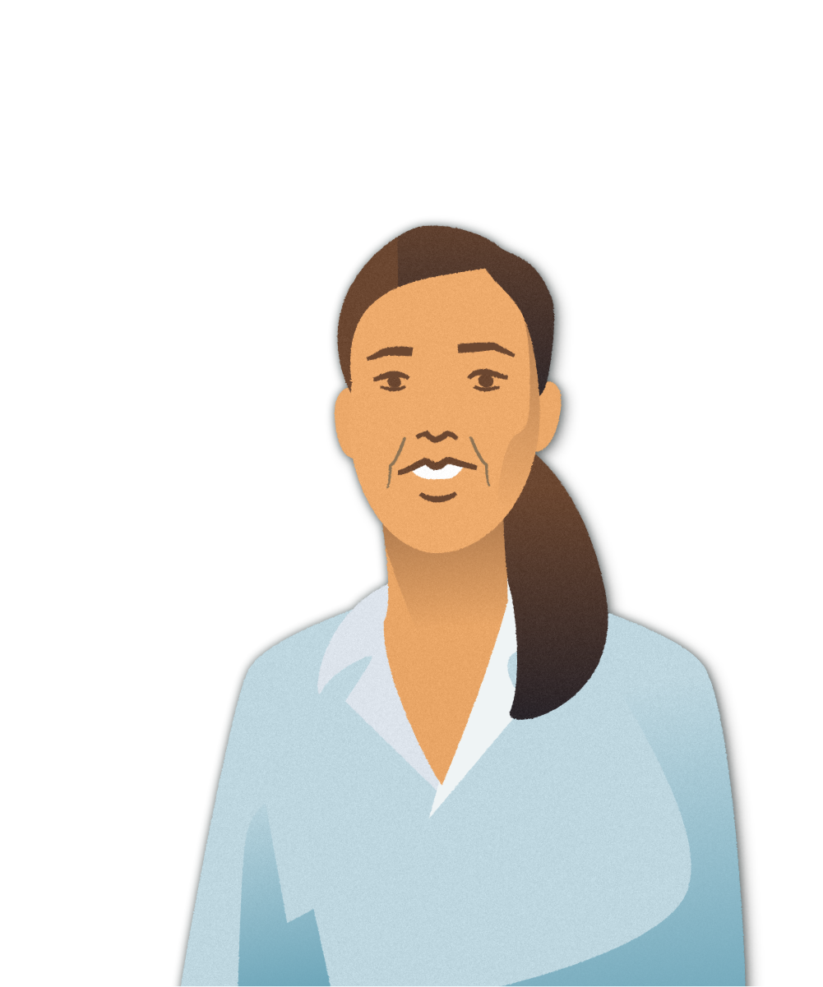

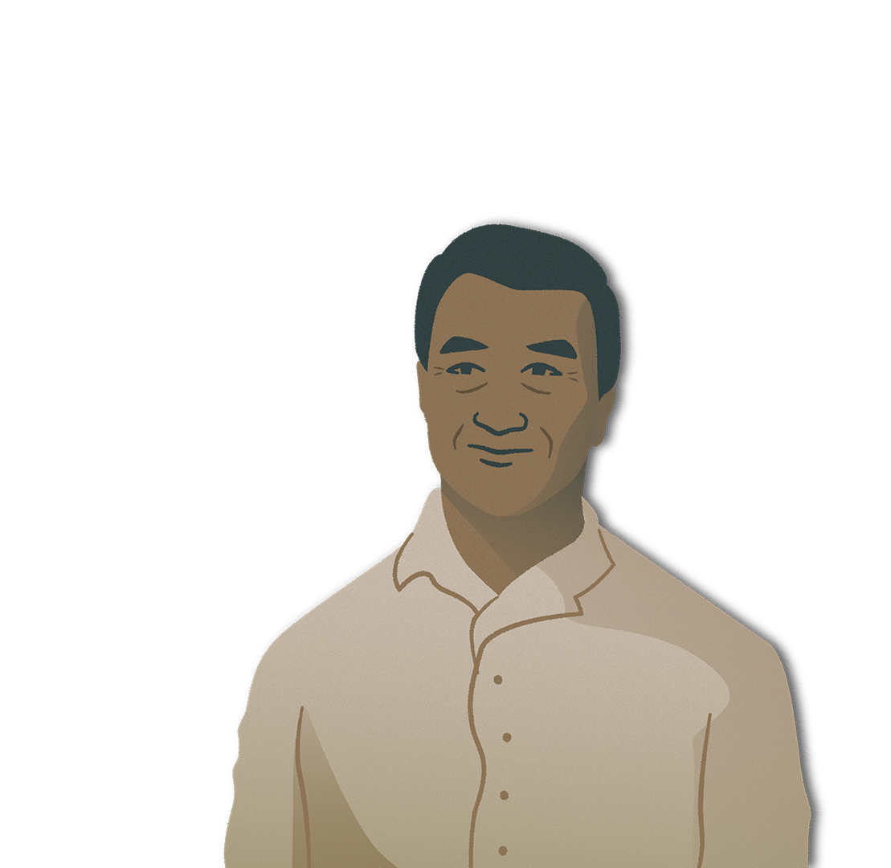
TROUBLESHOOTING GUIDANCE
Ensure you have the right URL: www.outbreakready-thislandincrisis.com.
If you see a white screen that says “Can’t load this page” or “Can’t reach this page”,
please refresh the page.
Ensure you are opening the URL on a supported browser: the sim is supported on
Google Chrome, Microsoft Edge, and Firefox.
Ensure most updated version of browser is being used: the sim is supported on the
latest and one-before the latest versions of Google Chrome, Firefox, and Microsoft Edge.
Try opening the simulation in an ‘incognito’ window.
The initial title screen may take time to fully load, depending on internet speed.
If participants are able to see the title screen, then they have access and must
wait for the progress bar to load before clicking "Start Simulation".
Try opening the simulation in an ‘incognito’ window.
READY: Global Readiness for Major Disease Outbreak Response

Slide 5

QUIZ TIME!
Q1: Where is Murelle located?
Along the eastern coast.
In the northeast of the country.
In the Western Province.

Slide 6
QUIZ TIME!
Q2: How would you describe the current political and economic climate of Thisland?
Stable. All conflict has ceased in recent years and the economy is getting stronger.
Unstable. Sporadic violence has increased in the Western Province, leading to new waves of displacement and making it difficult for IDPs to return home. Unemployment is high across the country.
Active conflict. There is no recognized government and fighting has escalated to the point of civil war. Inflation has made basic needs too expensive and the majority of Thislanders live in severe poverty.

Slide 7
QUIZ TIME!
Q3: What is the relationship between IDPs and Easterners?
They come from the same ethnic group, and there are no major tensions between the groups.
They come from the same ethnic group, but prolonged displacement is creating new tensions that have led to mistrust and discrimination.
They come from different ethnic groups, and prolonged displacement is creating worsening tensions that have led to mistrust and discrimination.

Slide 8
QUIZ TIME!
Q4: What was HxNy?
A READY acronym standing for Health & Nutrition.
The region's seasonal influenza that causes morbidity and mortality each year.
An influenza epidemic that occurred three years ago and killed thousands of people in Thisland and across the region.

Slide 9
QUIZ TIME!
Q5: What is the state of the health care system after HxNy?
Budget cutbacks have caused many rural clinics to close. A few district hospitals gained PCR machines during HxNy but many are in need of repair.
The HxNy epidemic led to a significant increase in public health funding that has sustained three years later. Clinics and laboratories are well-staffed and –resourced.
While funding has declined, it has not largely affected communities' access to health care or the capacity of laboratories to test for infectious diseases.

Slide 10
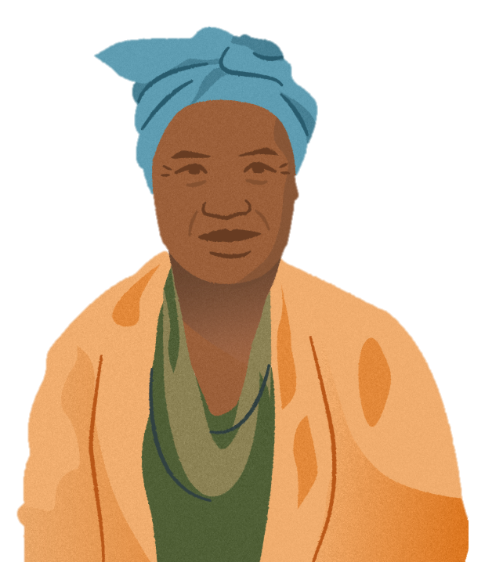
KEY INFORMATION
Structured in three chapters, which are further broken down into weeks
Making Key Decisions based on the information you collected moves you forward
Player-led – YOU decide what you do, when
Purpose to reflect on what is the most appropriate choice given the context
Fast paced, unable to read all the information provided
Timing prompts given throughout the simulation
Feedback is provided at the end of each chapter and during the Epilogue after Chapter 3.
Do not exit the webpage or press the browser back button

Slide 11
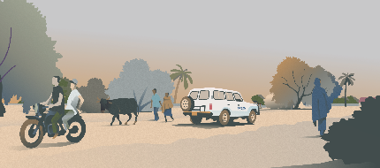
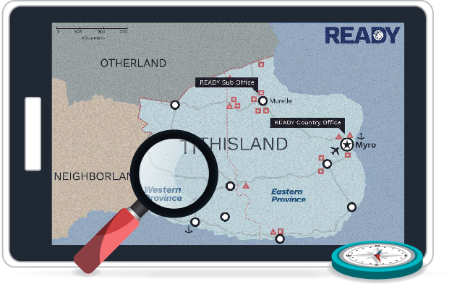

WELCOME TO THISLAND

Slide 12



Slide 13
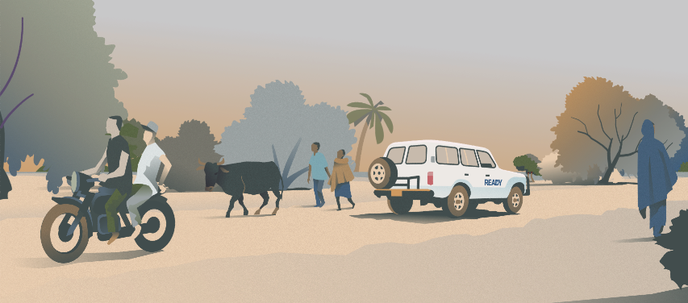
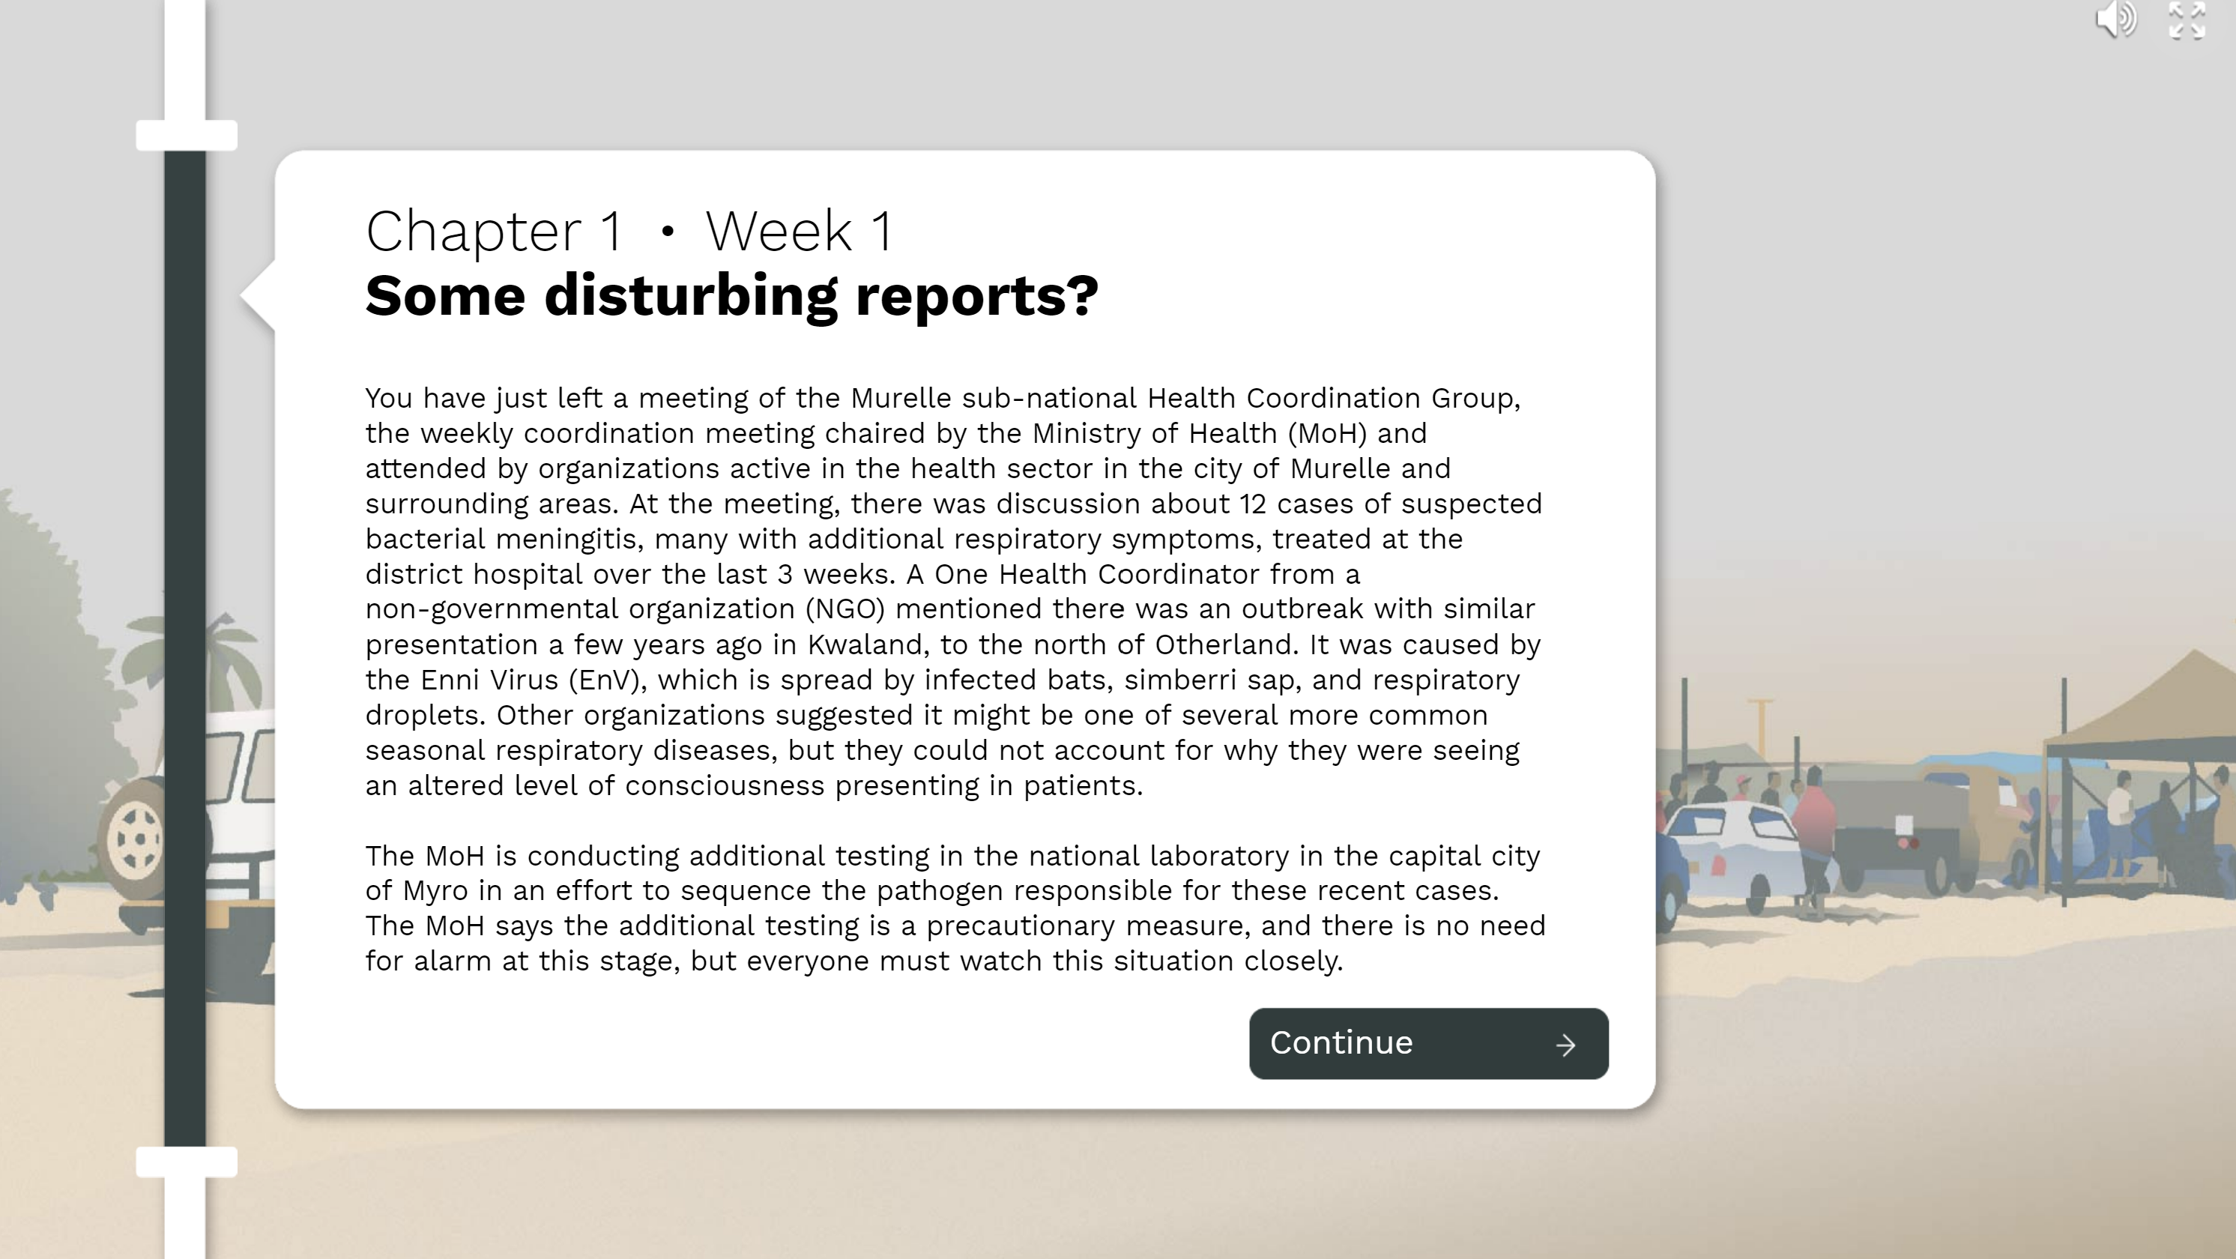
BEGIN PLAYING

Slide 14
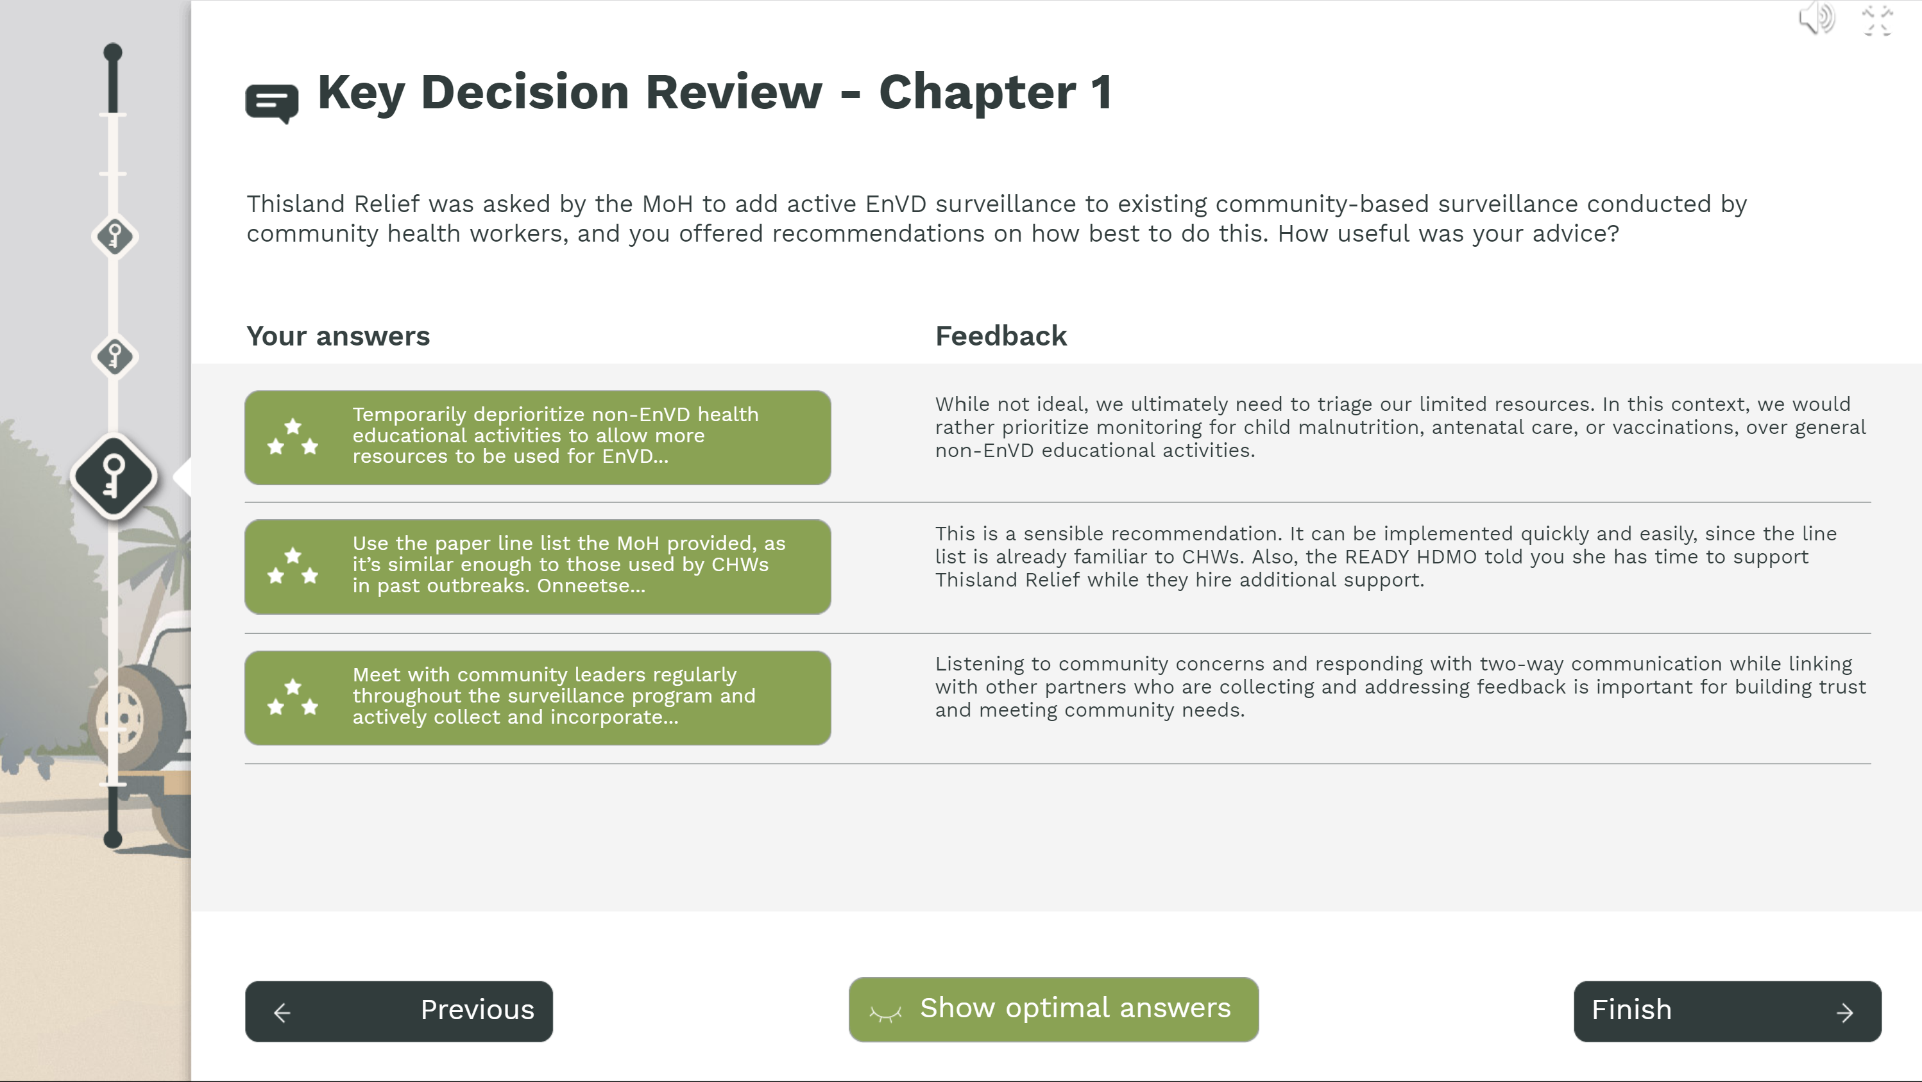
PAUSE PLAY
AT THE FINAL FEEDBACK SCREEN
Do NOT click "Finish"

Slide 15
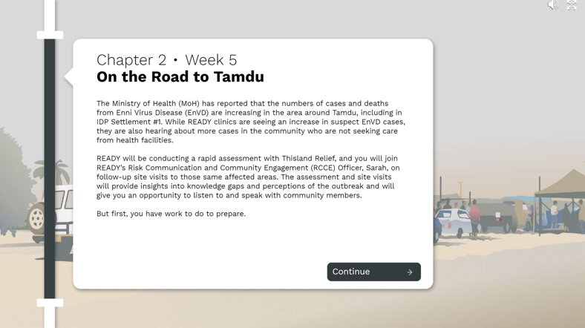
BEGIN PLAYING CHAPTER 2

Slide 16
PAUSE PLAY
AT THE FINAL FEEDBACK SCREEN
2
Do NOT click "Finish"

Slide 17
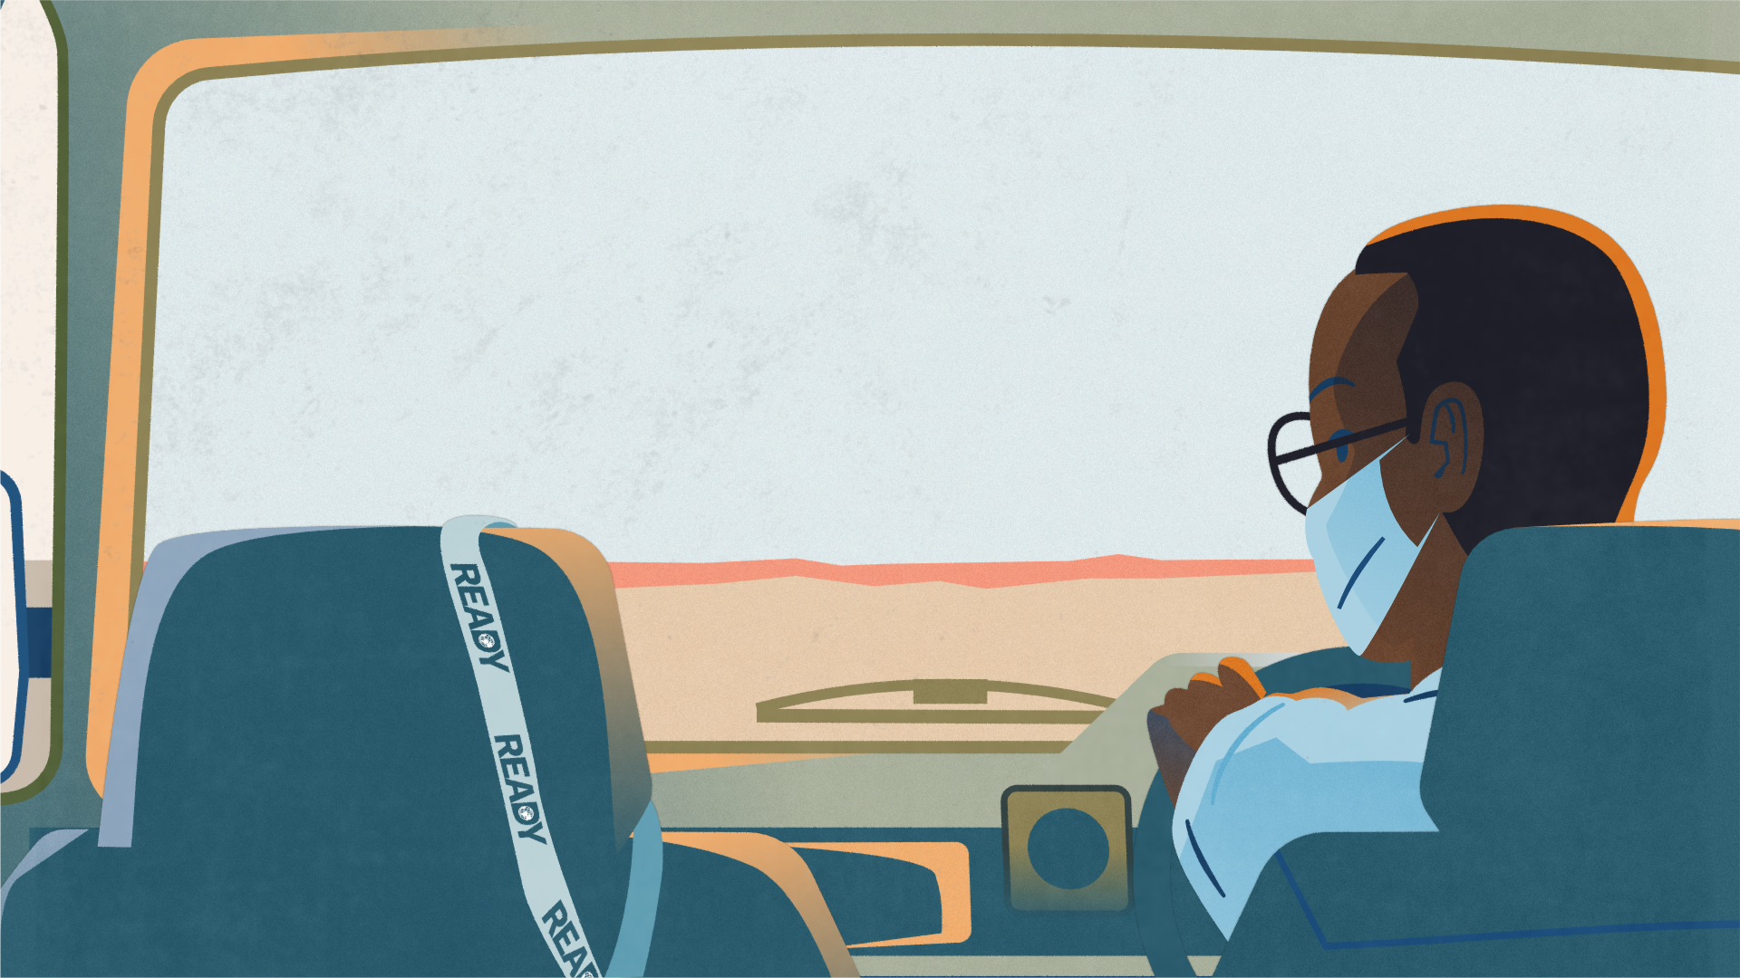
Time for a break! We’ll restart in
5 minutes.
SLIDE TWELVE

Slide 18
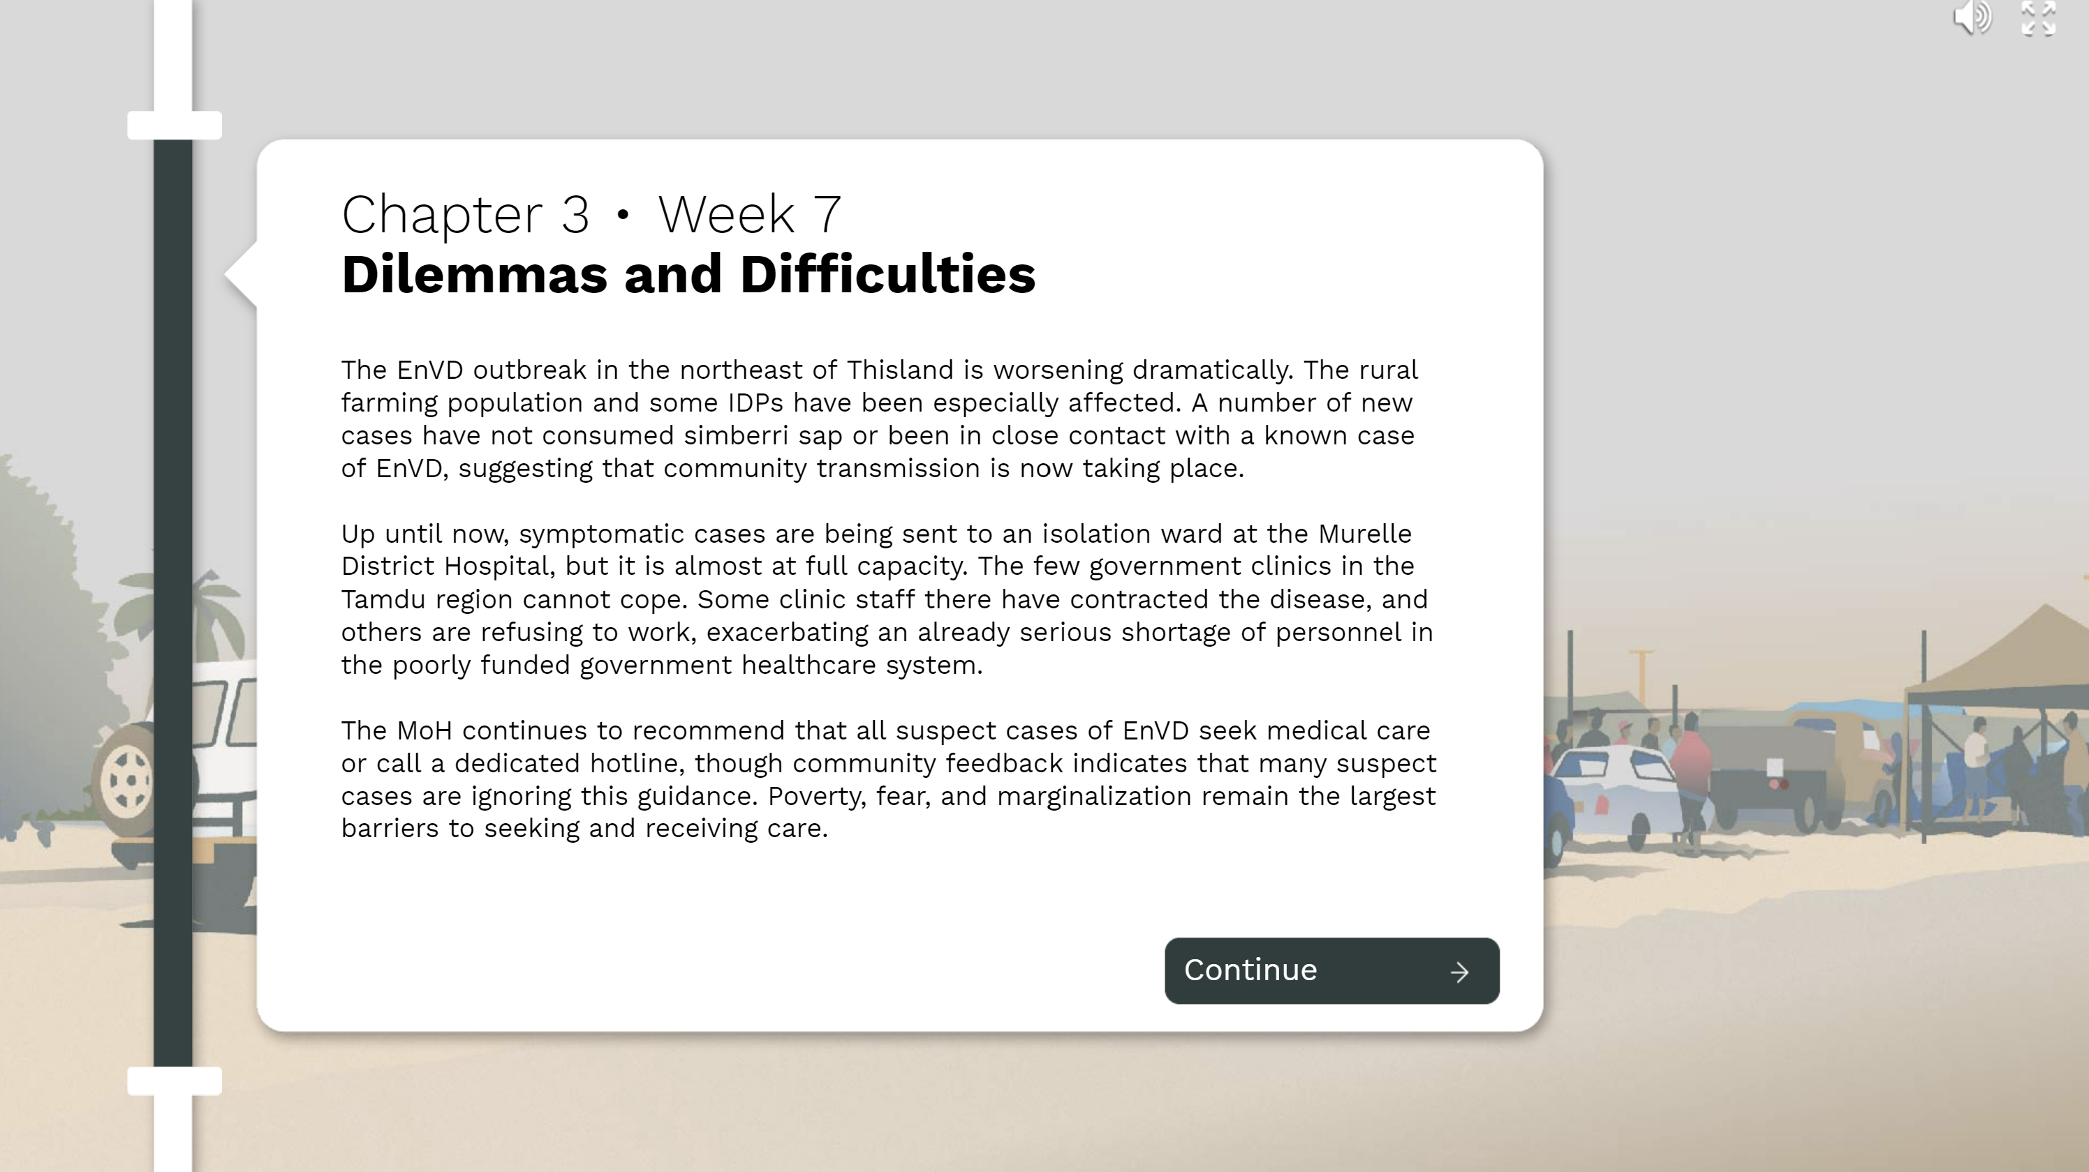
BEGIN PLAYING CHAPTER 3

Slide 19
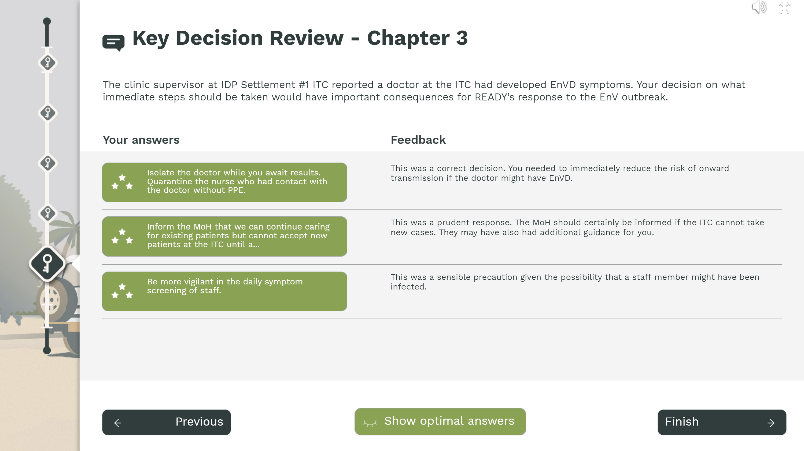
PAUSE PLAY
AT THE FINAL FEEDBACK SCREEN
3
Do NOT click "Finish"

Slide 20
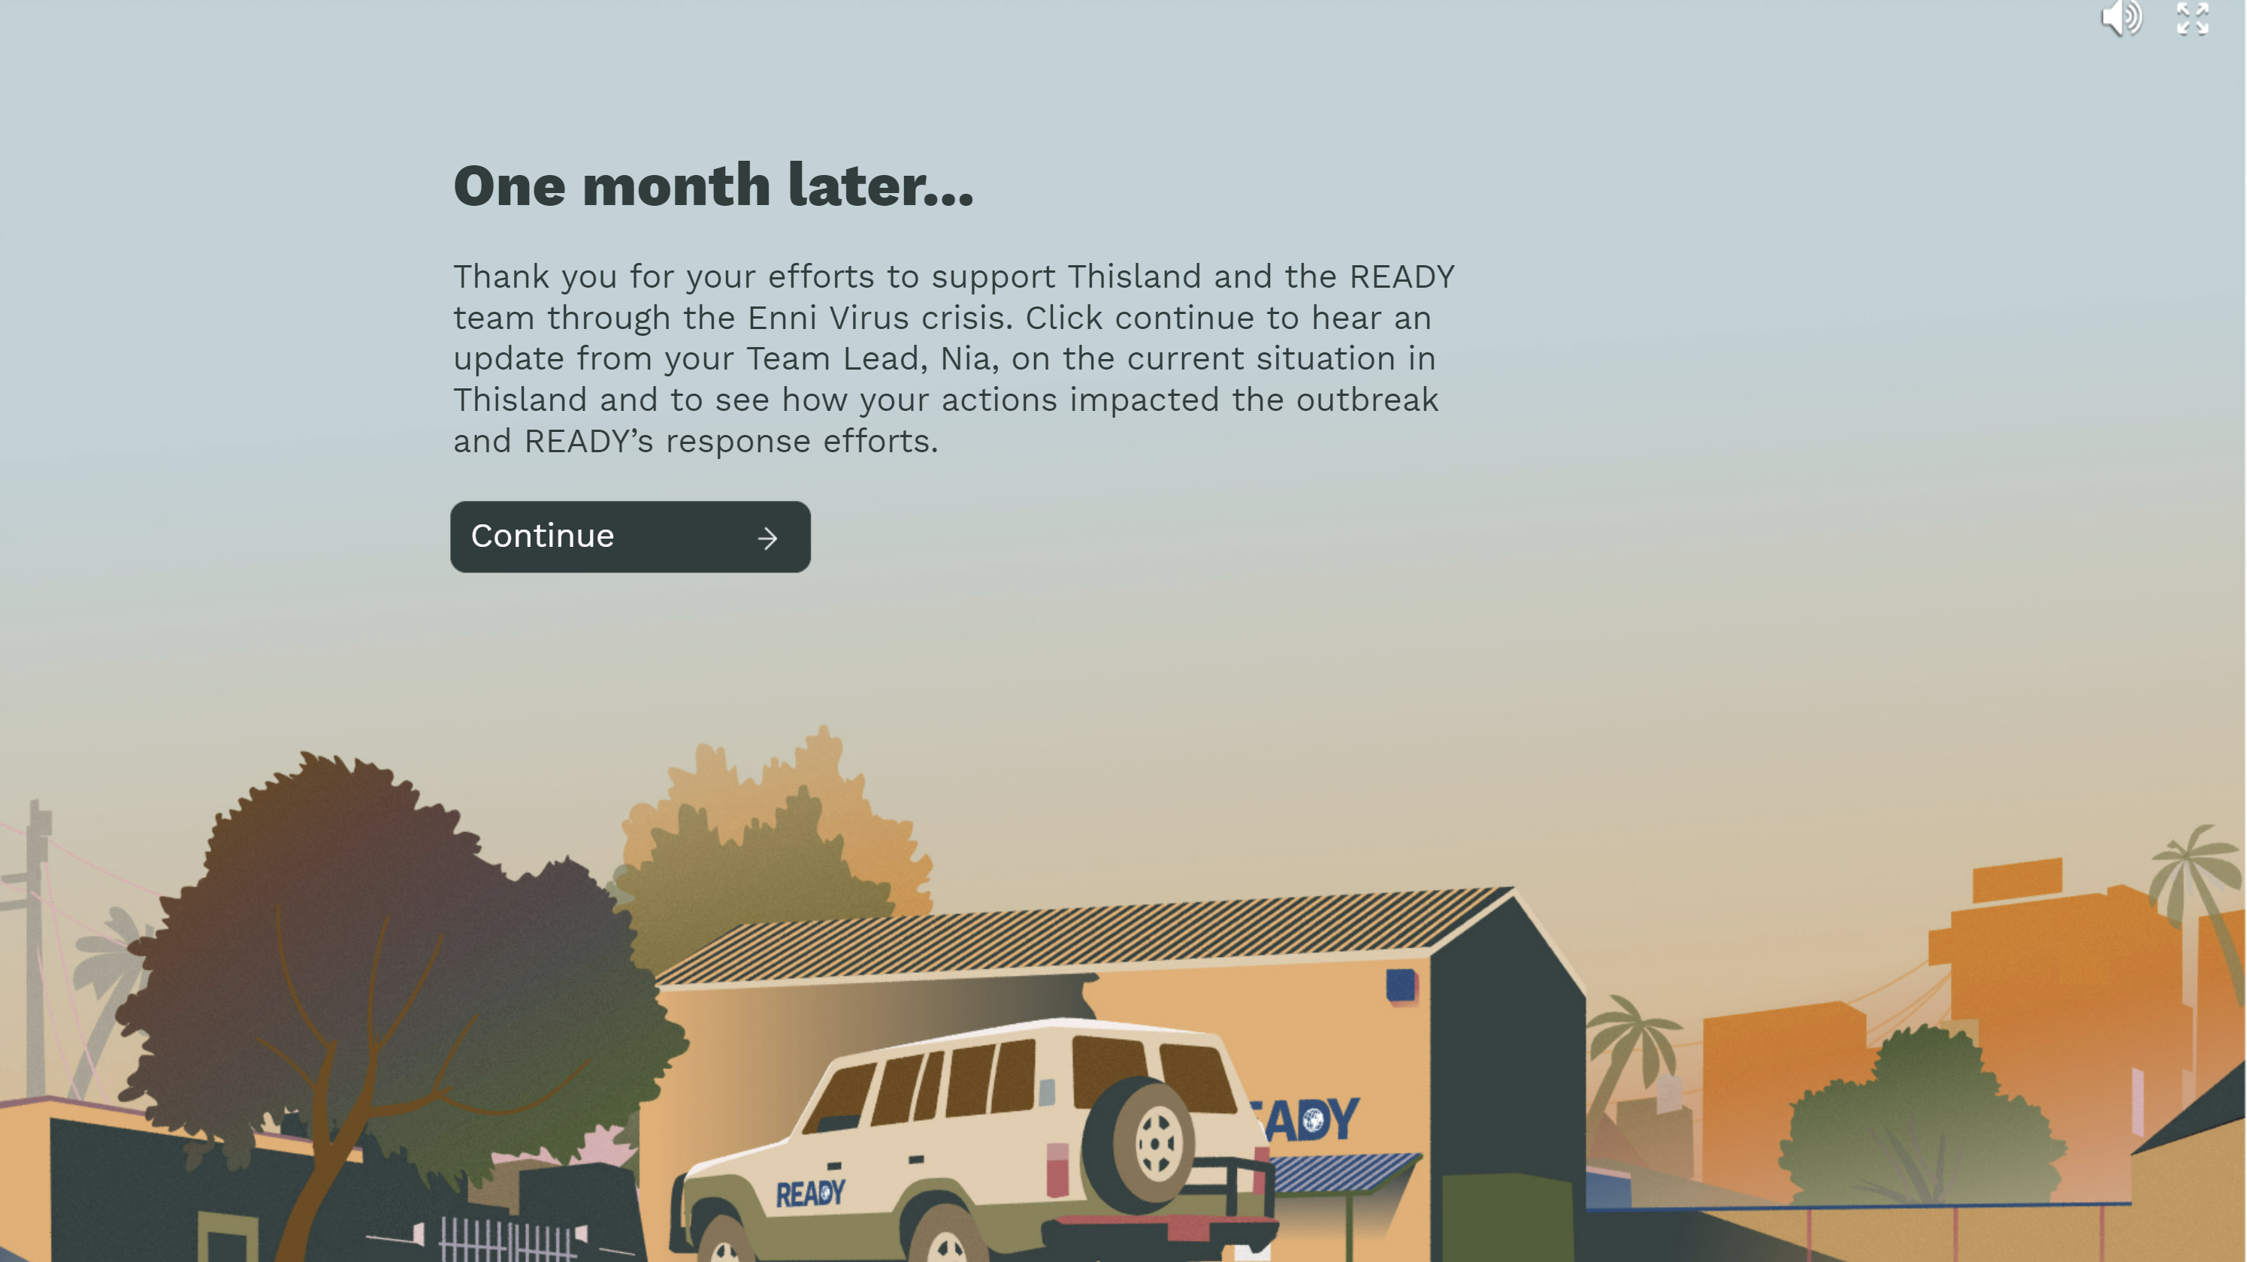
BEGIN EPILOGUE

Slide 21
Time for a break! We’ll restart in
10 minutes.
SLIDE TWELVE

Slide 22

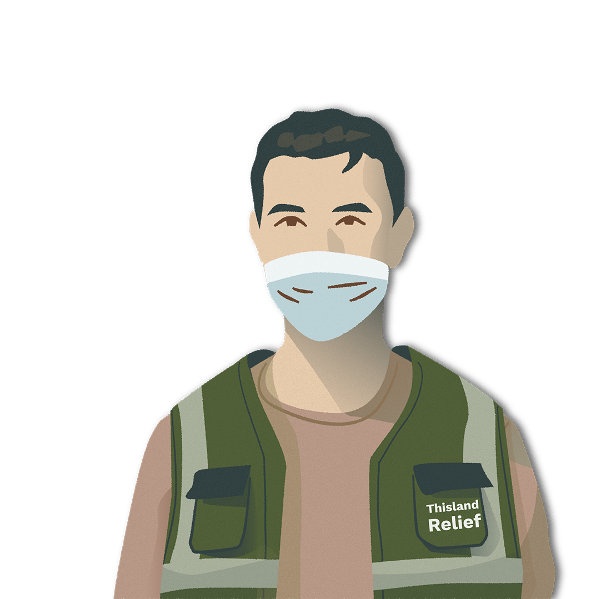
GROUP DISCUSSION

Slide 23
TOPIC ONE
[INSERT TOPIC HERE]
[INSERT SELECTED QUESTION HERE]
SLIDE TWELVE

Slide 24
TOPIC TWO
[INSERT TOPIC HERE]
[INSERT SELECTED QUESTION HERE]
SLIDE TWELVE

Slide 25
TOPIC THREE
[INSERT TOPIC HERE]
[INSERT SELECTED QUESTION HERE]
SLIDE TWELVE

Slide 26
TOPIC FOUR
[INSERT TOPIC HERE]
[INSERT SELECTED QUESTION HERE]
SLIDE TWELVE

Slide 27
ACTION STEPS
Q1: What action steps will you take to enhance you or your organization's readiness for an infectious disease outbreak?
Q2: Who will you share this simulation with?

Slide 28

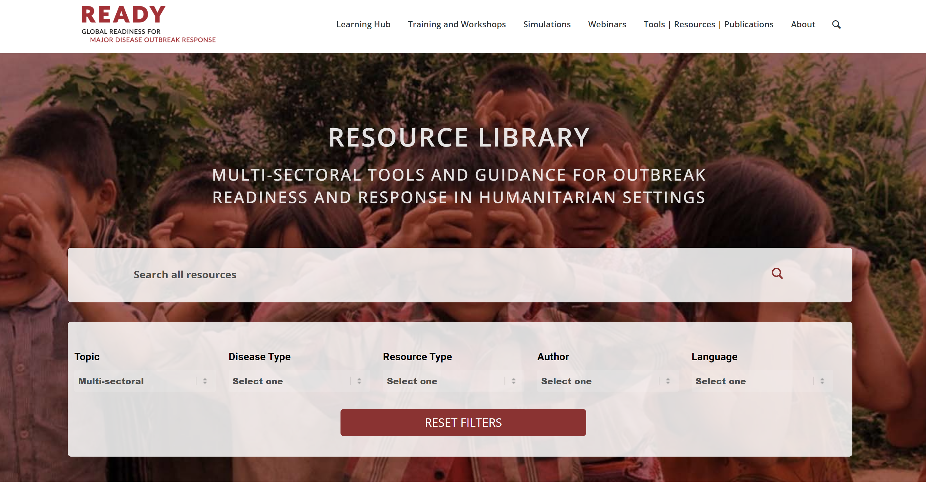
OTHER RESOURCES
You can access Outbreak READY 2!, Outbreak READY!, and other training tools via the READY website here: www.ready-initiative.org.

Slide 29
THANK YOU FOR PLAYING!

